Slide 1
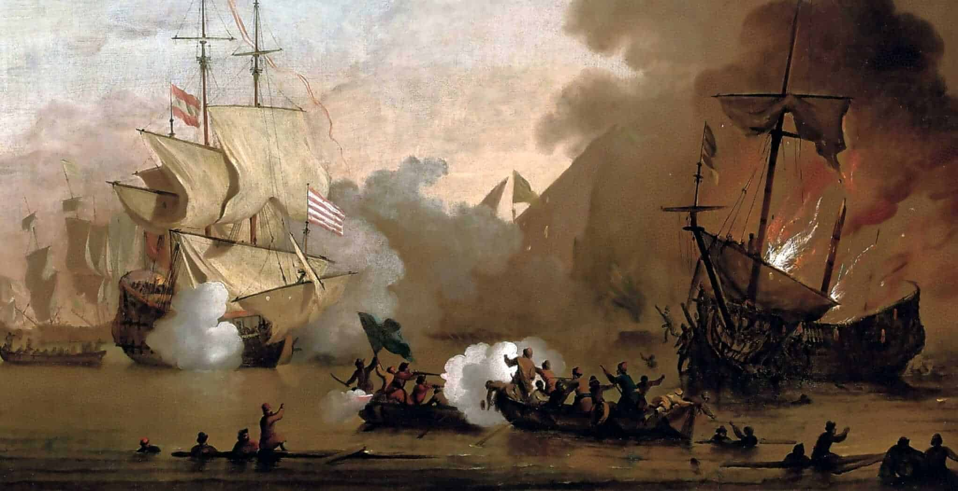
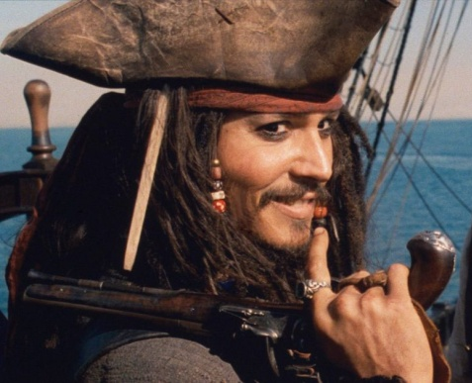
Short Writing Task: Creating a new Original Pirate Character
Short Creative Writing Task:
This work is to help build your skills and confidence using research to create and then writing an outline for a new pirate character.
Watch and talk about a favourite pirate film, book or programme you have at home.
Planning: Make brief notes of key background information you are going to include in your writing.
Ready to write: Write an outline of your new pirate character to explain your idea to others.
Extension task : Create a flag for your new character’s pirate ship
Key Words:
fiction = made up/story
non-fiction = real facts and
information
original = beginning or first, a new
idea [not a copy]
outline = includes the important
information [brief]
brief notes = ideas recorded in
single words or short phrases
paragraph = a section of writing

Slide 2




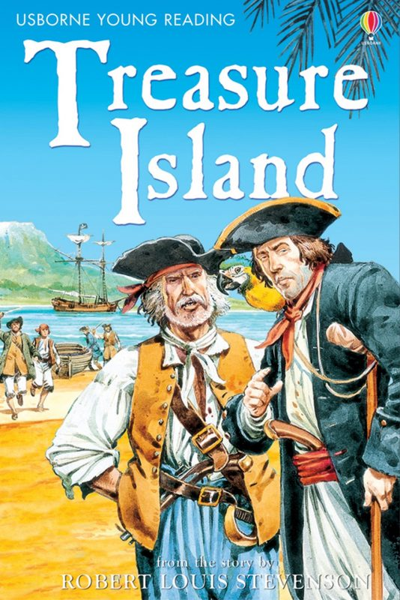



Research Fictional Pirate Characters: Tell your folks this is for your English work this week ... pull up a pirate pillow, grab a snack from the galley – if you go for the hard tack don’t forget to tap out the weevils!

Slide 3
New Character Planning Sheet: [You can also use your yellow workbook.]
Talk your ideas through then complete your plan
Focus: Building planning skills. [Just brief notes – not sentences]
Main events in their life:
What do they look like:
Where were they born:
Character Name
Stories told about them :
Personality:

Slide 4
New Character Outline Sheet: [You can also use your yellow workbook.]
______________________________________________________________________________________________________________________________________________________________________________________________________________________________________________________________________________________________________________________________________________________________________________________________________________________________________________________________________________________________________________________________________________________________________________________________________________________________________________________________________________________________________________________________________________________________________________________________________________________________________________________________________________________________________________________________________________________________________________________________________________________________________________________________________________________________________________________
Write an outline for your new pirate character
Top Tip: Use the examples in the research powerpoint to help with how to do this.

Slide 5
Extension Task: Design a pirate flag for your new pirate

