Slide 1
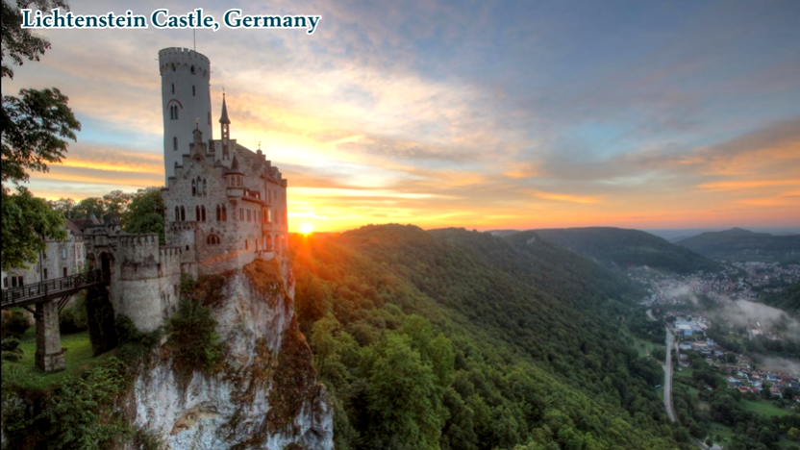
Research: Castles of the World – Setting for a Story
https://www.youtube.com/watch?v=bgRE3dhmWMA
Research Task:
This work is to help build your speaking and listening and reading and understanding skills. All writer’s research before they write to make sure their story feels true even when it is completely made up!
Watch and talk about the castles in
the youtube clip.
Read and talk about the castles in this powerpoint.
Practise your writing skills: write down as many adjectives as you can to describe the castles.
[Getting a bit stuck? Try looking up words
that mean the same, ‘synomyns’, you could
learn some cool new words to use.]
Key Words:
research = to find out information about something.
castle = a strong building which can withstand an attack usually with thick walls and battlements.
setting = a place where a story happens
adjective = a word that describes an animal, person, place, thing.

Slide 2
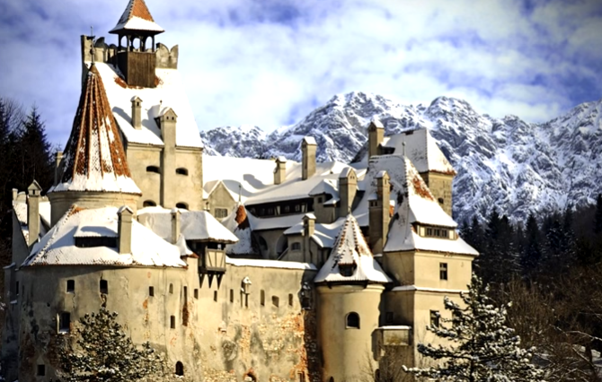
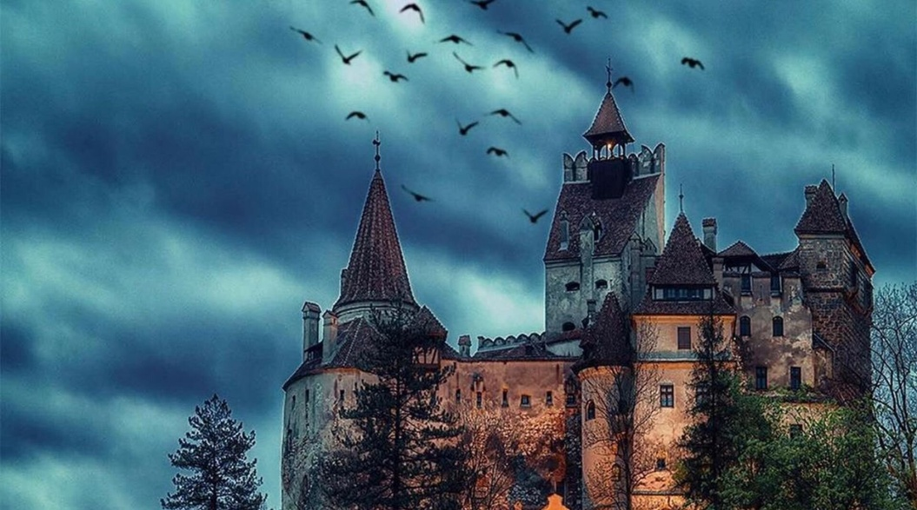
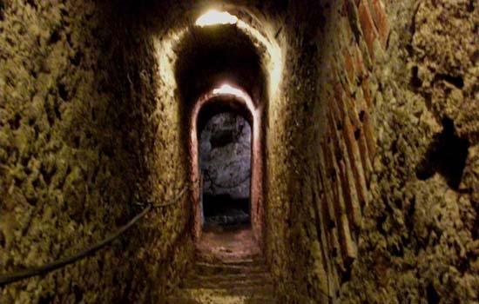
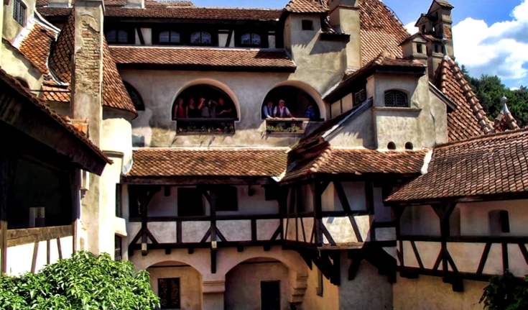
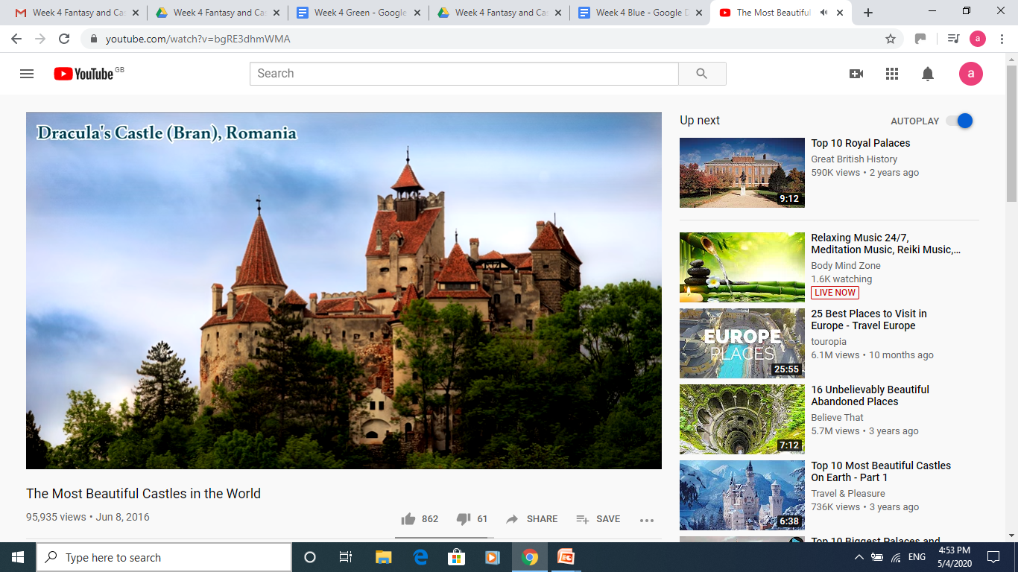
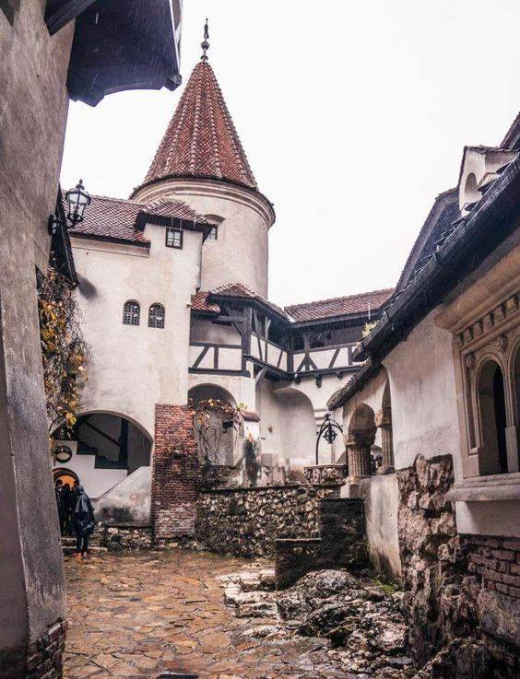
Bran Castle, Transylvania, Romania
A wooden castle was first built on this site in 1212 but was destroyed an invading army. The castle was rebuilt in stronger stone in 1377 by the Saxons. Unlike most castles, this castle was not build for royalty to live in, it was built to protect the country against raids from its enemies and for border control. The cruel person in history Count Dracula is based on did not actually ever live here but stayed many times. The castle is now a museum.

Slide 3
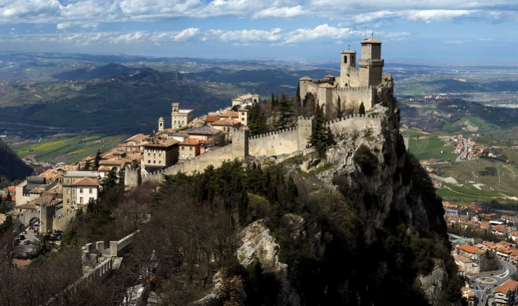
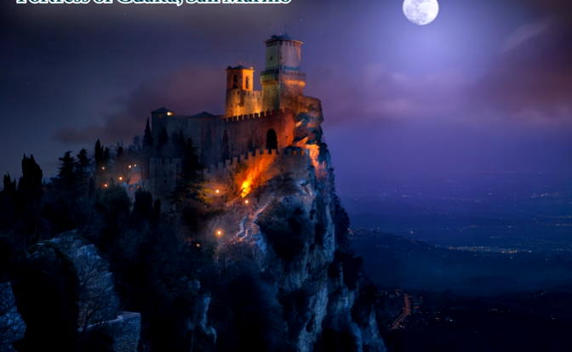
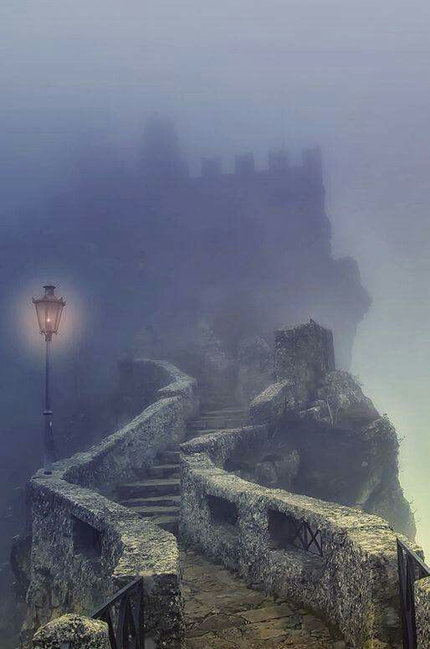
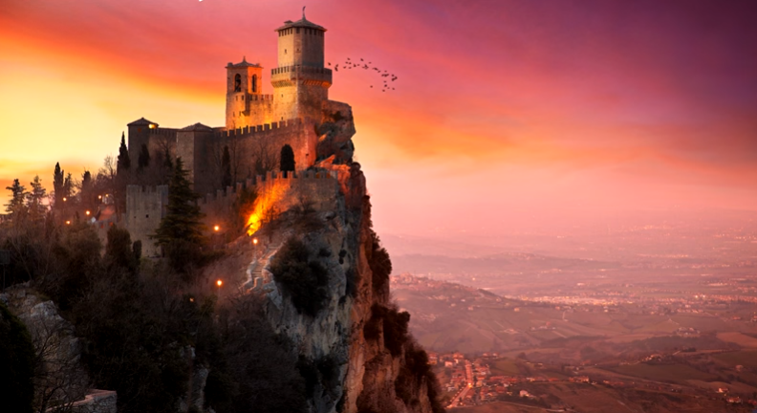
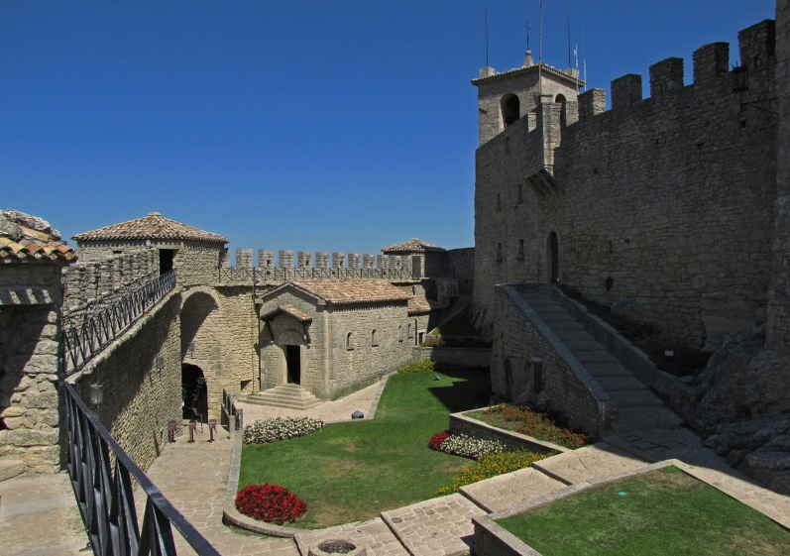
Fortress of Guaita, San Marino, Italy
This is one of three towers built in the 11th century on Mount Titano. It has a double wall surrounding it which meant it could protect the townspeople well during a siege but also made it so secure that it could be a prison too. Did you know, some rooms were used as a prison up until the 1970s! The castle still has two big artillery guns from World War II on it’s battlements. It is so famous that it even appears on the national flag! This fortress is now on the world’s heritage list which means it is important and must be protected.

Slide 4
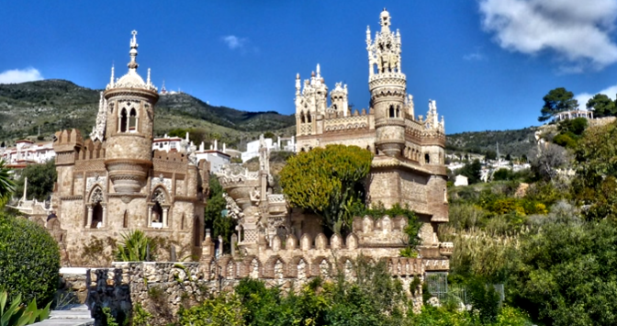
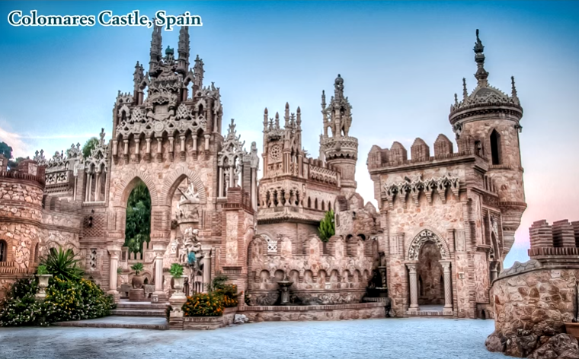
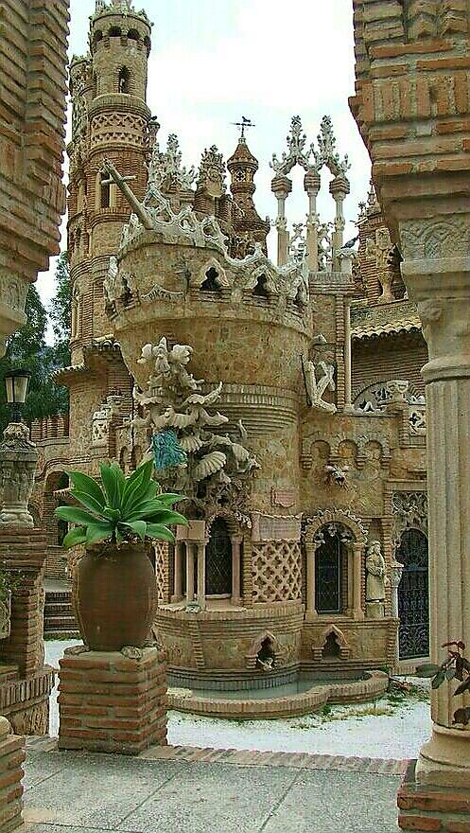
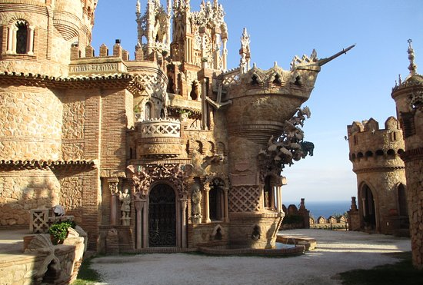
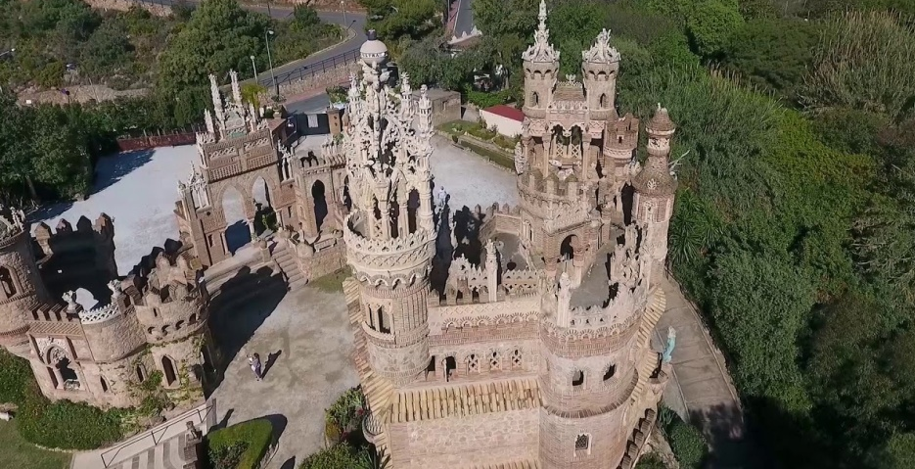
Colomares Castle, Spain
This castle (or castillo in Spanish!) is not really a castle, it is a monument and was actually built quite recently, between 1987 - 1994. It is the biggest monument in the world covering an area of 1,500 metres but it also has the world’s smallest church. If you look carefully you can see that some parts of the castle look like the front of a ship. This is because this huge building is an monument to Christopher Columbus, the explorer who was famous for having discovered America. We now know that people were already living there!
[monument = statue or building built to remember an important person]

Slide 5
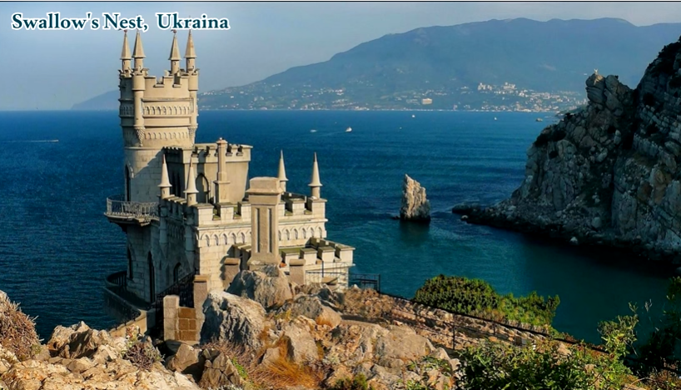
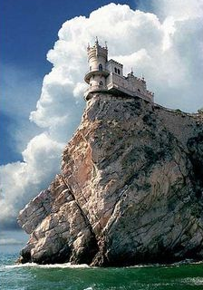
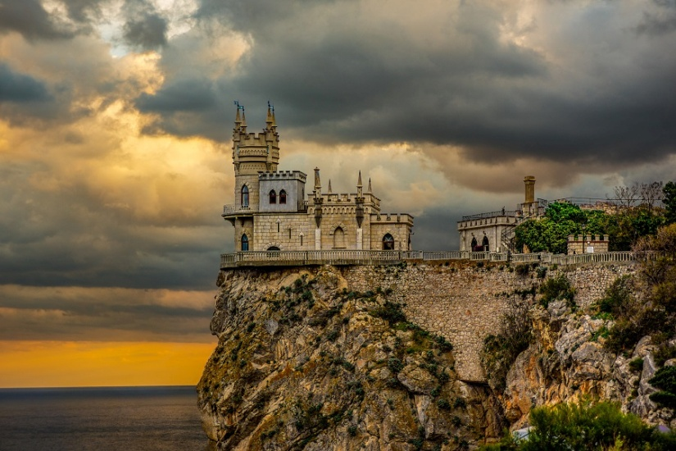
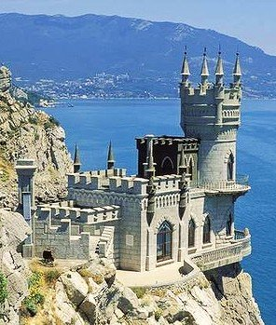
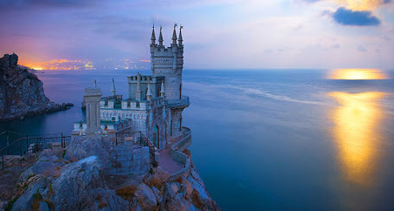
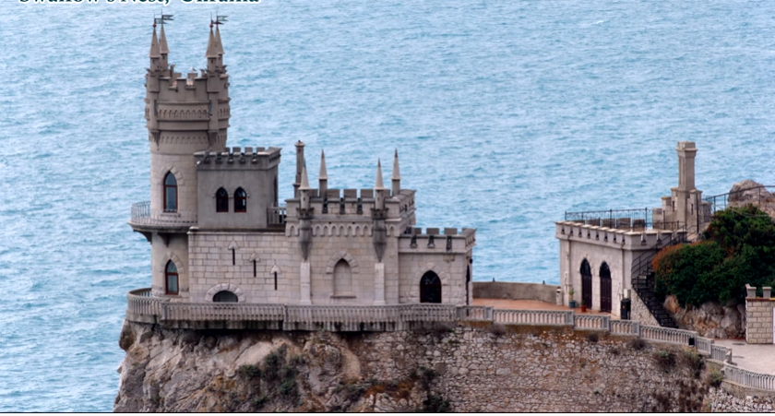
Swallow’s Nest, Ukraina
There used to be a wooden cottage on this site but when the land was bought by a very rich businessman. He wanted to build something a bit more grand that would stand up to the power of the Black Sea in winter He decided to build a strong, stone castle and work was finally completed in 1911. This castle is built on top of the 40 metre high Aurora Cliff and is not very big as castles go! It has an entrance hall, a guest room and a stairway to the tower which has two bedrooms on two different levels. There is an observation deck that runs the whole way around the building so that you can enjoy the beautiful view.

Slide 6
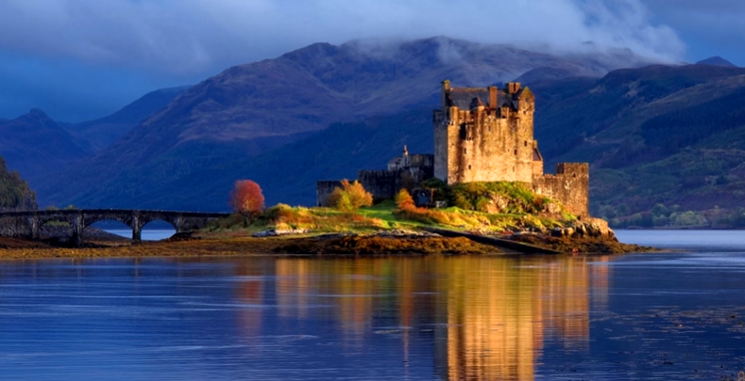
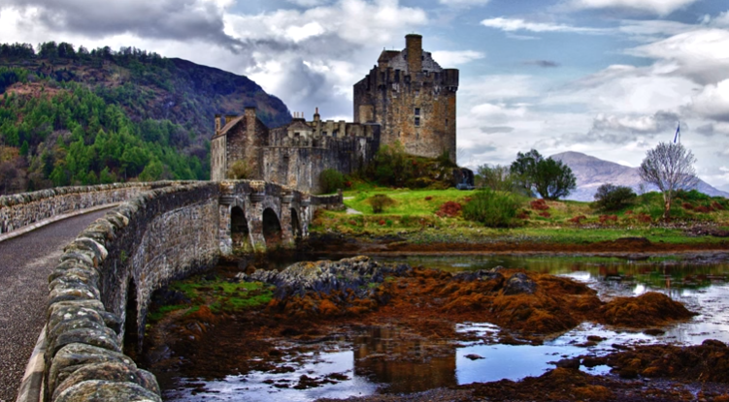
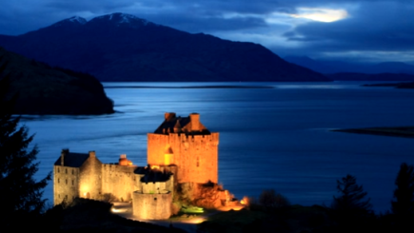
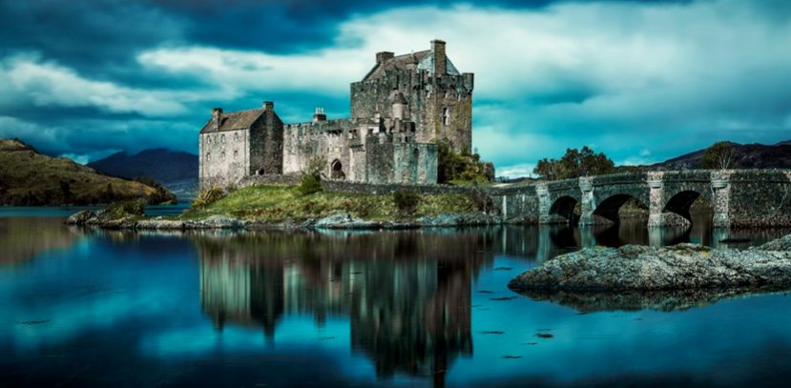
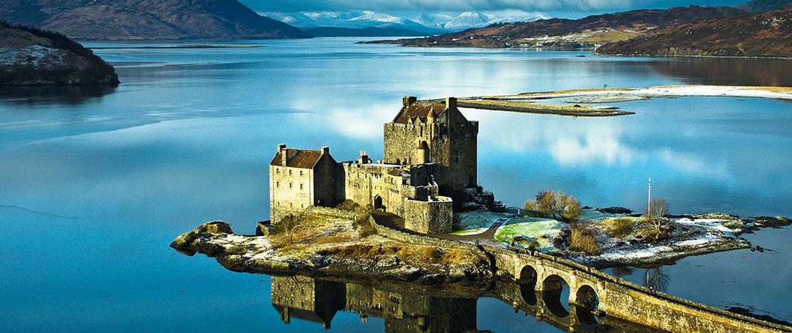
Eilean Donan Castle, Scotland
A castle was built on this island to protect the lands of Kintail against the Vikings who controlled most of the North of Scotland between 800 and 1266. This area was a separate Sea Kingdom of the Lord of the Isles. The sea was the main highway and so this castle was in the perfect defensive positive. The castle has got bigger and smaller over the centuries. The medieval castle was probably the largest, with towers and a strong wall that covered nearly the whole island. A firing platform for cannons was added by the 16th century.

Slide 7
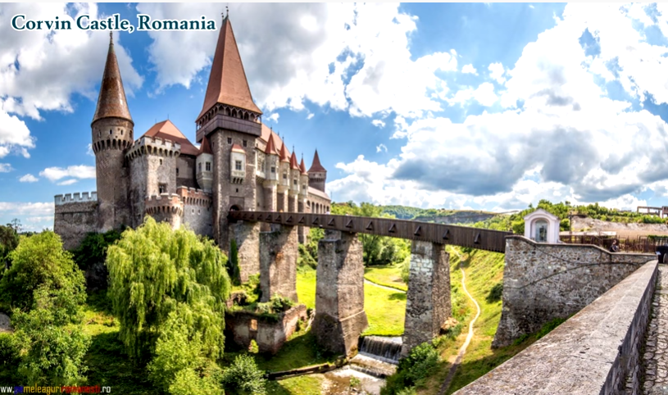
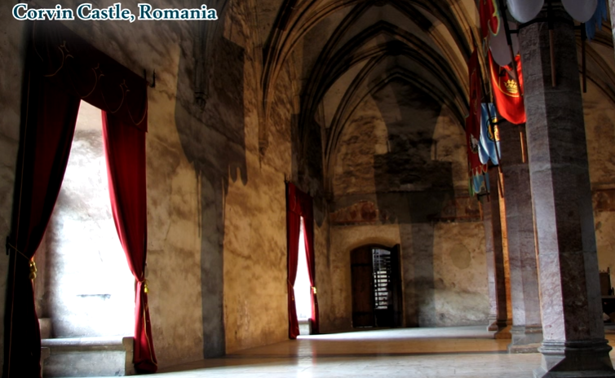
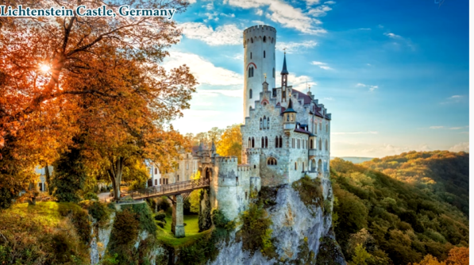
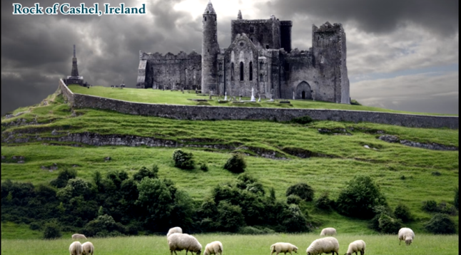
Look at these castles. When you write your story could one of these be the setting? Practise your writing skills, write as many adjectives as you can to describe them.

Slide 8
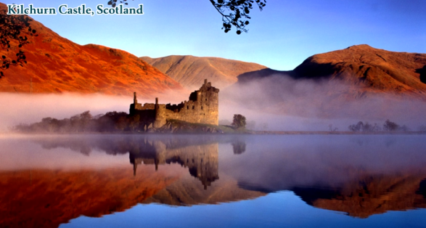
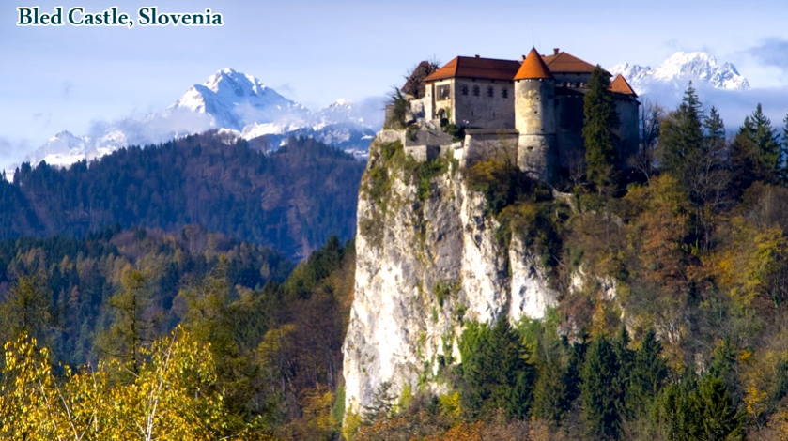
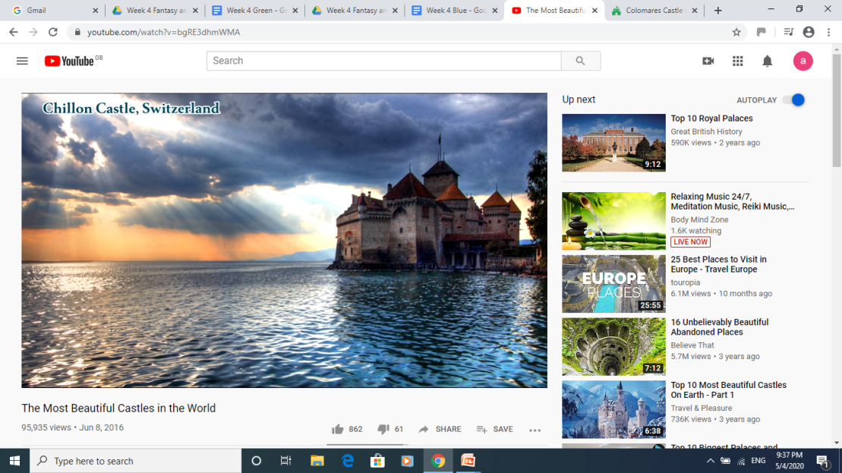
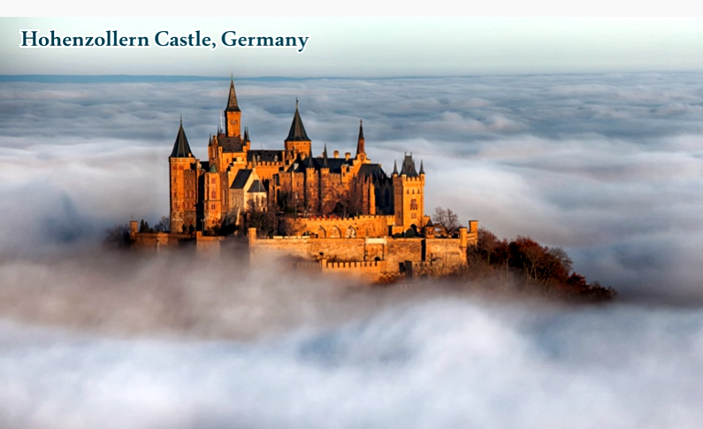
Look at these castles. When you write your story could one of these be the setting? Practise your writing skills, write as many adjectives as you can to describe them.

Slide 9
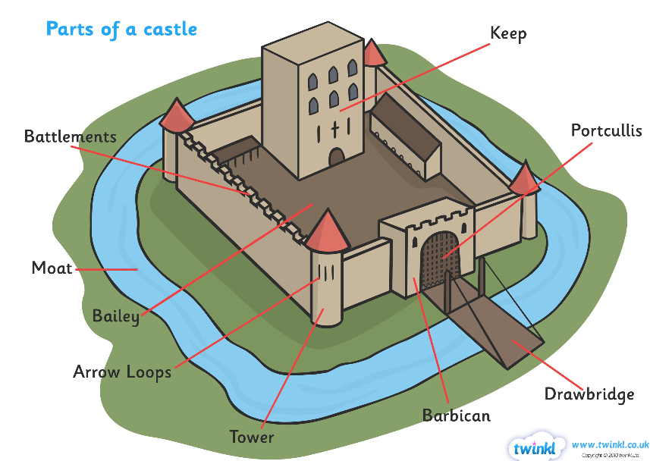

Slide 10


