Slide 1
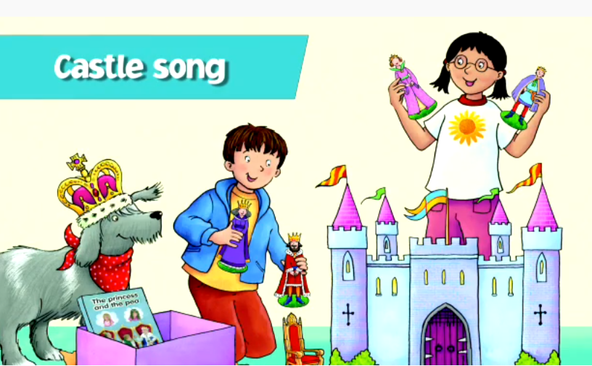
Oxford University Press Castle Song [with actions]
https://www.youtube.com/watch?v=rEbrwAIEDRI&list=RDqn8RDDb7CDA&index=2
First: Look at the picture for the Castle Song and talk about what you can see. [This will help your child know what the song is going to be about.]
Then: Look at and read through the words on the slides. Encourage your child to copy the actions in the pictures.
Finally: If you can, click the youtube link and join in the song.
Well done! You are now ready for this week’s story, Castle Adventure!
[Go to the next powerpoint W4 Castle Adventure Biff&Chip BLUE as.]
Language skills to practise :
Pronouns: he, she, and they
Possessive pronouns: his and her
Conjunction: and
Question word – where
Key words for the story this week:
King, castle , crown.

Slide 2
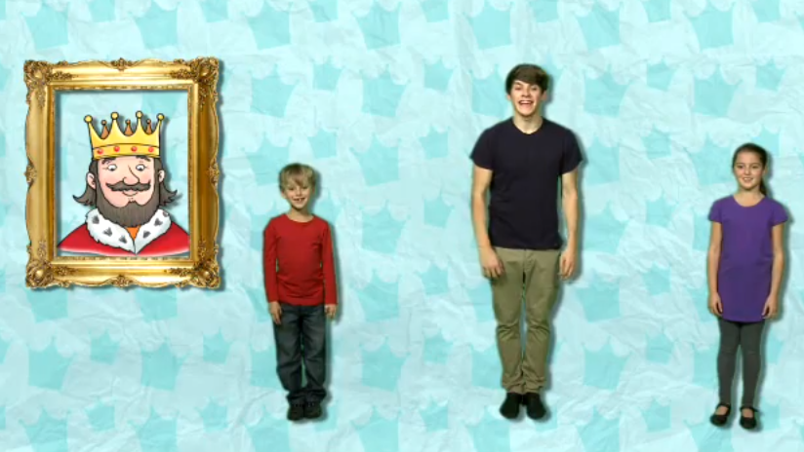

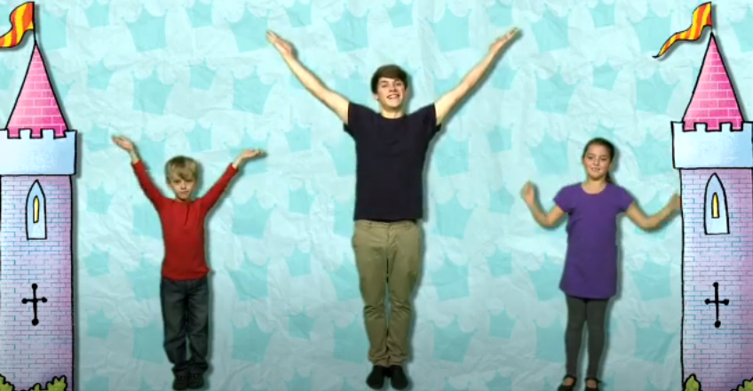
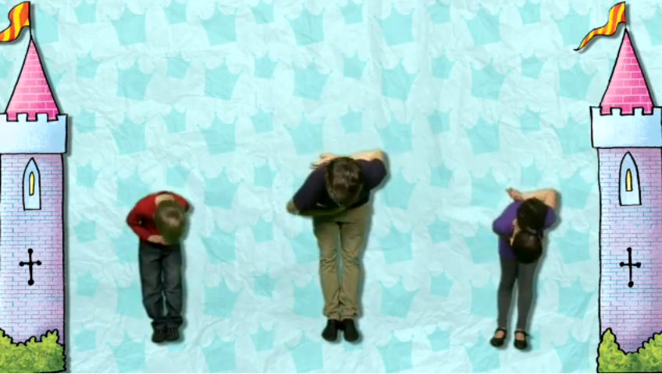
This is a king.
This is throne.
his
Where does live?
he
In a castle.

Slide 3
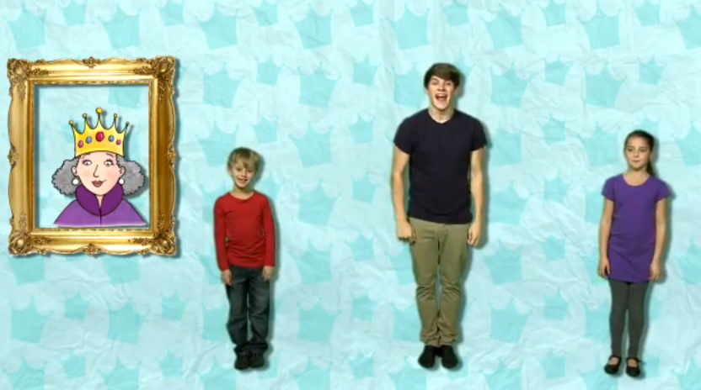
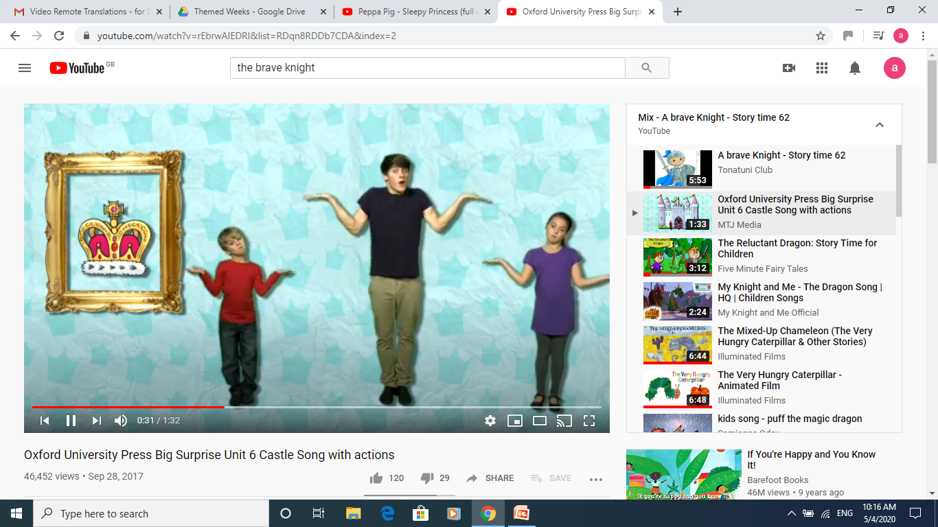
This is a queen.
This is crown.
her
Where does live?
she
In a castle.

Slide 4

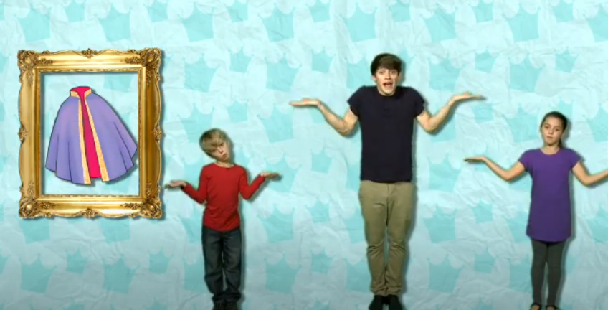
This is a prince.
This is cloak.
his
Where does live?
he
In a castle.

Slide 5

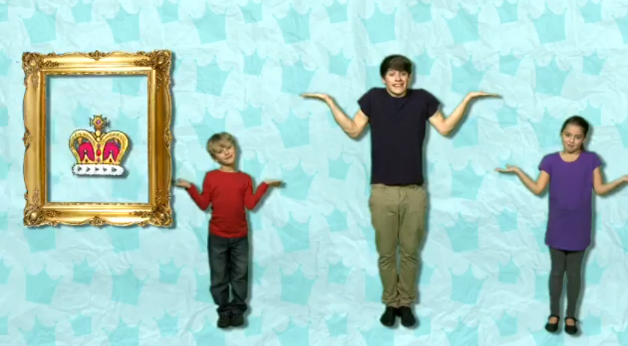
This is a princess.
This is crown.
her
Where does live?
she
In a castle.

Slide 6
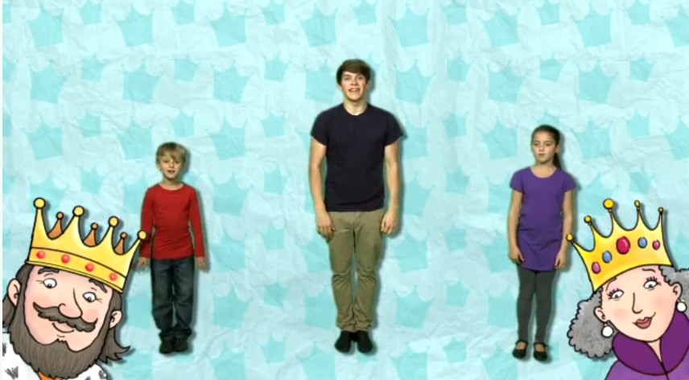
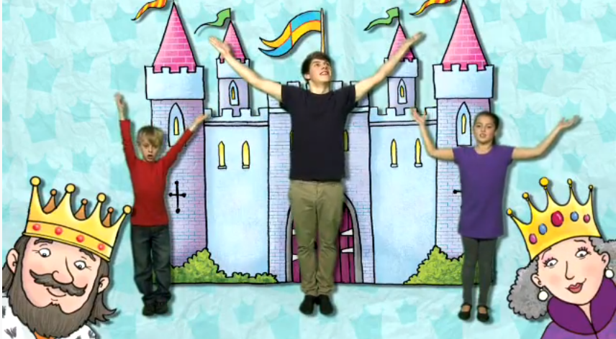
This is a king
and
this is a queen.
Where do live?
they
In a castle.

Slide 7
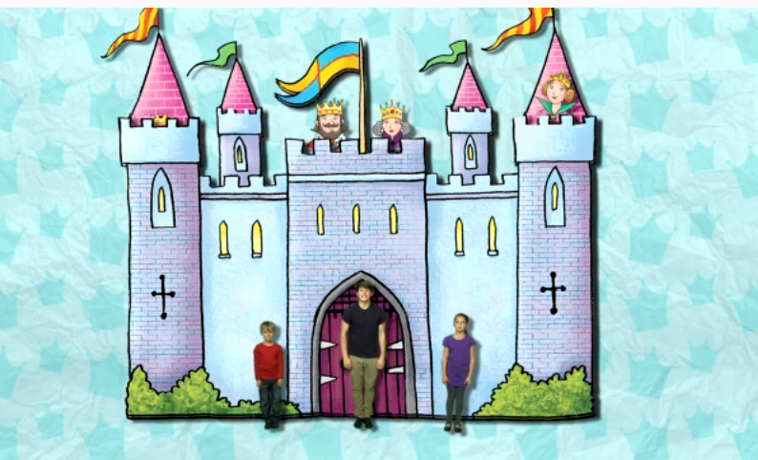


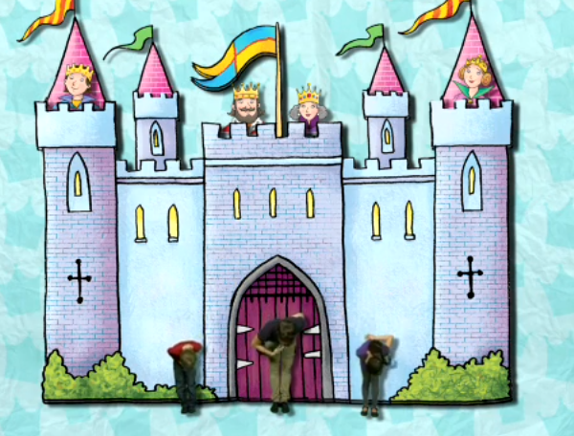
This is a princess
and
this is a prince.
Where do live?
they
In a castle.

