Slide 1

Strategies to help a young person achieve and maintain a calm & alert state at home.
By Juliette Kerin Occupational Therapist
Meadow High School, April 2020

Slide 2
THE AIM OF THIS PRESENTATION IS TO HELP YOU:
Be able to recognise a person's level of alertness
Be able to identify which strategies best help your young person achieve and maintain a calm and alert state.

Slide 3
If you have any questions following this presentation, please feel free to contact the Occupational Therapists in the Therapy Team at Meadow High School

Slide 4
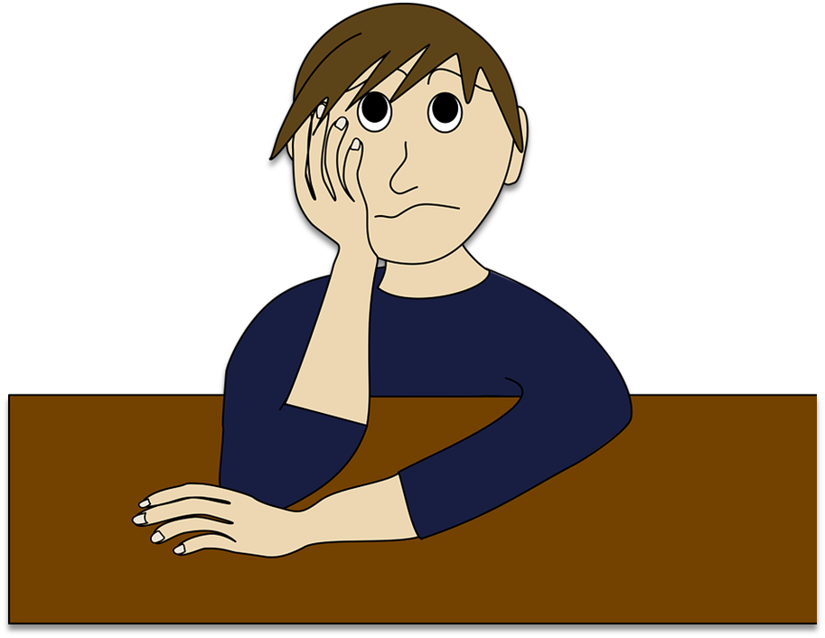
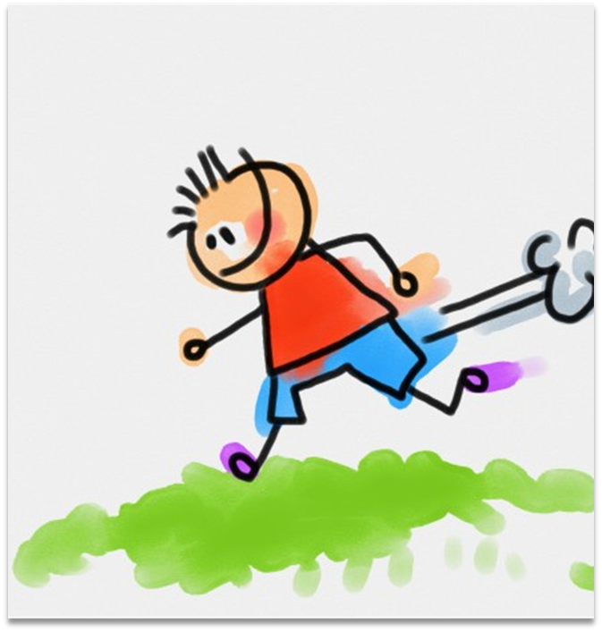

There are 3 states of alertness that a person can be in, they are:
High State of Alert
Just Right State of Alert
Low State of Alert

Slide 5

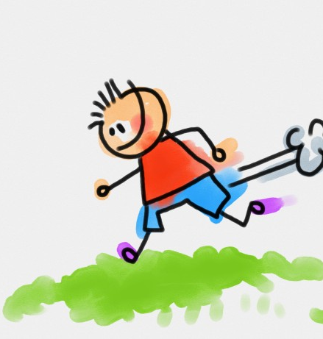
A person in a HIGH state of alert may:
Have difficulty sitting at a desk/table
Be running around the room
Be talking quickly
Be overstimulated
Be hyped up
Be hyperactive
Be wild
Be out of control

Slide 6


A person in a JUST RIGHT state of alertness for the task they are doing, may appear:
Focused
Attentive
Ready to listen
To be having fun
To be looking and listening to the person speaking
To sit easily in a chair in an upright position at a desk/dining table,
To be playing well
Calm

Slide 7

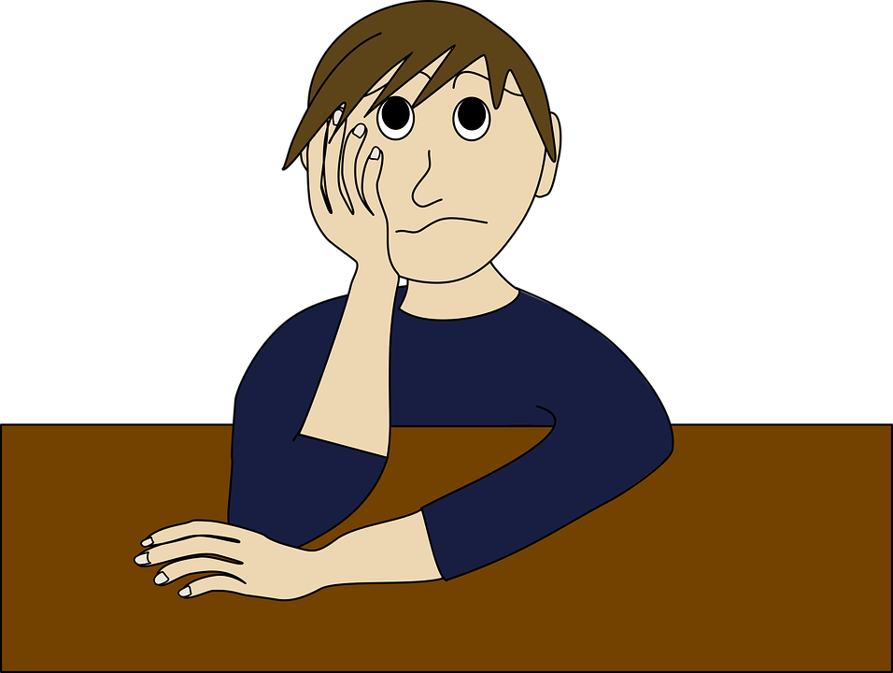
A person in a LOW state of alert may appear:
Slow moving or be slow to move
Find it hard to get going
Lethargic
Spaced out
Droopy
Slouched on a chair or sofa
Be resting their chin on their hands when sitting at a table or desk

Slide 8
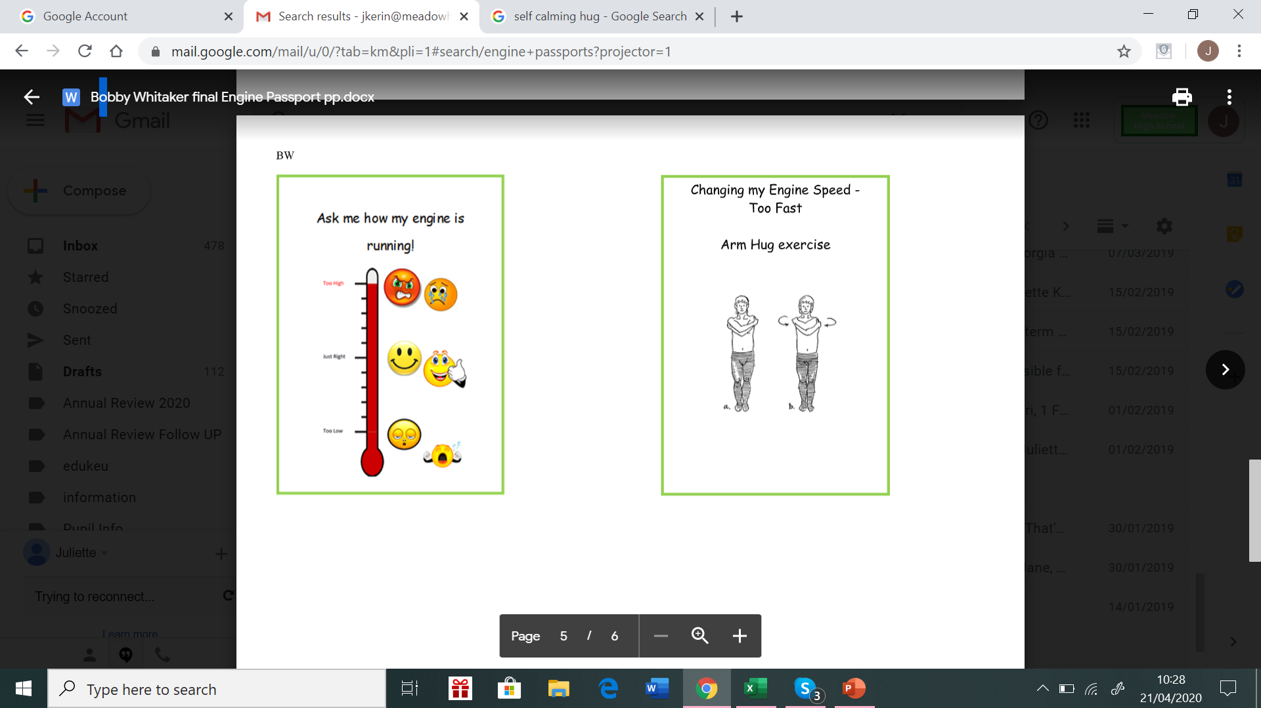
High State of Alert
You could use this chart to ask your young person to show you how they are feeling
Just Right State of Alert
Low State of Alert

Slide 9





There are 5 sensory-motor inputs that can be used to help a person change their state of alertness, these are:
Mouth
(Oral Motor input)
Move
Touch
Listen
(Auditory input)
Look
(Visual input)

Slide 10





Take a moment to think about what you do in the morning to move from a low state of alertness to a just right state of alertness, so that you feel ready to cope with the day ahead.
You might:
have a hot drink of tea or coffee (Mouth)
Go for a walk or a run (Move )
Have a hot or cold shower (Touch )
Prefer bright or dim light to wake you up (Look)
Listen– to loud fast music eg: rock or pop music

Slide 11
It is important to remember that we are all different and like different types of sensory input at different times
and
that what works one day for us won’t necessarily work the next day - this is the same for our young people,
so
it is important that we use a variety of sensory-motor inputs to help us and them at different times.

Slide 12
WARNING:
Before moving onto the next slide please remember that some of our young people may need proper supervision when lifting objects and if they have a neck or back problem or other medical conditions please contact the Therapy Team to find out if they can safely carry out these activities before trying them.

Slide 13
Below are some activities that can help a person in a high or a low state of alert achieve and maintain a calm alertness.
Other activities that can help are:
Helping with housework eg
Carrying a heavy load – shopping from the car, a laundry basket or box of toys
Sweeping the floor with a big brush or mopping the floor
Wiping down the kitchen or dining table
Helping to move furniture
Digging in the garden or raking up leaves
Cleaning Windows
Please see Appendix 1
Pushing/Pulling games eg: tug of war
Chair Push Ups or Table Push Ups
Wall presses
Head presses
Lying under a heavy blanket or pile of pillows
Jumping jacks or skipping
Sipping a cold drink of water through a straw or sports top bottle
Having a chewy snack eg cheese string, bagel or a crunchy snack eg crackers, breadsticks

Slide 14

General strategies that can help a person move from a high state of alert to a just right state of alert are:
Having a quiet space at home where they can go if it gets too noisy. It could be their bedroom or a place that is not visually distracting and has dim lighting. It could be a corner of a room set up with cushions or you could use a pop up tent or make a den with a blanket and chairs
Talking to the young person in a quiet slow dull voice
Playing soft calming music
Introduce crunchy foods (eg crisps) and chewy foods (eg: popcorn)
Sucking a drink through a straw or sports top drinks bottle
Lying under a heavy duvet/blanket
Carrying out heavy work tasks

Slide 15

General strategies that can help a person move from a low state of alert to a just right state of alert are:
Fast vigorous movements such as bouncing or jumping
Spinning one way and then the other
Dancing to fast up-tempo music
Bright lighting
Talking to the young person in a lively excited voice
Playing lively music
Introduce different texture & temperature foods (for example crunchy foods such as muesli or cold snacks eg: ice lollies)
Sucking a cold drink through a straw or sports cap bottle

Slide 16

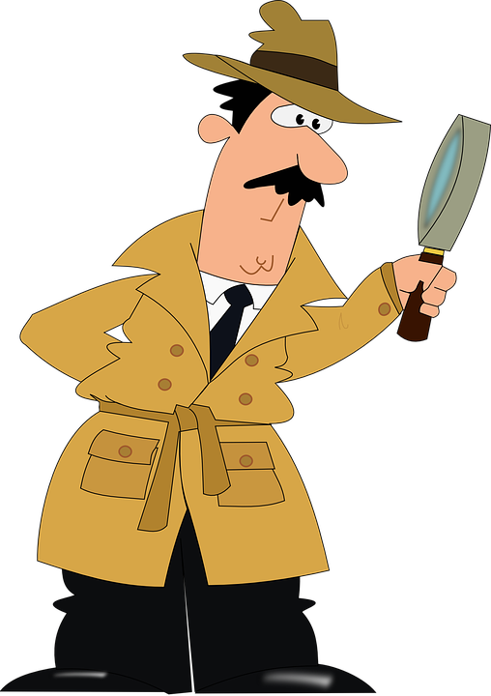



The next step is for you to identify what strategies your young person is already using and the effect these strategies have on their state of alertness.
What do they already put in their mouths? Do they:
  Prefer crunchy or chewy foods?
  Chew on their pen tops or clothing when they are concentrating?
What do they use in the move category? Do they like to:
  Spend time swinging or spinning?
  Pace about while telling you a story?
  Watch TV draped upside down over a sofa?
What are their preferences in the touch category?
  Do they tap their pencils on the table while thinking or love to snuggle underneath a heavy duvet or with a favourite soft toy?
  What kinds of clothing textures do they prefer to wear?

Slide 17
What type of visual environment does your young person work best in? Do they:
  Work best with a clear desk or do they seem to prefer lots paper and things around them while they work?
  Decorate their bedroom with lots of bright colourful posters or do they prefer few visual distractions?
What type of auditory input does your young person like? Do they:
  Listen to music while doing their homework or do they prefer silence to study in?
  Listen to music when they are learning a new topic or only when they are completing homework on a familiar topic?
When you’ve identified what works for your young person you can work these strategies into their day eg: if you know that they become hyper after having lunch and they like being squashed under cushions you could get them to try some arm hug exercises or carefully squash them under a pile of cushions.

Slide 18
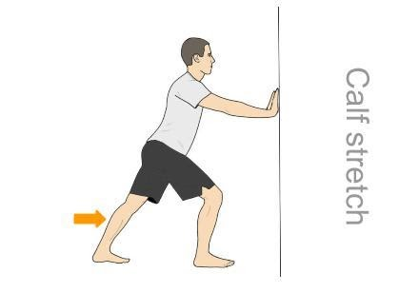
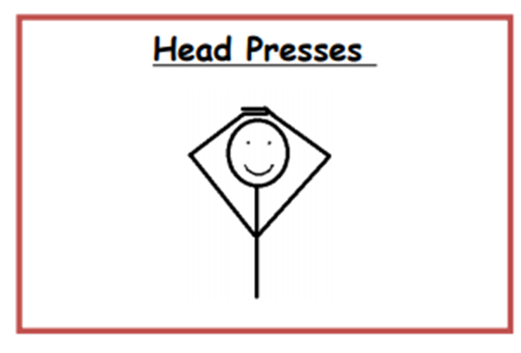
Appendix 1 - Calming & Alerting Activities
If any of these exercises cause pain or discomfort stop immediately and please contact an Occupational Therapist in the Therapy Team
Head Presses
Look straight ahead - Keep your neck straight and place both hands on your head and firmly press down
Hold for 10 seconds and repeat 5 times
Wall Presses
Put one leg forward and the other leg back. Then push wall for a count of 10 (keeping arms straight)
Change legs and push wall again for a count of 10

Slide 19
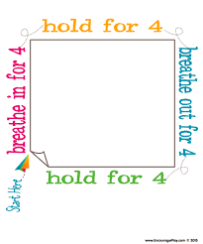
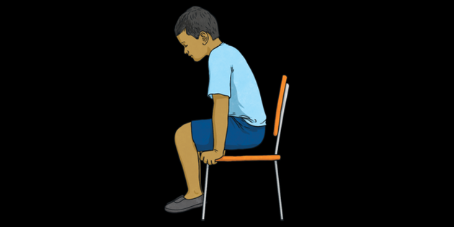
Square breathing
Chair Push Ups
Put both hands at the side of the chair and push up (as is you are going to stand up) keep your feet on the floor – hold for 5 seconds & sit down again – repeat 5 times.
Square Breathing
Slowly breathe in through the nose for 4 seconds
Hold your breath for 4 seconds
Slowly breathe out through the mouth for 4 seconds
Hold your breath for 4 seconds
Repeat 5 times

Slide 20

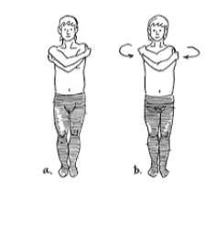
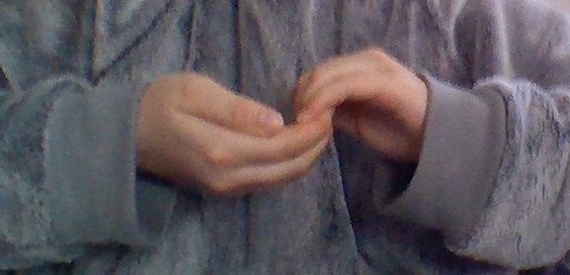
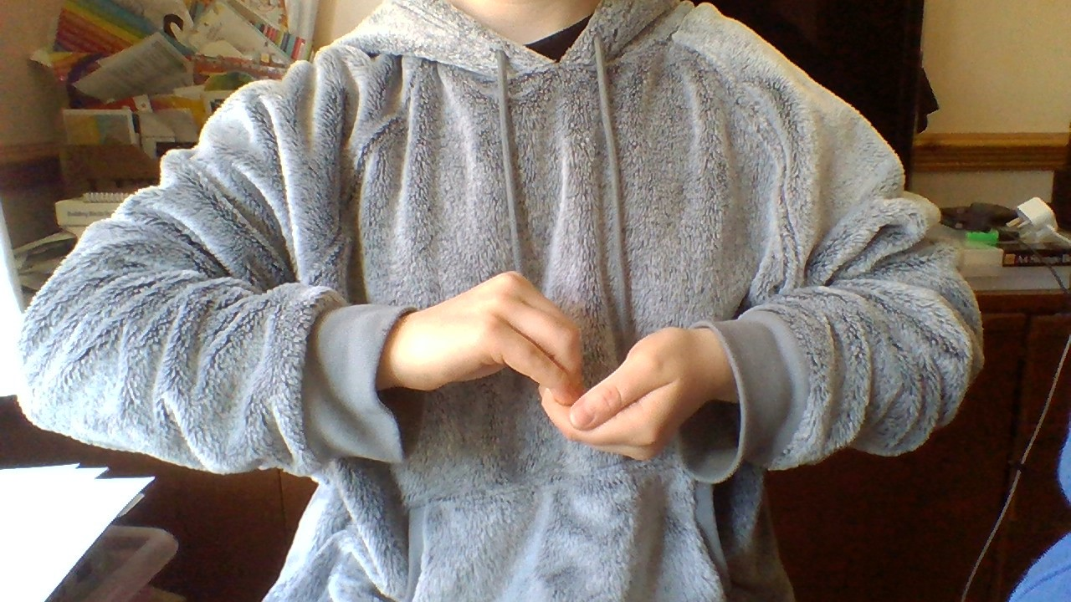
Pushing Hands Together & Pulling fingers
Arm Hug Squeezes
Push the palms of your hand together firmly and hold for a count of 10.
Then hook the fingers of both hands together at chest height and firmly pull for 10 seconds then repeat exercise with other hand on top
Cross your arms and place both hands on your shoulders and then squeeze firmly for a slow count of 10 and then release – repeat 5 times

Slide 21
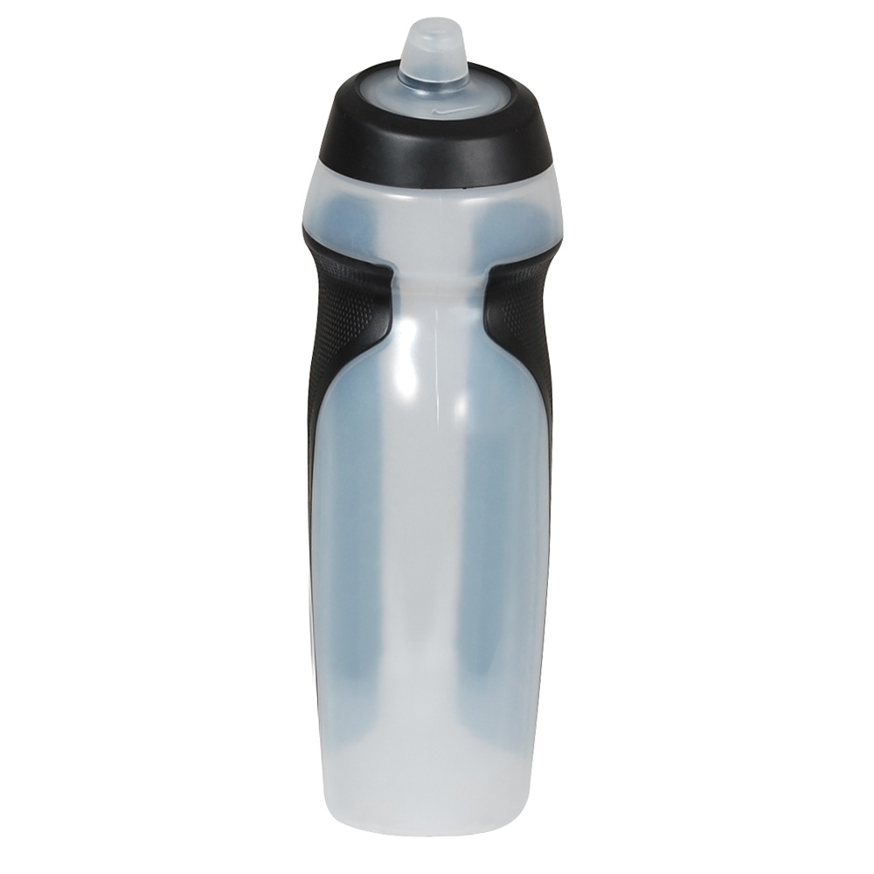

Sipping Cold Water
Hand Squeezes
Squeeze ball slowly and rhythmically 10 times in one hand and then swap hands
If you don’t have a squeeze ball don’t worry just clench and open your fist slowly & rhythmically for a count of 10 times & then swap hands.

