Slide 1
Coronavirus

Slide 2



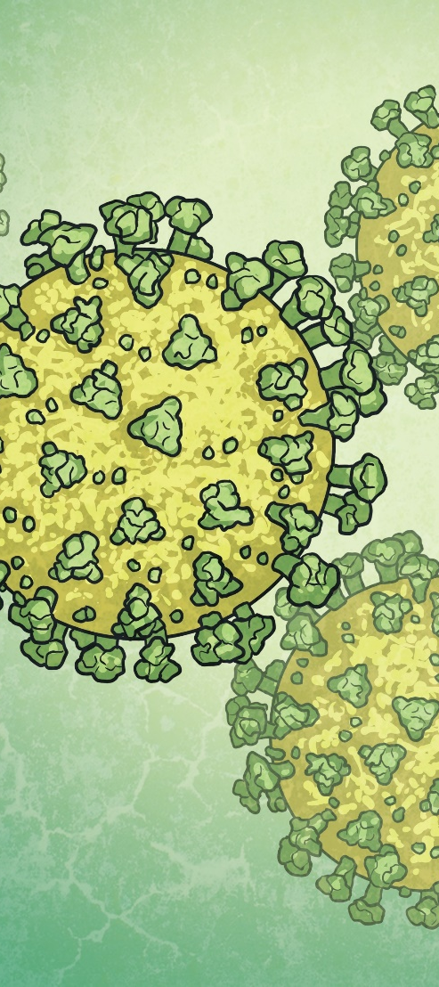
Daily News
Special Report x UK News x
20th March 2020
UK Government Closes Schools from Friday
UK schools will close from today to help stop the spread of the virus COVID-19. On Wednesday, Prime Minister Boris Johnson explained that he was doing this to keep everyone safe. He said schools will stay closed “until further notice.”
Many children could be learning from home, starting on Monday. This is to help slow the spread of a coronavirus called COVID-19.
COVID-19 has been in the news a lot recently. It’s a type of virus. It can cause coughing, tiredness, difficulty breathing and a fever. The virus can also cause more severe symptoms for people who are already ill or elderly.
The World Health Organisation (WHO) say that most people recover without needing any special treatment.
The WHO is asking people to practise something called social distancing. This means keeping enough space between people to help stop the virus spreading.
Read the full article online here.
What is coronavirus?
What is being done about it?
What can we do?
What changes might I see?
What should I do if I’m upset by the news?
Illustration: A zoomed-in image of the virus.

Slide 3
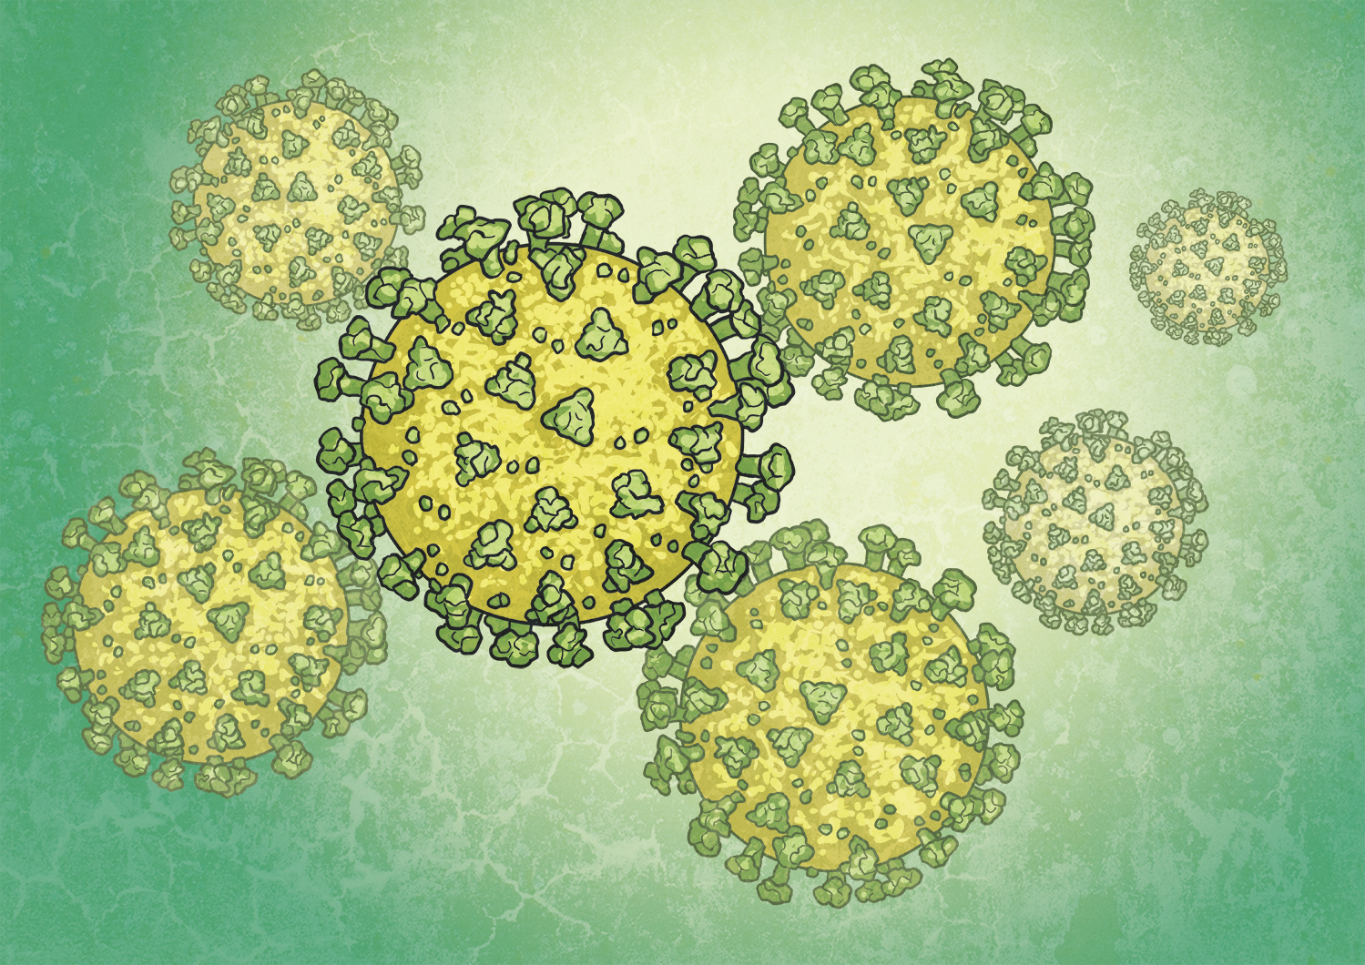

Slide 4

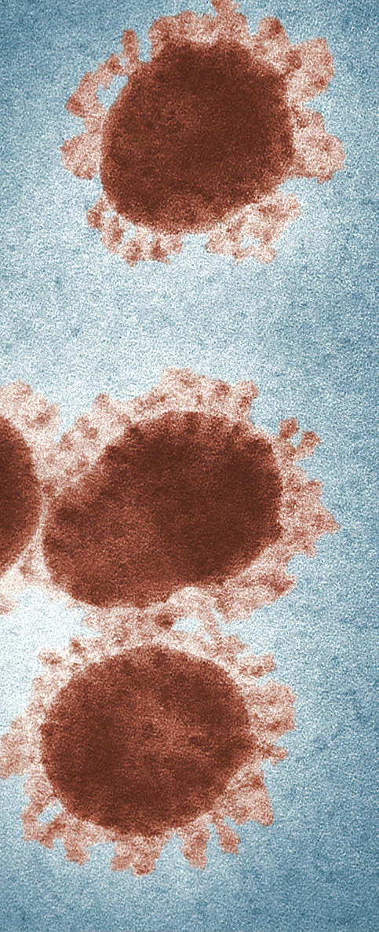
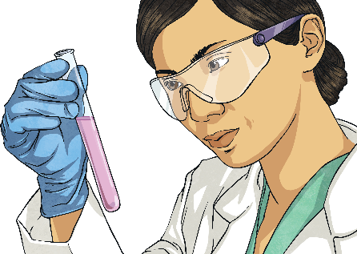
What Is Coronavirus?
Coronavirus is the name of a large family of viruses. They get their name because under a microscope they look a bit like a crown.
As it is new, scientists are still learning about it.
This coronavirus causes symptoms, such as coughing, a high temperature and difficulty breathing.
The UK government says that the “current evidence” is that most cases are mild. The World Health Organisation say that most people recover without needing any special treatment.
It can cause more serious symptoms for some people who are older or already ill.
Doctors and governments are keen to slow the spread of the virus.

Slide 5


Slide 6
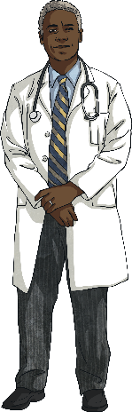


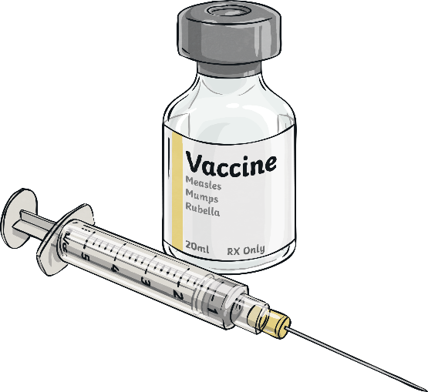
What Is Being Done about It?
In Wuhan, China, new hospitals have been built to help people with coronavirus.
The World Health Organisation is also working with countries to learn about the virus and help governments respond.
Schools have been closed in the UK from Friday. This is to reduce the risk of the virus spreading. Teachers are using the internet to teach children.
Children of key workers will still go to school so their parents can work.
Scientists are also working to develop a vaccine. This would help protect people from the virus.

Slide 8
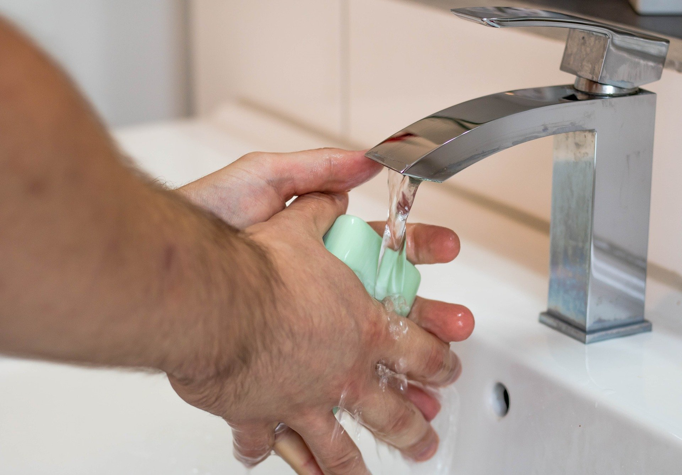
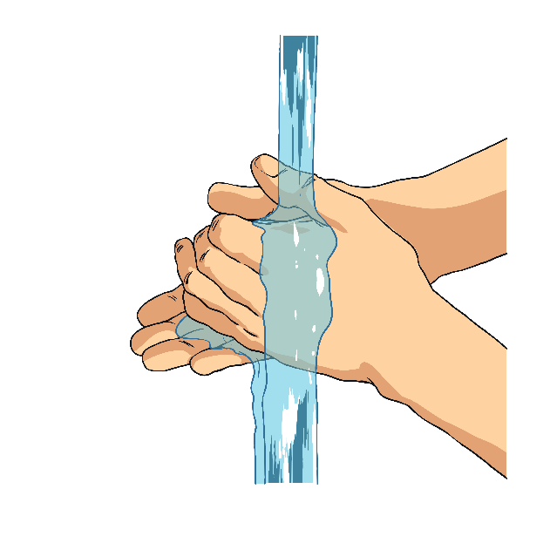
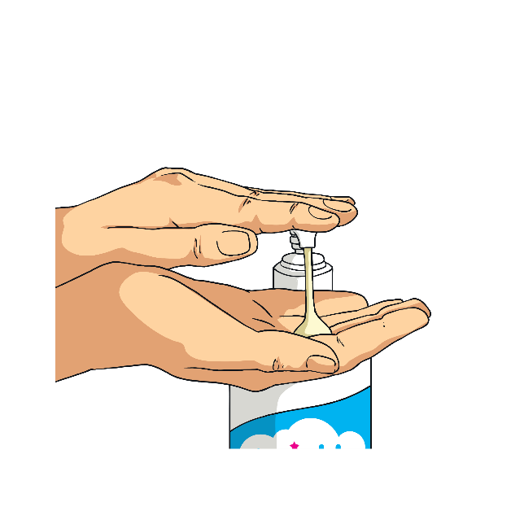
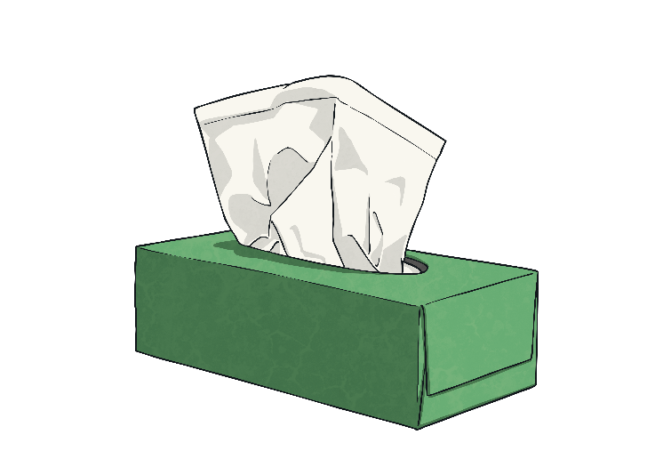
What Can We Do?
The government says that there are a lot of things we can do to stay safe.
Sing while you wash! Doctors say that if you sing ‘Happy Birthday’ twice while washing your hands, you will make sure you wash for a good amount of time.
If you cough or sneeze, catch it with a tissue, bin it and then wash your hands with hot water and soap.
Use soap and hot water to wash your hands after you use the toilet, before you eat and after break.
We can also look out for others. You can give older relatives or people who might be self-isolating a call.

Slide 10
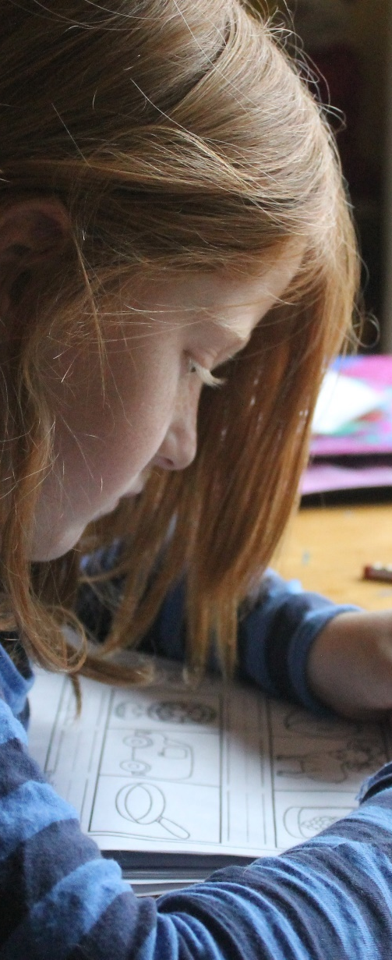
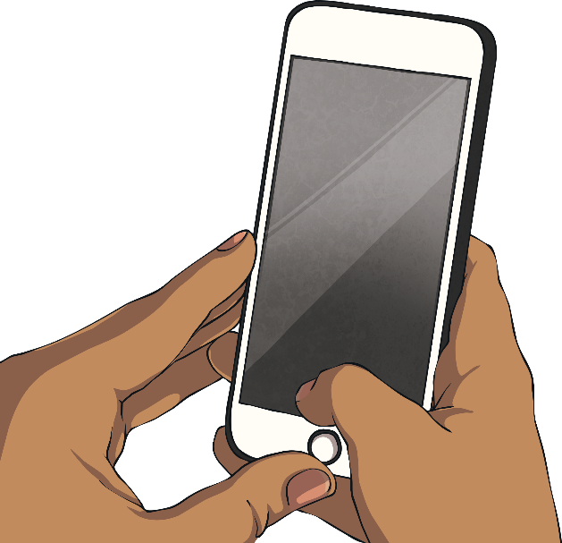
What Changes Might I See?
As schools close and some adults start to work from home, you may begin learning from home. You may be using online learning tools to do this.
This won’t be happening forever and things will get back to normal.
This doesn’t mean you can’t communicate with other people! You may just have to think of different ways of doing it, like calling someone on the phone.
You might hear about social distancing. This means people will not be going to big sporting events and concerts.
Therefore, people will not be seeing each other in person. It will also mean that some of your clubs may not be happening for the time being.

Slide 11


Slide 12

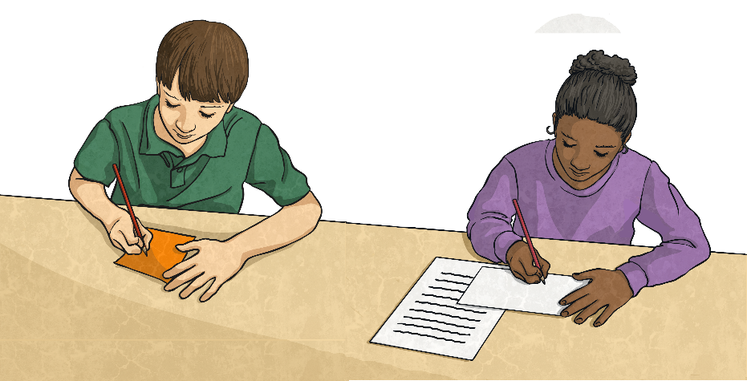


What Should I Do If I’m Upset by the News?
Some of the things we see or hear in the news are upsetting.
Talking to a trusted adult can help you to feel safe and help you think of things you can do if you feel worried or upset in the future.
It’s normal to feel upset or worried about the news. Adults often do as well.
Drawing or writing about your worries might also help you to understand your emotions.
The news can sometimes make things seem scarier than they are. You can find out the facts about the news using child-friendly news sites.
Learn more about what to do if the news upsets you here.
Remember that upsetting events are rare – that’s why they’re in the news.
Ask yourself how you can help. We often feel better if we’ve an opportunity to help others.
What do you do when you feel upset?

Slide 13


Slide 14
Glossary
Word | Definition
virus | A very small particle which can cause an illness.
further notice | Until people are told to do something.
symptoms | A physical or mental sign of an illness.
treatment | Medical care given for an illness or injury.
social | Meeting other people and talking to others.

