Slide 1
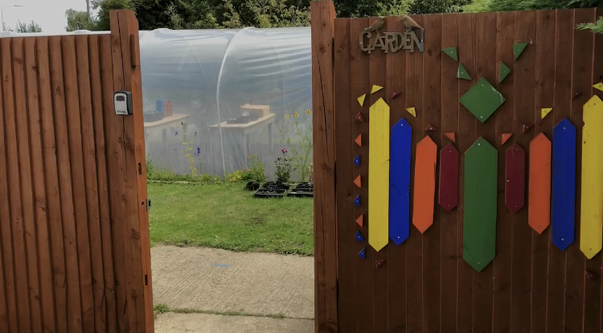
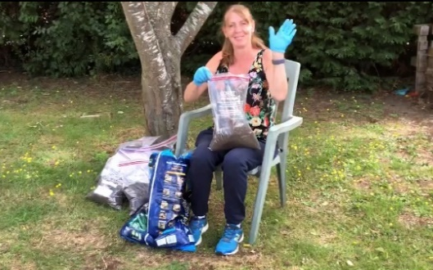
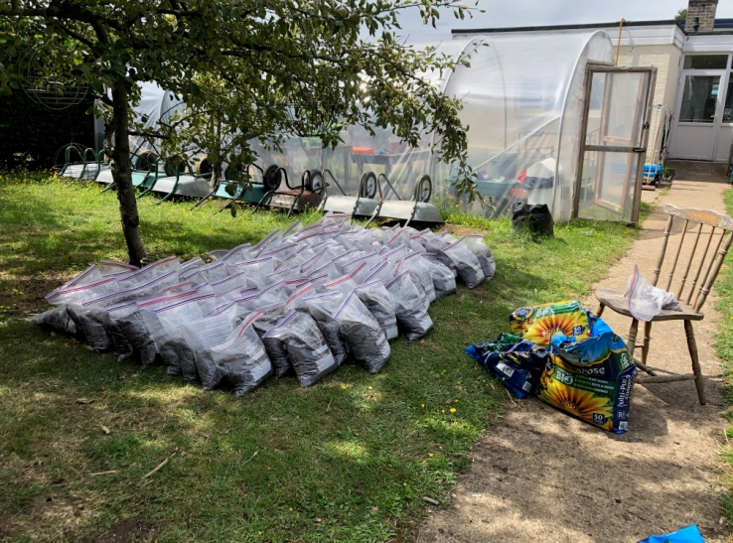
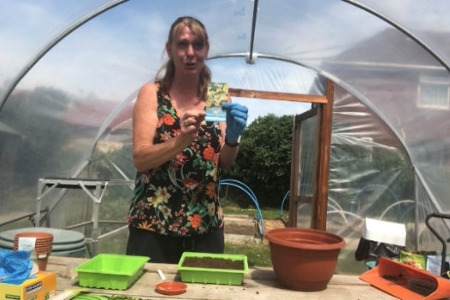
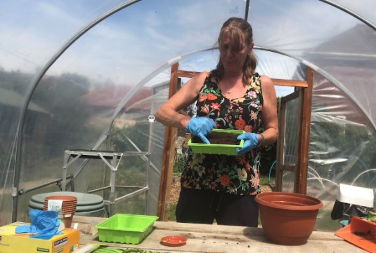
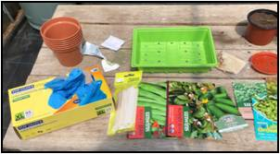
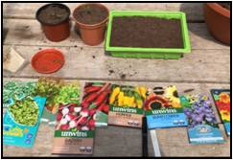
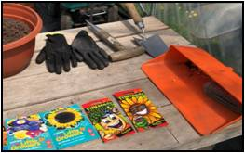
Holiday Work:
Theme: Leisure – Activities
First: [Miss Lennon has made a video.]
Watch and make notes
Focus: Following a sequence of verbal
instructions. Making clear notes.
Next: Extension Work
Keep a Gardener’s Diary
Focus: observation skills, measuring, notes
Making a Paper Flower Pot
Focus: Following a sequence of written
instructions [fine motor skills]
Finally: Creating a Calm Place...
Build a camp/den
Get creative, find a space in your bedroom
or outside [if you have garden].
Focus: logical thinking skills, sequencing
inc. writing instructions, understanding
your sensory regulation needs
– lighting, colours, size space, textures

Slide 2
Note-Taking Practise: How to Plant a Seed [You can use your yellow workbook.]
______________________________________________________________________________________________________________________________________________________________________________________________________________________________________________________________________________________________________________________________________________________________________________________________________________________________________________________________________________________________________________________________________________________________________________________________________________________________________________________________________________________________________________________________________________________________________________________________________________________________________________________________________________________________________________________________________________________________________________________________________________________________________________________________________________________________________________________
Making notes is a key skill: Watch Miss Lennon’s How to Plant a Seed video and make
brief notes. You need to focus on equipment, method and any hand hints she gives.

Slide 3
Note-Taking Practise: How to Plant a Seed [You can use your yellow workbook.]
______________________________________________________________________________________________________________________________________________________________________________________________________________________________________________________________________________________________________________________________________________________________________________________________________________________________________________________________________________________________________________________________________________________________________________________________________________________________________________________________________________________________________________________________________________________________________________________________________________________________________________________________________________________________________________________________________________________________________________________________________________________________________________________________________________________________________________________
Key Words:
equipment = the things you need for the task method = step by step instructions
handy hints = any tips the instructor gives you to make the job easier.

Slide 4


Keep a Gardener’s Diary
Take photos regularly OR draw
Focus:
Building your observational skills – what has changed from the last time you looked.
Develop your Maths skill – measure how much it has grown.
Please send us your drawings and photos so that we can add them to the website.
Date:
What have you observed [noticed] today?
Date:
What have you observed [noticed] today?

Slide 5
Keep a Gardener’s Diary
Take photos regularly OR draw
Focus:
Building your observational skills – what has changed from the last time you looked.
Develop your Maths skill – measure how much it has grown.
Please send us your drawings and photos so that we can add them to the website.
Date:
What have you observed [noticed] today?
Date:
What have you observed [noticed] today?

Slide 6
Keep a Gardener’s Diary
Take photos regularly OR draw
Focus:
Building your observational skills – what has changed from the last time you looked.
Develop your Maths skill – measure how much it has grown.
Please send us your drawings and photos so that we can add them to the website.
Date:
What have you observed [noticed] today?
Date:
What have you observed [noticed] today?

Slide 7
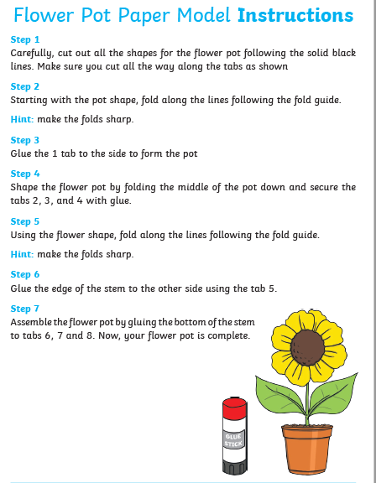
This task is good practise following instructions.

Slide 8
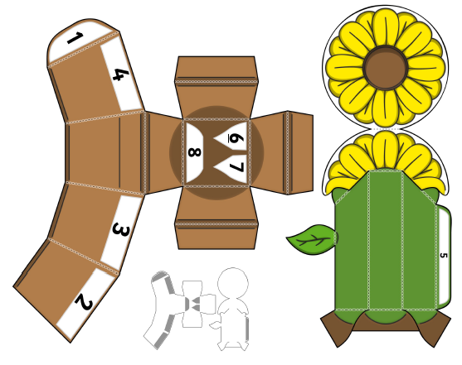

Slide 9
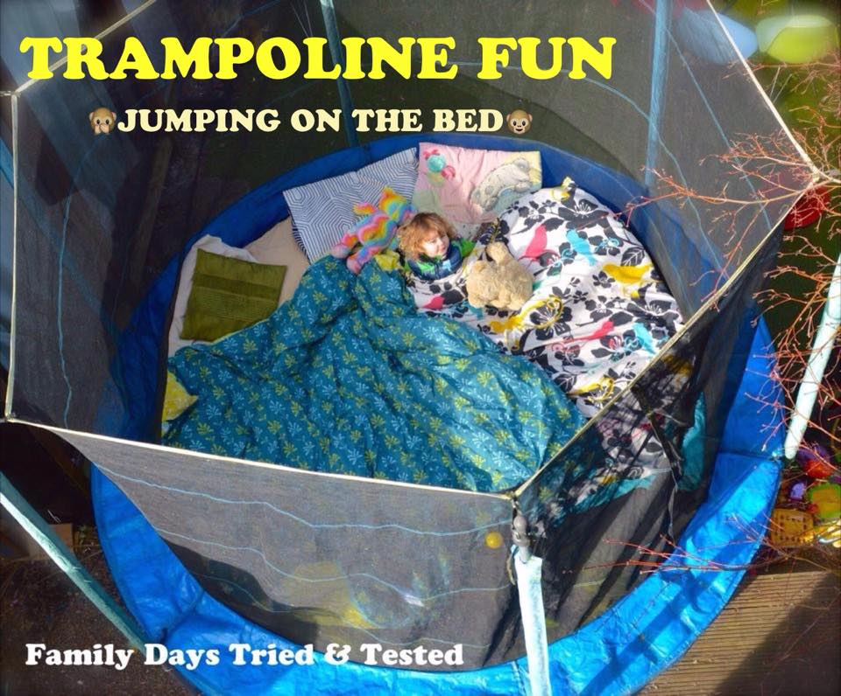
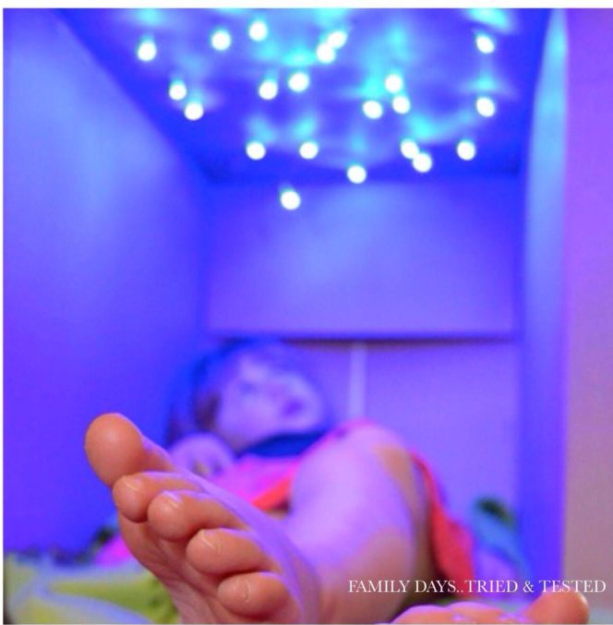
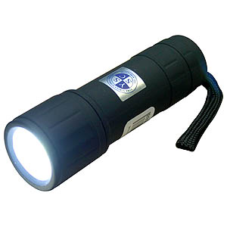
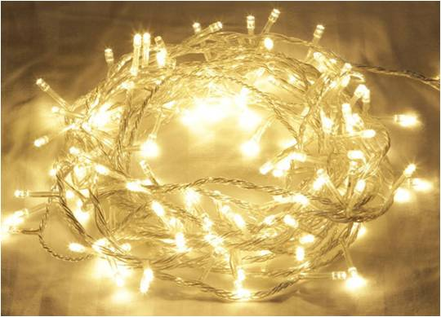
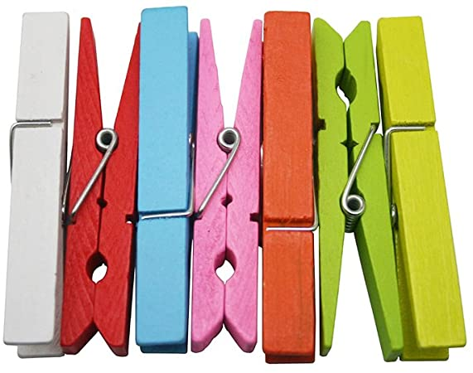
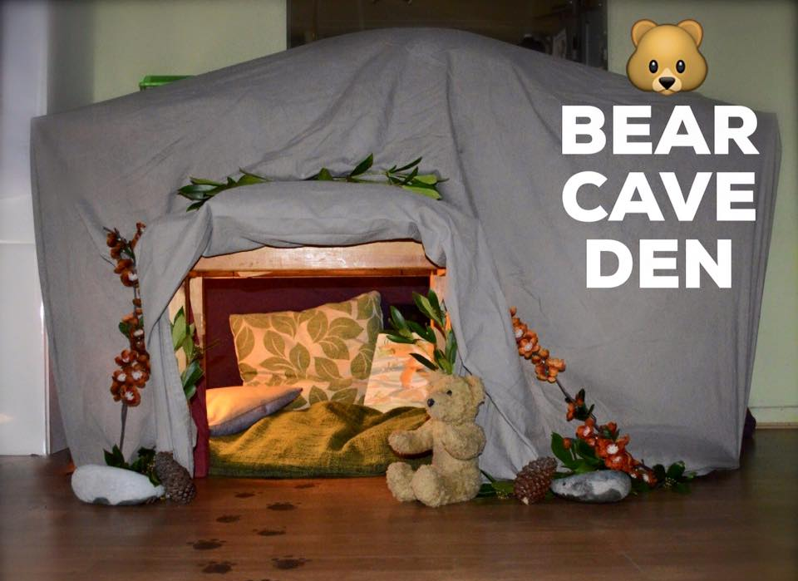
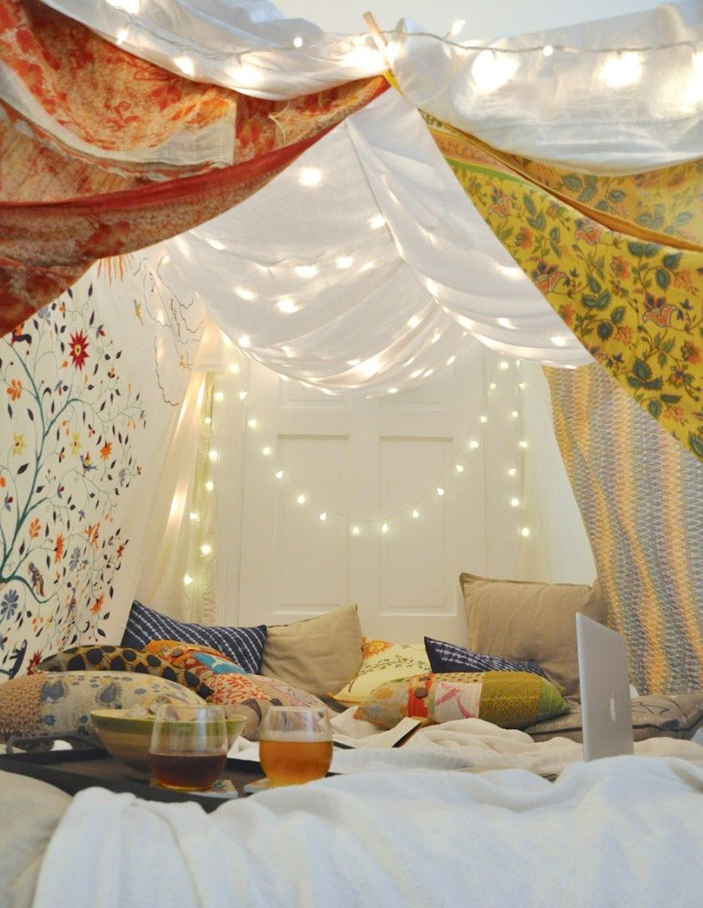
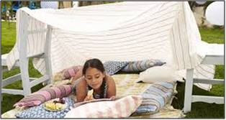
Have a go at - building a camp. Inside or outside, add some lighting if you can.
What you need ideas:
blanket
bed sheet
string
clothes pegs
fairy lights
torch
glo sticks
Pillows/cushions
and of course...
biscuits!

Slide 10
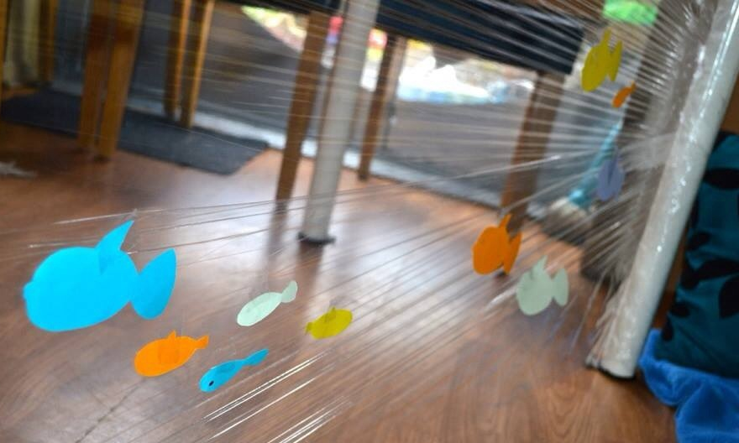
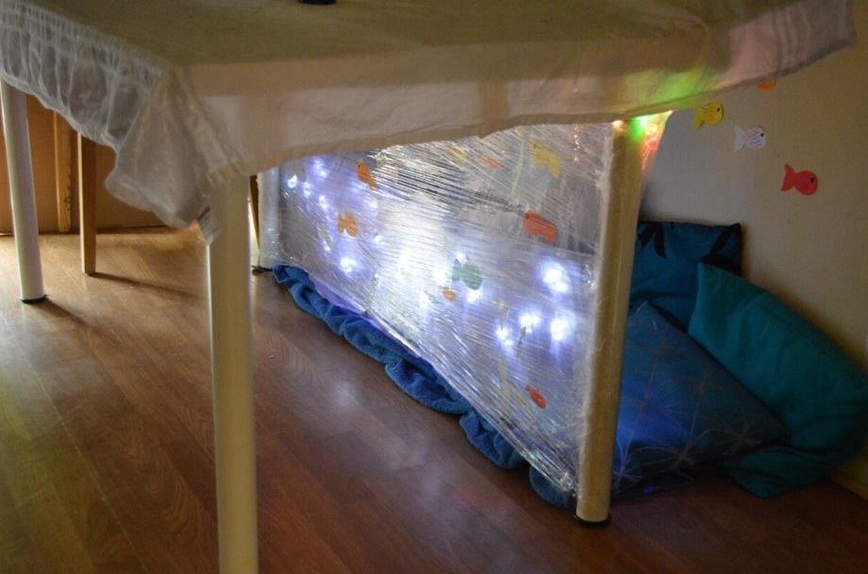
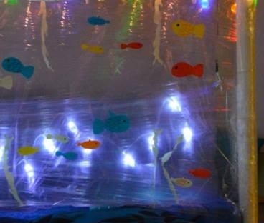
Have a go at - building a camp. Inside or outside, add some lighting if you can.
What You Need - Under Table Ocean Den
coloured paper/card
felt tip pens to decorate the paper fish
cling film
sticky tape
blue towel/sheet/table cloth for the ocean floor
cushions (blue or green, if possible)
fairy lights (battery operated?)
big table cloth to go over the top

Slide 11
Project Planning Sheet: [You can also use your yellow workbook.]
Complete this Project Plan to help get organised!
Focus: Building planning skills. [Just brief notes – not sentences]
Finally: Special final touches
Next: List the things you need.
Then: Any problems to fix.
Quick planning sketch [useful if others are going to help you]:
First: - Where will you build?

Slide 12
Project Evaluation: My Den [You can use your yellow workbook.]
______________________________________________________________________________________________________________________________________________________________________________________________________________________________________________________________________________________________________________________________________________________________________________________________________________________________________________________________________________________________________________________________________________________________________________________________________________________________________________________________________________________________________________________________________________________________________________________________________________________________________________________________________________________________________________________________________________________________________________________________________________________________________________________________________________________________________________________
You need to think about: Was it easy to find the things you needed? Did you have any problems
to over-come? Did it turn out the way you’d planned? How do you feel when you’re inside the den ?

Slide 13
Writing Instructions: How to Build a Den [You can use your yellow workbook.]
You need to think about: Using the Flower Paper Flower Pot instructions as a guide, write clear
instructions for someone who loves your den and wants to make one too.
Include: Equipment List [Things you need], Method [step by step instructions], Handy Hints.
____________________________________________________________________________________________________________________________________________________________________________________________________________________________________________________________________________________________________________________________________________________________________________________________________________________________________________________________________________________________________________________________________________________________________________________________________________________________________________________________________________________________________________________________________________________________________________________________________________________________________________________________________________________________________________________________________________________________________________________________________________________

Slide 14
Writing Instructions continued... How to Build a Den
________________________________________________________________________________________________________________________________________________________________________________________________________________________________________________________________________________________________________________________________________________________________________________________________________________________________________________________________________________________________________________________________________________________________________________________________________________________________________________________________________________________________________________________________________________________________________________________________________________________________________________________________________________________________________________________________________________________________________________________________________________________________________________________________________________________________________________________________________________________________________________________________________________________

Slide 15
Writing Instructions: How to Build a Den [You can use your yellow workbook.]
Optional: Draw illustrations to go with your instructions [think Ikea – clearly labelled line drawings].

