Slide 1
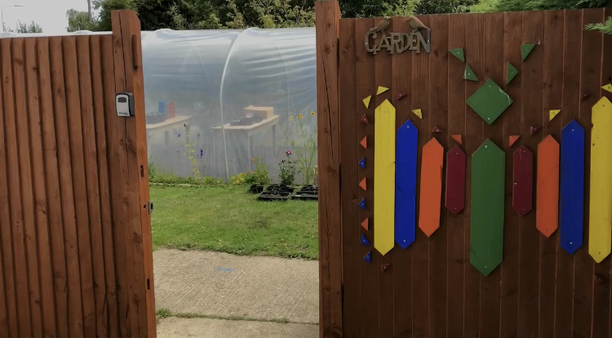
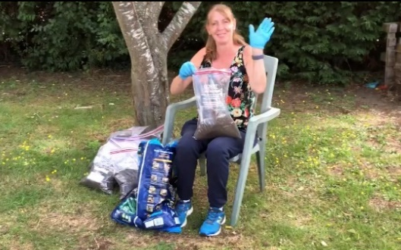
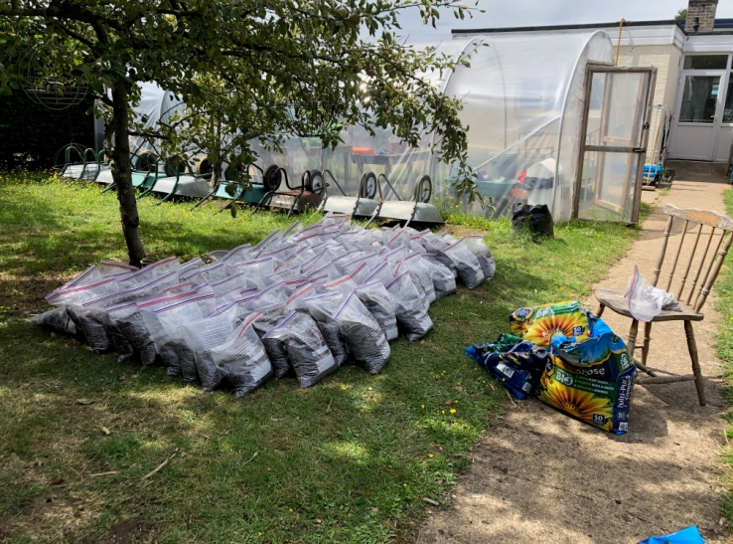
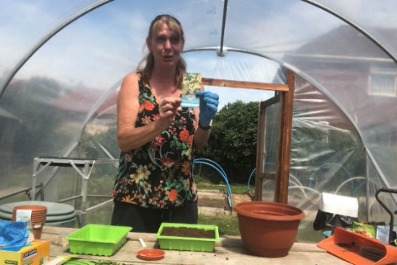
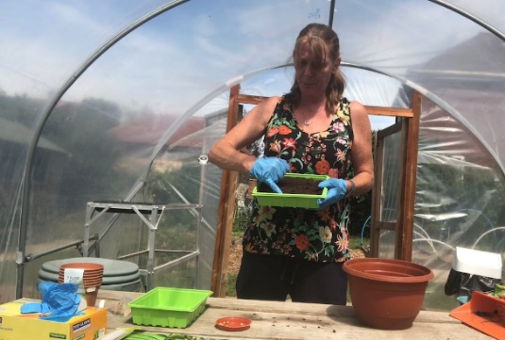
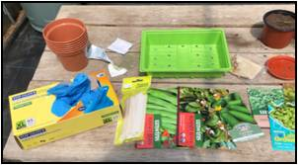
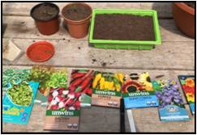
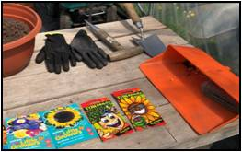
Holiday Work:
Theme: Leisure – Activities
First: [Miss Lennon has made a video.]
Watch/listen/follow along and
talk about.
Focus: Follow a sequence of instructions.
Next: Extension Work
Keep a Gardener’s Diary
Focus: observation skills, measuring, notes
Test your plant knowledge!
Focus: cross-curricular learning, creative
tasks [fine motor skills, following instructions]
Finally:
Have a go - build a camp/den –
inside or outside, add some lighting.
Focus: Building communication +
logical thinking, sequencing , motor
skills and sensory awareness
– create a calm place

Slide 2


Keep a Gardener’s Diary
Take photos regularly OR draw
Focus:
Building your observational skills – what has changed from the last time you looked.
Develop your Maths skill – measure how much it has grown.
Please send us your drawings and photos so that we can add them to the website.
Date:
What have you observed [noticed] today?
Date:
What have you observed [noticed] today?

Slide 3
Keep a Gardener’s Diary
Take photos regularly OR draw
Focus:
Building your observational skills – what has changed from the last time you looked.
Develop your Maths skill – measure how much it has grown.
Please send us your drawings and photos so that we can add them to the website.
Date:
What have you observed [noticed] today?
Date:
What have you observed [noticed] today?

Slide 4
Keep a Gardener’s Diary
Take photos regularly OR draw
Focus:
Building your observational skills – what has changed from the last time you looked.
Develop your Maths skill – measure how much it has grown.
Please send us your drawings and photos so that we can add them to the website.
Date:
What have you observed [noticed] today?
Date:
What have you observed [noticed] today?

Slide 5
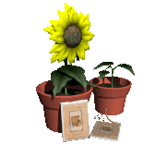
What Plants Need

Slide 6

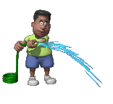
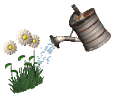
What do plants need to grow ?
1. Water
Without water a plant will dry up and die.
Plants need water to help them grow.

Slide 7

Light
Green plants need sunlight so that they can make their own food.

Slide 8
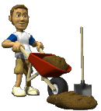
Nutrients
Plants need the good food found in soil for healthy growth.

Slide 9


Warmth
The plant will not grow properly if it is too cold or too hot.

Slide 10

What do plants need to grow ?
Time for a quiz!
Without this a plant will die!
Water

Slide 11

What do plants need to grow ?
Time for a quiz!
This helps plants make their own food.
Light

Slide 12

What do plants need to grow ?
Time for a quiz!
These are found in the soil.
Nutrients

Slide 13

What do plants need to grow ?
Time for a quiz!
This comes from the sun, just like light.
Warmth

Slide 14
So, these are the things plants need to grow!
Water
Light
Nutrients
Warmth

Slide 15
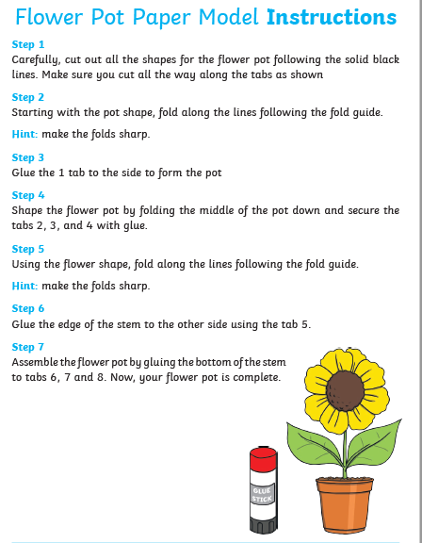
This task is good practise following instructions.

Slide 16
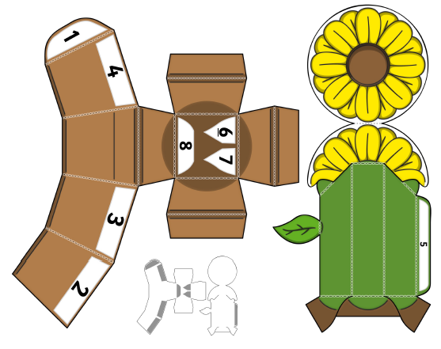

Slide 17
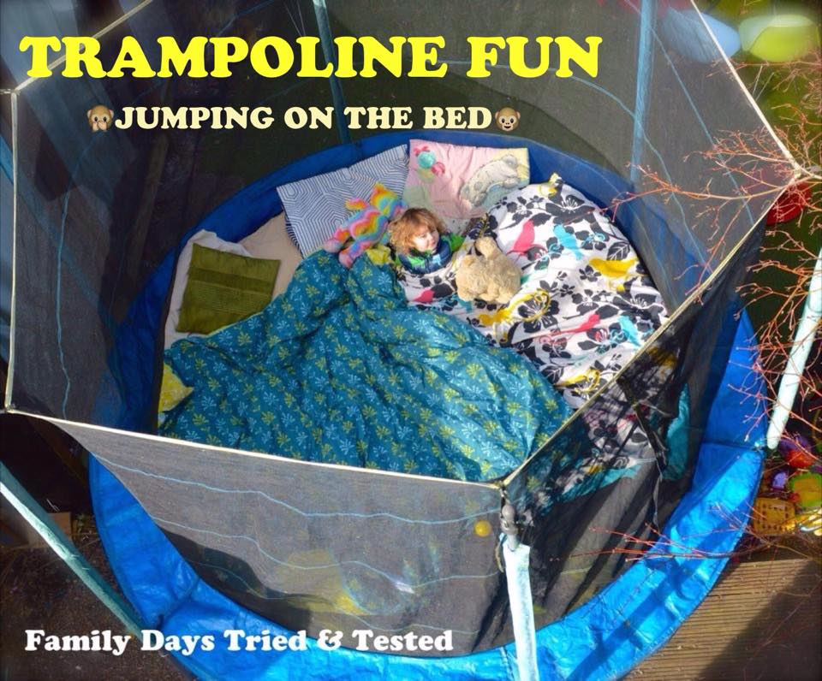
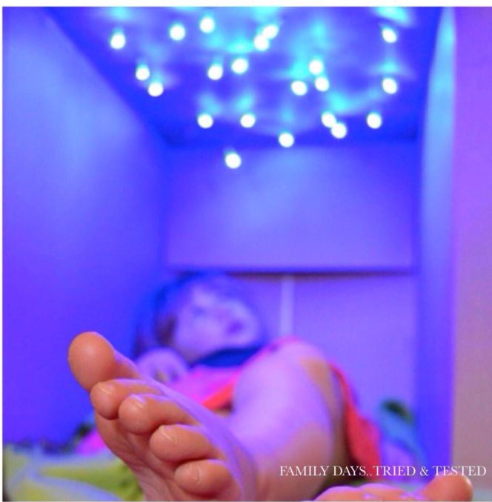
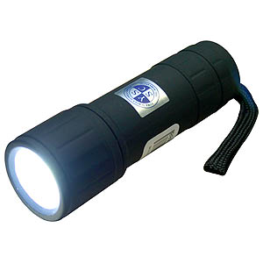
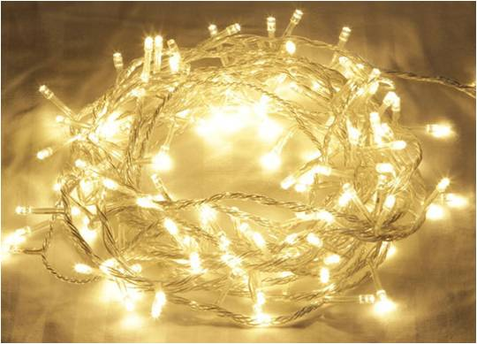
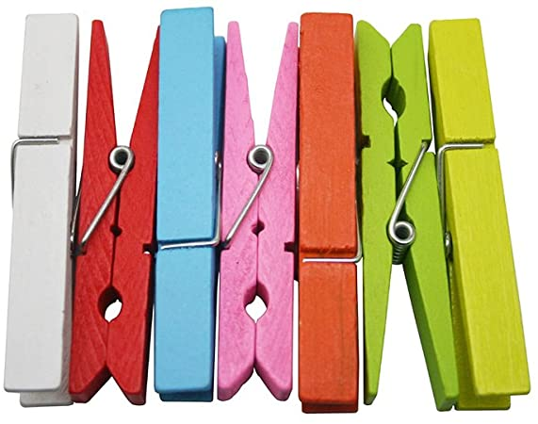
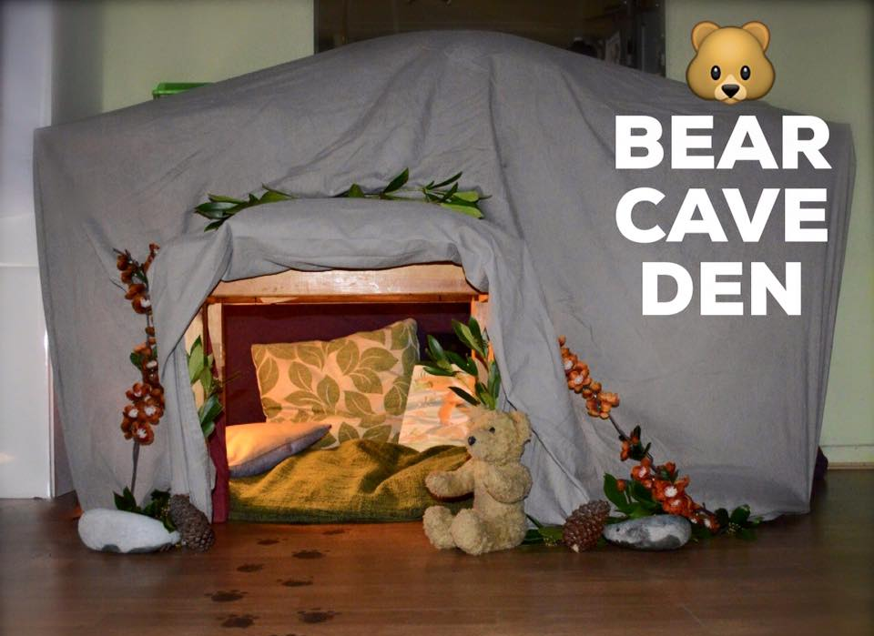
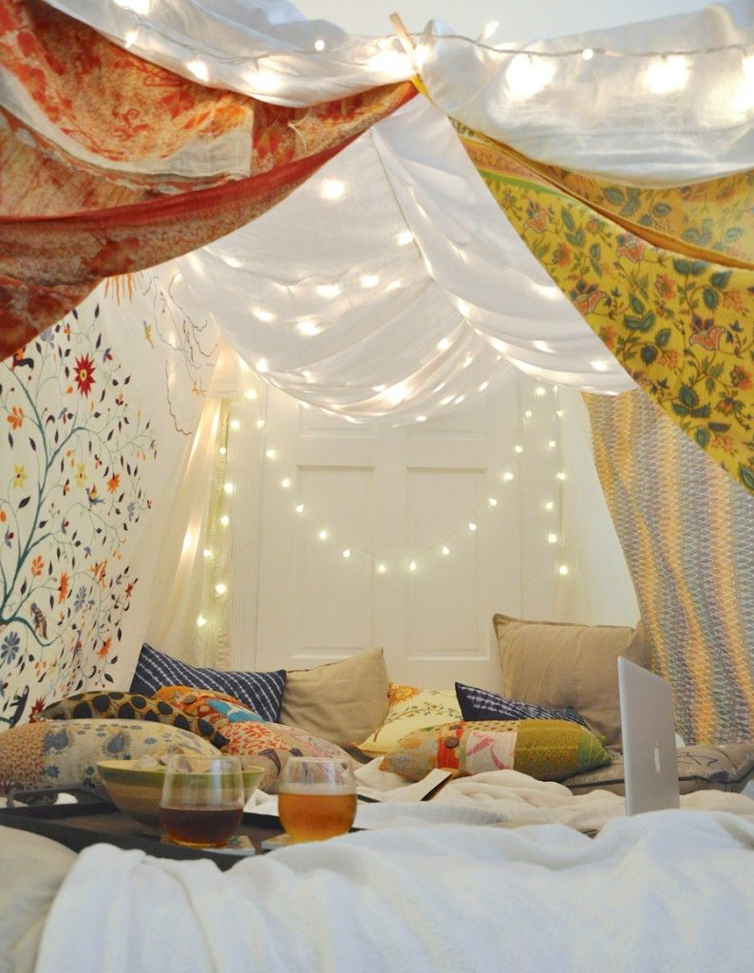
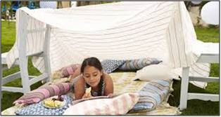
Have a go - building a camp. Inside or outside, add some lighting if you can.
What you need ideas:
blanket
bed sheet
string
clothes pegs
fairy lights
torch
glo sticks
Pillows/cushions
and of course...
biscuits!

Slide 18
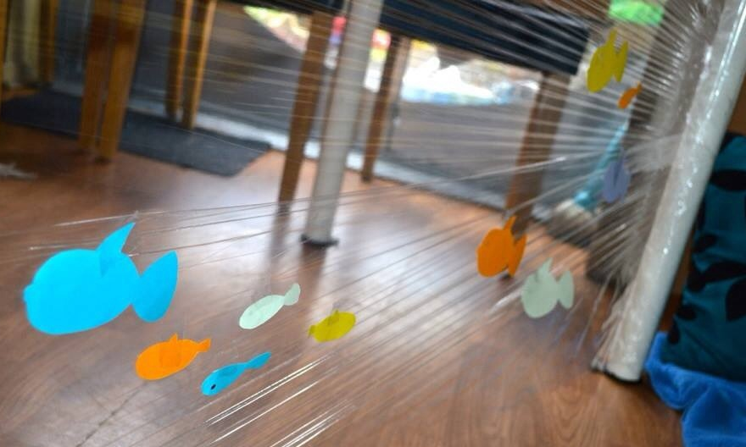
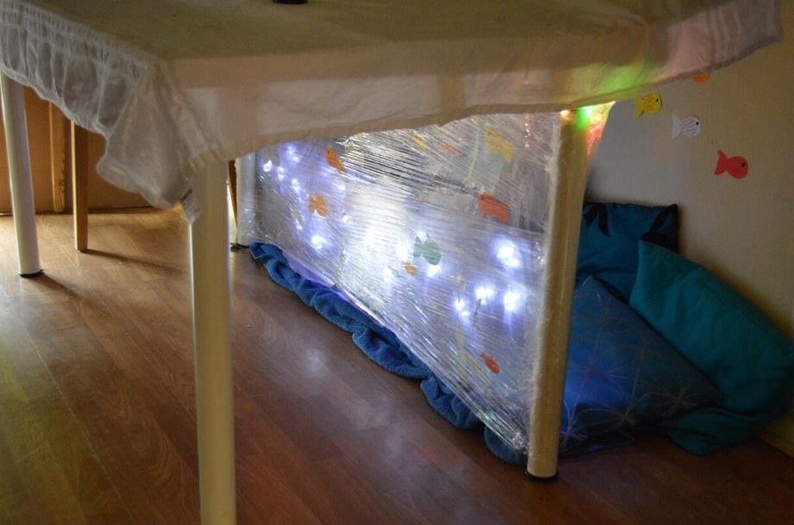
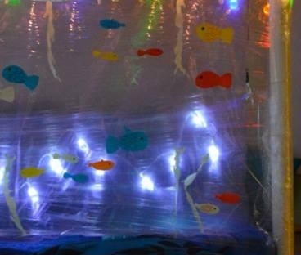
Have a go - building a camp. Inside or outside, add some lighting if you can.
What You Need - Under Table Ocean Den
coloured paper/card
felt tip pens to decorate the paper fish
cling film
sticky tape
blue towel/sheet/table cloth for the ocean floor
cushions (blue or green, if possible)
fairy lights (battery operated?)
big table cloth to go over the top

Slide 19
Project Planning Sheet: [You can also use your yellow workbook.]
Complete this Project Plan to help get organised!
Focus: Building planning skills. [Just brief notes – not sentences]
Finally: Special final touches
Next: List the things you need.
Then: Any problems to fix.
Quick planning sketch [useful if others are going to help you]:
First: - Where will you build?

Slide 20
Project Evaluation: My Den [You can use your yellow workbook.]
______________________________________________________________________________________________________________________________________________________________________________________________________________________________________________________________________________________________________________________________________________________________________________________________________________________________________________________________________________________________________________________________________________________________________________________________________________________________________________________________________________________________________________________________________________________________________________________________________________________________________________________________________________________________________________________________________________________________________________________________________________________________________________________________________________________________________________________
You need to think about: Was it easy to find the things you needed? Did you have any problems
to over-come? Did it turn out the way you’d planned? How do you feel when you’re inside the den ?

