Slide 1
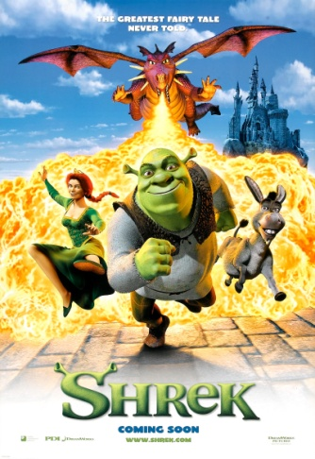

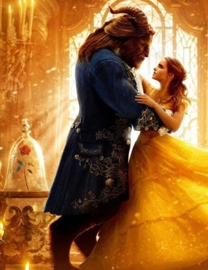
Ready to Write: Writing an original Story – Set in a Castle
Storytelling Task:
This work is to help build your skills and confidence planning and then writing an original story.
Remember: Use your research to make your story feel true even if it is full of fantastic ideas!
Watch and talk about either the video clips or films/stories you have at home.
Planning: Choose a castle, decide on 2 or 3 main characters and then the order of events in your story. [see slide 3]
Ready to write: Write a short story set in a castle.
Think: What genre of story will it be?
adventure, action, gothic terror, modern horror or maybe a romance or fairytale.
Will the characters be heroes or villains?
royalty, dragon, witch, vampire OR in the style
of Frankenstein + Macbeth, a human whose
ambition leads them to make a fatal error...
Key Words:
character = a person, animal, creature or animated object in a story.
genre = a specific type of music, film or writing eg rap, rock or horror, romance
setting = a place where a story happens
narrative writing = tells a story. The 5 key elements are plot, setting, character, conflict and theme.
[NB. A skill you need for GCSE English .]

Slide 2
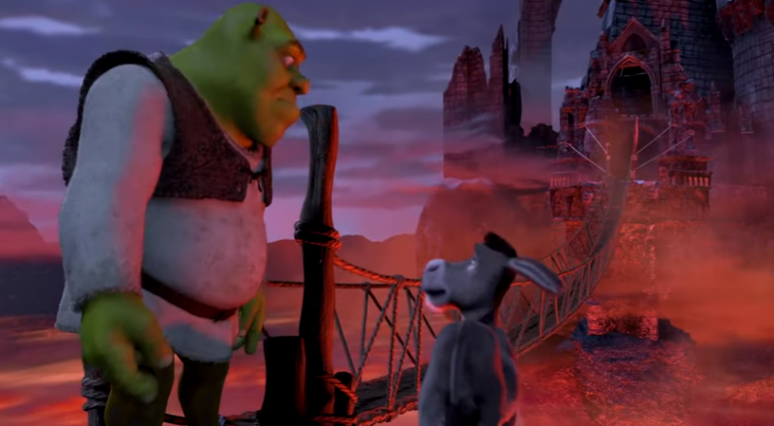
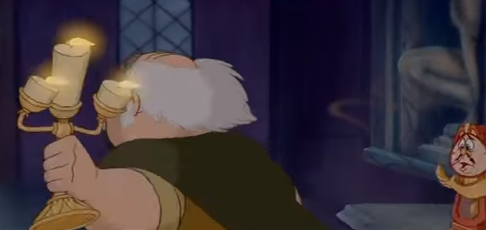
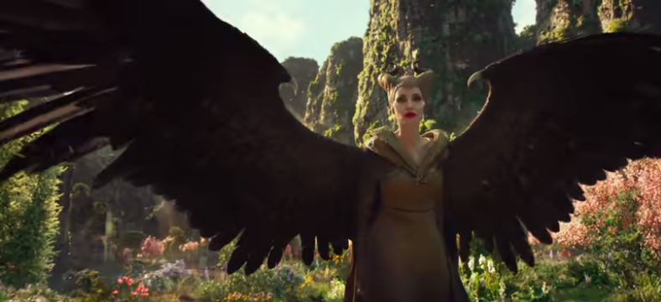
Characters and what might happen?
Watch these clips OR re-watch your favourite films, T.V. Programmes or stories.
THINK
Who will be in your story? hero, villain – or a human whose grand plans go horribly wrong.
What will happen in your story? moments of tension and danger for your characters; moments of romance or comedy ? Whose side are you on – is the ‘baddie’ really bad?
Shrek - Entering the Princess Fiona’s castle
https://www.youtube.com/watch?v=Za2QkHEAE9Q
Shrek - The highest room in tallest tower
https://www.youtube.com/watch?v=iropsnsCEjA
Beauty and the Beast – Who lives here?
https://www.youtube.com/watch?v=i3Kh61bNpgA
Malificent - Whose side are you on?
https://www.youtube.com/watch?v=n0OFH4xpPr4
Please Note: I haven’t included anything scary here to avoid upsetting anyone, mostly me! - Do watch your own if this is the genre you want to choose.

Slide 3
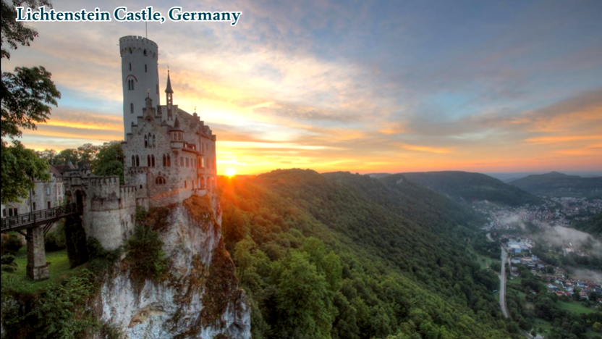
Story Title: ___________________________________________________
Task A: Talk your ideas through then complete your plan Focus: Building story planning skills. [Just brief notes – not sentences]
1. Introduce where:
2. Introduce when:
4. First Event:
3. Introduce the main character(s) in your story:
5. Next – leading to the most exciting bit :
6. Finally – the climax to the story and ending:

Slide 4
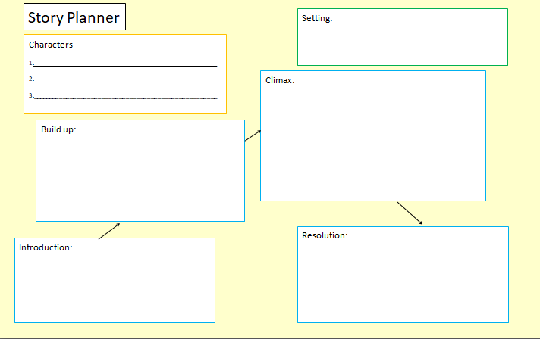
Either use this planning sheet or create your own in your workbook. Notes are words and phrases NOT full sentences.

Slide 5
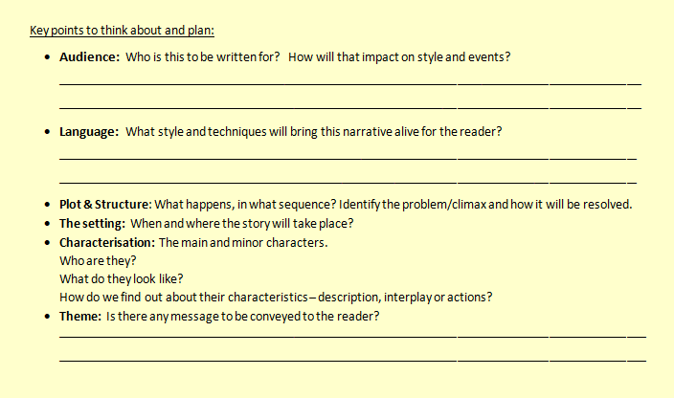
Higher Challenge: Don’t worry if this feels like a bit too much – leave this page for now and enjoy your writing! Some of you might find this helpful to really think your idea through in greater depth.

Slide 6
Key Terms to try and learn: There are lots of others but these are the main ones to focus on.
noun = naming words eg table, chair, pencil, cat, dog
verb = doing word eg the boy crept along the corridor
adjective = describing word eg the corridor was dark and spooky.
adverb = tells you more about the verb eg the boy crept quietly.
punctuation = . , ? ! ‘ we need this to help the reader understand.
. = full stop used at the end of a sentence
, = comma used for listing in a sentence eg She bought jam, butter and bread.
? = question mark used when you are asking a question eg How much?
! = exclamation mark when you are saying something more loudly eg. excited, shocked ,surprised.
isn’t = apostrophe used when we shorten a word eg isn’t - is not , I am - I’m
tense = when something happened, past, present or will happen in the future.
eg. past – ran, present – run(s), future – will run
Higher Challenge: Have a go at using some GCSE descriptive language writing techniques this week to really bring your story alive!
simile – compares one thing with another, usually using ‘as’ or ‘like’.
eg. The trees stood as tall as towers.
onomatopoeia – words that sound a little like their meaning.
eg. The autumn leaves cracked and crunched underfoot.
alliteration – the same letter or sound at the beginning of words that are next to or closely
connected. eg. The birds sang sweetly in the still and silent morning air.
emotive language – language intended to create an emotional response [think stories in the news].
eg. A heart-breaking feeling of sorrow filled his heart as he surveyed the devastation and
destruction all around them.

