Slide 1
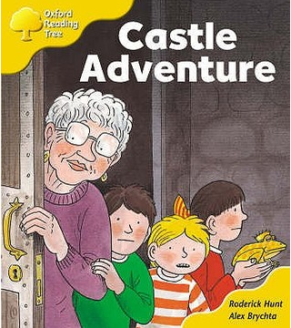
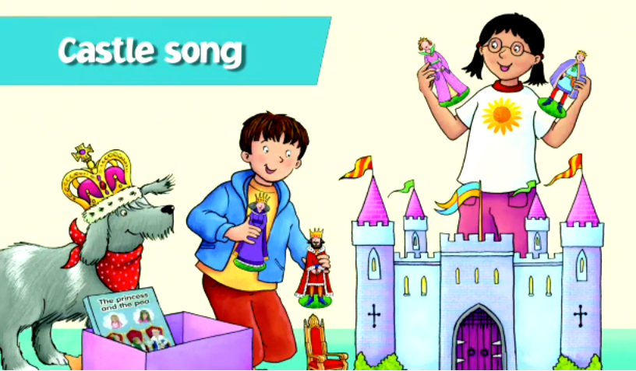
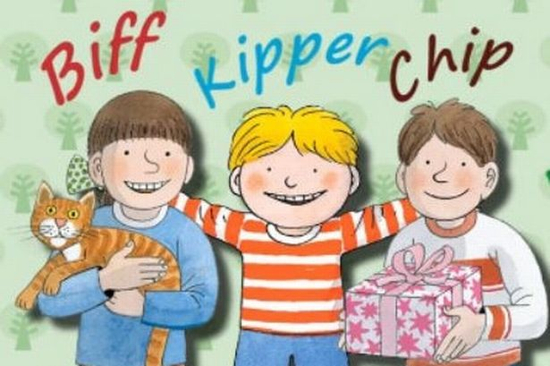
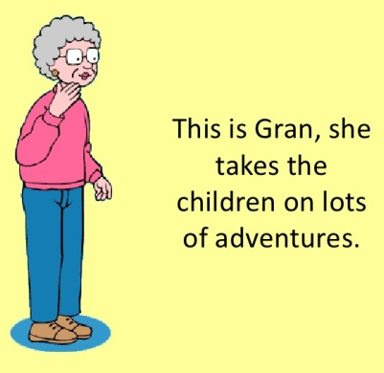
Castle Adventure Oxford Reading Tree
https://www.youtube.com/watch?v=QR3LCRmgxMQ
Before Reading:
First: Briefly look through all the slides.
Ask who they can see on the front cover.
Ask what they know about castles.
[Make a link to the Castle Song. What do castles
look like? Who lives in a castle?]
Ask what they know about witches?
Challenge Word: ‘Adventure’ – what does it mean?
Next: Now you are ready to listen along and/or read and talk about the story.
Gran
adventure = an exciting trip

Slide 2
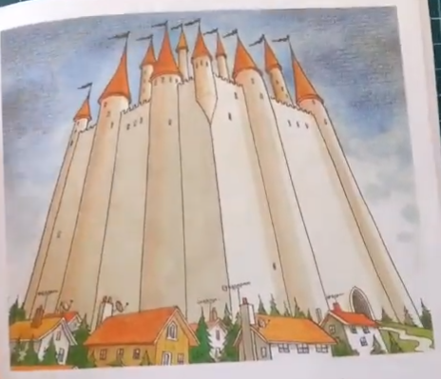
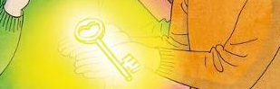
The magic key glowed.
Where will they go this time!
The magic took them to a castle.

Slide 3
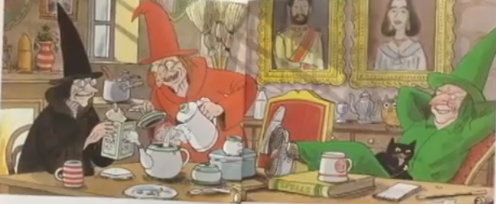
Three witches lived in the castle. They were nasty witches.
One was a black witch. One was a red witch. One was a green witch.
Look carefully. What are the witches doing? What does ‘nasty’ mean?

Slide 4
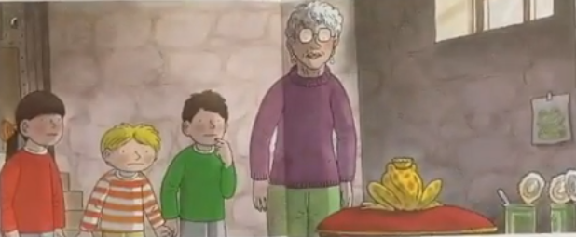
The magic took the children inside the castle. It took them to a room.
A frog was in the room.
“I am a king,” said the frog. “I am the king of this castle.”
Look carefully. What is the frog wearing? Is he telling the truth? Is he really a king?

Slide 5
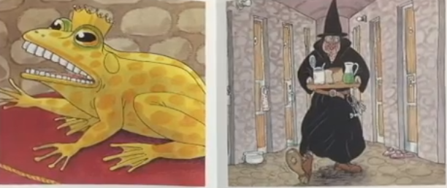
“The witches turned me into a frog. Help me,” he said.
A witch was coming. It was the black witch.
“Look out!” said the frog.
“Look out!” said the frog. Look around your room. Where could you hide?

Slide 6
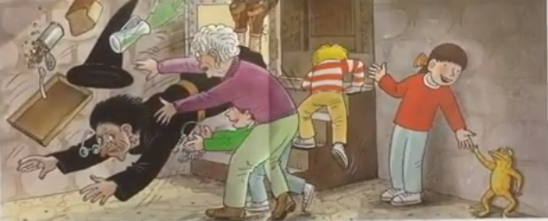
The witch opened the door. Gran pushed the witch. Chip took the witch’s keys.
They ran out of the room. Chip locked the door. The witch couldn’t get out.
Lots of action words in this bit of the story. Spot these words happening in the picture.

Slide 7
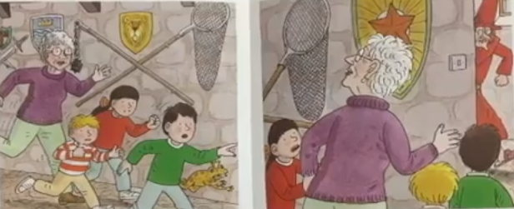
Everyone ran.
“Look out!” called Chip.
A witch was coming. It was the red witch.
Can you see the red witch? Look around the room. Where could you hide this time!

Slide 8
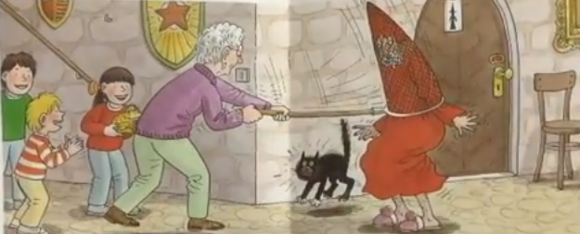
“I don’t like witches,” said Gran. She put a net over the witch.
The witch couldn’t get out.
“Good old Gran,” called Biff.
What is a net? What do we use a net for? Where did Gran get the net from? Do you think Gran is brave? Why? Would you be as brave as Gran?

Slide 9
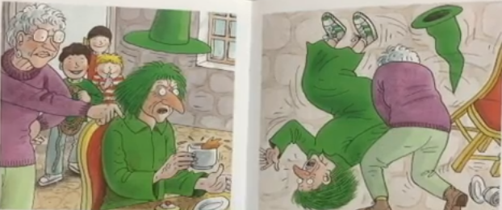
Gran went to the green witch.
“I don’t like witches,” said Gran. “I don’t like nasty witches.”
Gran threw the witch on the floor.
“Help!” yelled the witch
“Good old Gran,” said the children.

Slide 10
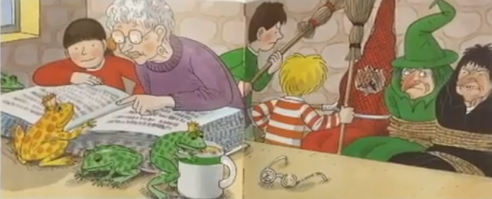
Some frogs came in and jumped on the table. One was the king.
“Help us,” he said.
Biff and Gran looked in the witches book.
How many frogs can you see? Which frog is the king? Who do you know this?

Slide 11
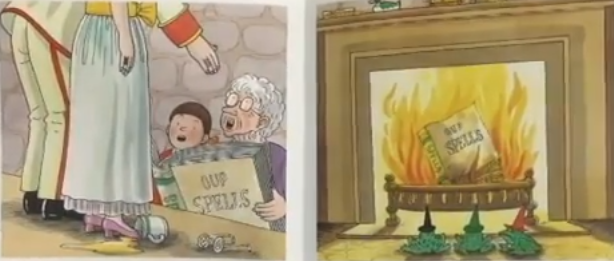
The frogs turned into people.
“Thanks!” said the king.
The witches turned into frogs. Gran put the book on the fire.
“Oh no!” said the witches.
What happened to the frogs? What happened to the witches?
Tricky Question: Why did Gran put the spell book on the fire?

Slide 12
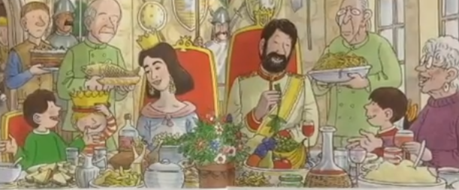
The king had a party. Everyone went to it.
“What a good party!” said Chip.
“What an adventure!” said Biff.
“I like adventures,” said Gran.
“Good old Gran!” said everyone.
What food can you see? What food do you like at your party?

Slide 13
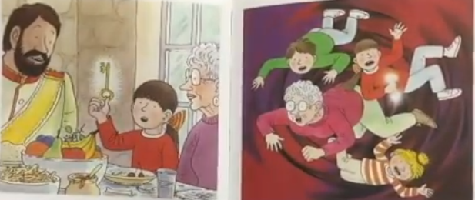
The magic key was glowing.
“It’s time to go,” said Biff.
“Goodbye,” said the king.
The magic took them back to Biff’s room.
Point to Biff, Chip, Kipper and Gran. Can you pretend you are ‘falling’ too? [Do it very, very slowly – move your arms and legs like the picture.]

Slide 14
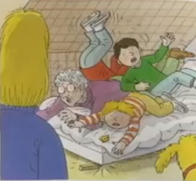
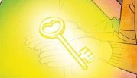
After Reading:
Understanding:
Read and/or talk about your
favourite part of the story.
Look at all the detail in the
picture to help you.
What do you think will happen
next? Do you think Gran told
Mum about the adventure?
Creative Ideas:
If you had a magic key, where would you like it to take you?
Ask someone to help to you: Write down your idea OR act it out. Draw a picture and write a caption to help you remember your adventure.
They fell on to Biff’s bed.
“Oh no!” said Mum.
Look at the picture carefully.
Why do you think Mum say ‘Oh no!”
caption = a sentence to go with a picture.

