Slide 2
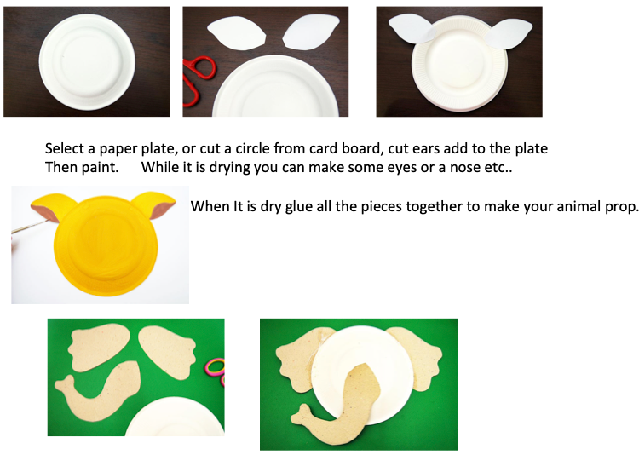

Slide 3
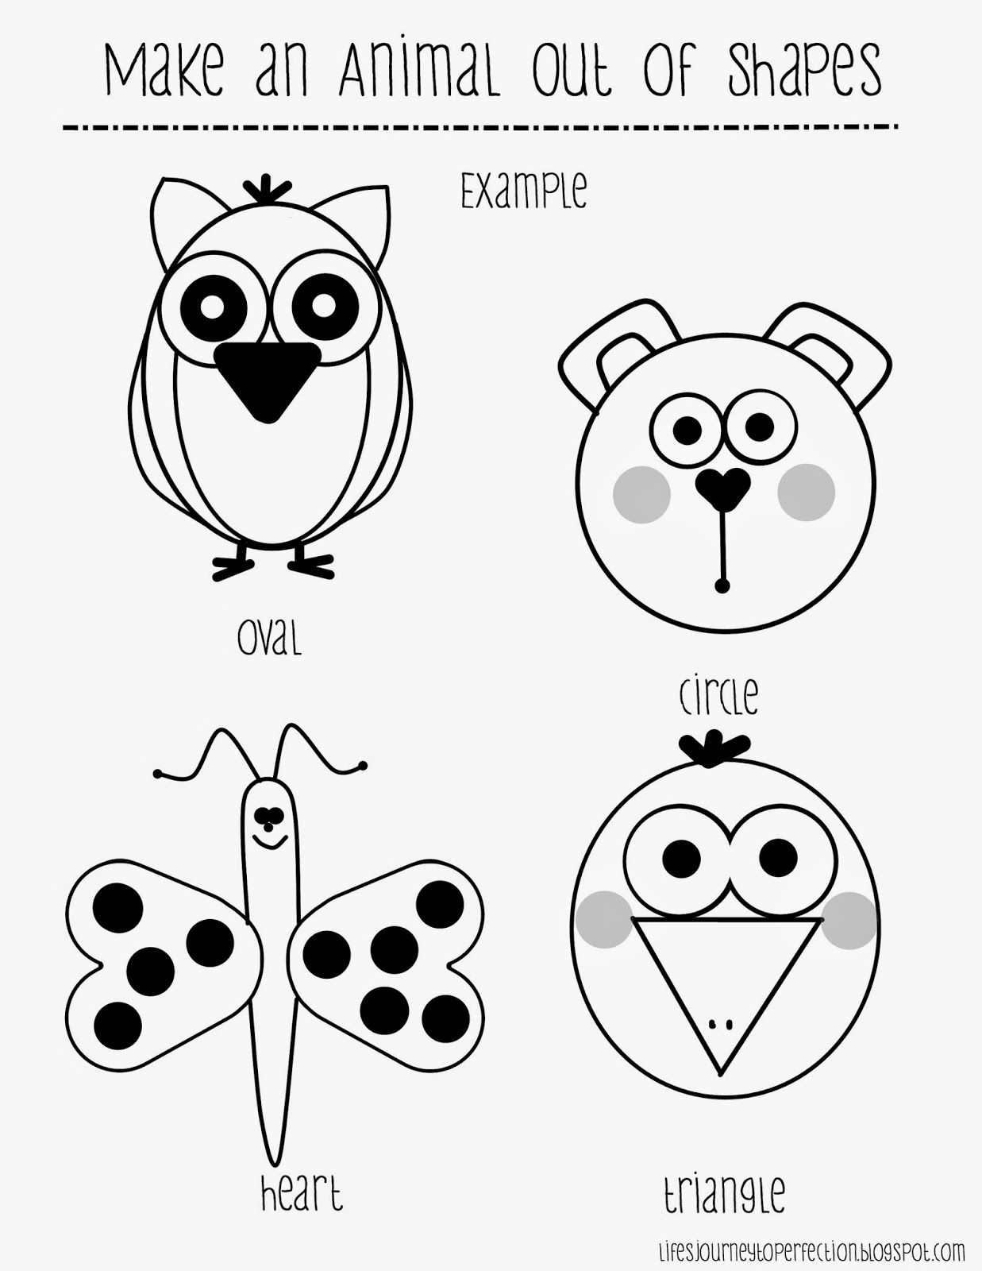
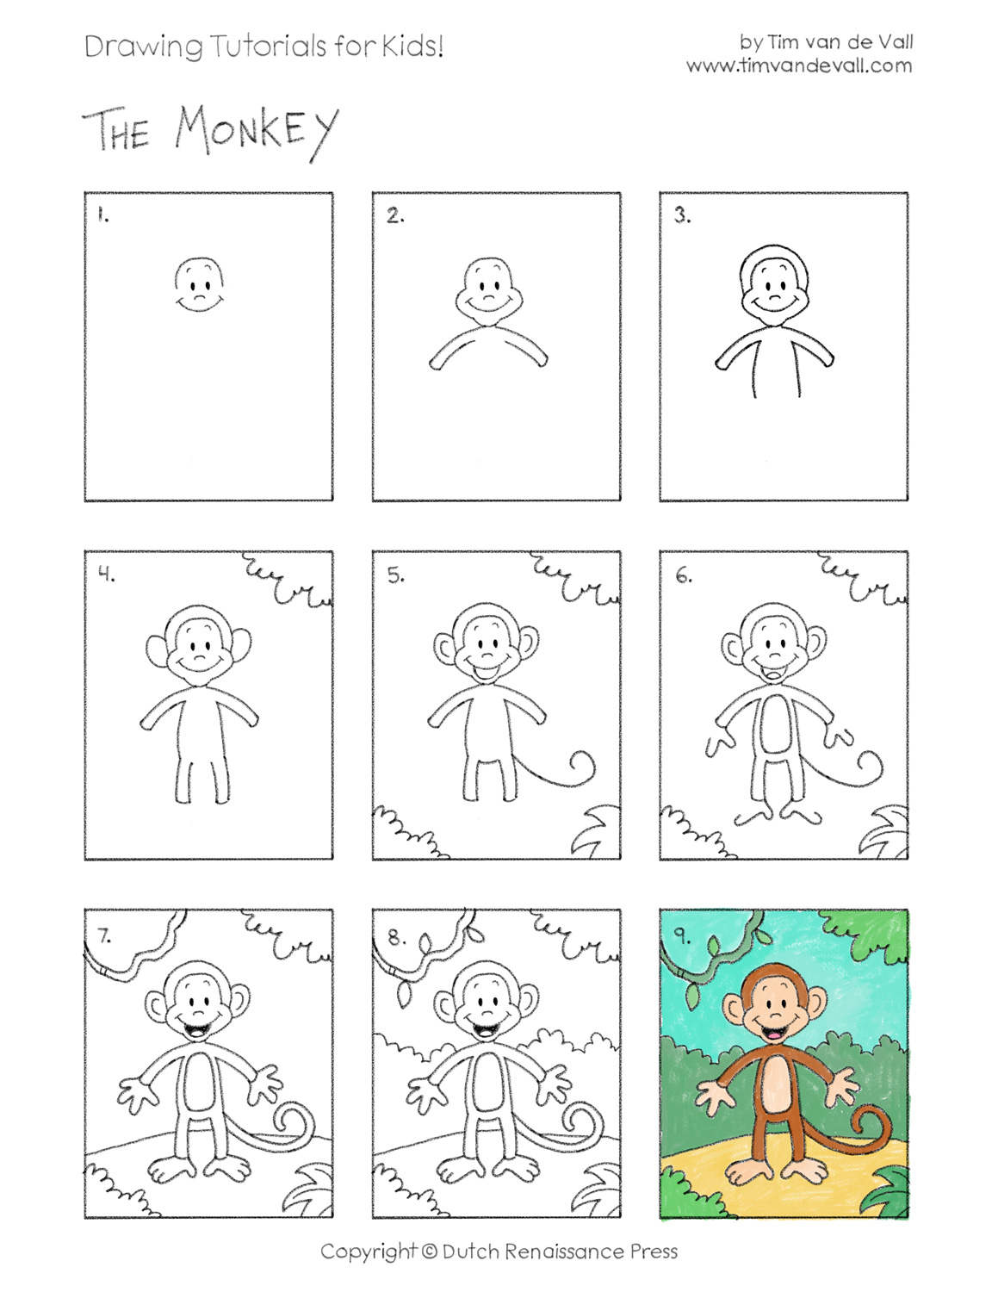

Slide 4
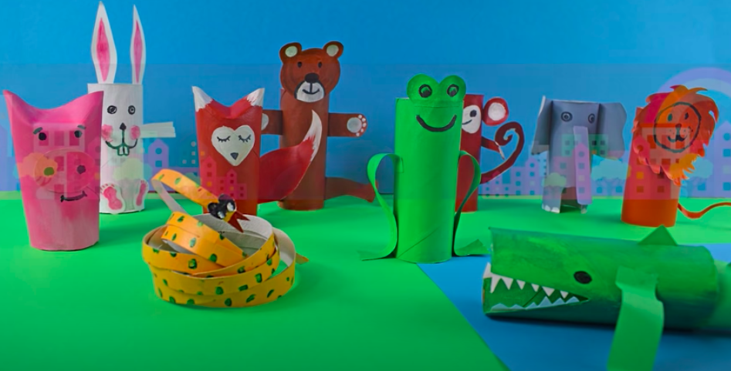
Slides for Green Theme Week-Arts Making an animal kingdom
Look at the pictures try and and work out how these have been made, can you make animals using recycled materials? Try and make at least 3 animals to make an animal kingdom.
Don’t forget to microwave toilet rolls before using them!

Slide 5
