Slide 1
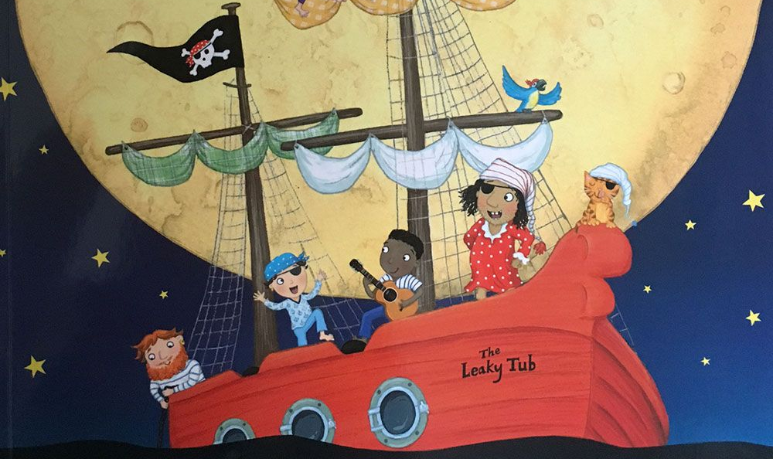
Becoming a Pirate!: Home is now your Pirate Ship!
Yo ho ho me hearties! Ready to become a pirate? Let’s get started!
First: What do pirates wear?
- make a dressing-up costume
- draw, take a photo or colour in
- do you have a new pirate name?
[slides 2- 5]
Then: Talk like a pirate!
- say/talk about the pirate words.
- write out 3 you are all going to
use this week.
[slides 6-7]
Finally: Pirate Ship Jobs
- talk about the jobs the pirates
do in the story
- talk about jobs in your house
- take part in the Good Pirate
Challenge
[slides 8-11]
Note for Parents:
Learning Focus: This week the aim is to have fun and learn through imaginative play.
Your child should be encouraged to make links between events in the story to build a greater understanding of their world.
what we wear – noticing detail, building fine/ gross motor skills.
words we use – every day words/phrases
being helpful – we all need to be good ‘ship mates’ and work together at home/school.
NB. Try and get everyone in the family to join in!

Slide 2
Becoming a Pirate: What do pirates wear?
Look at pictures of the pirates from our story. What clothes are they wearing?

Slide 3
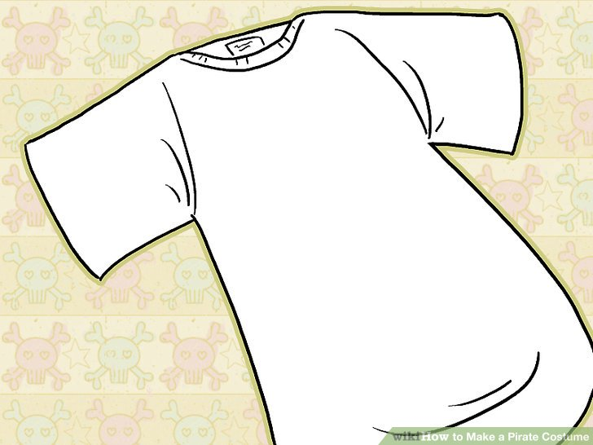
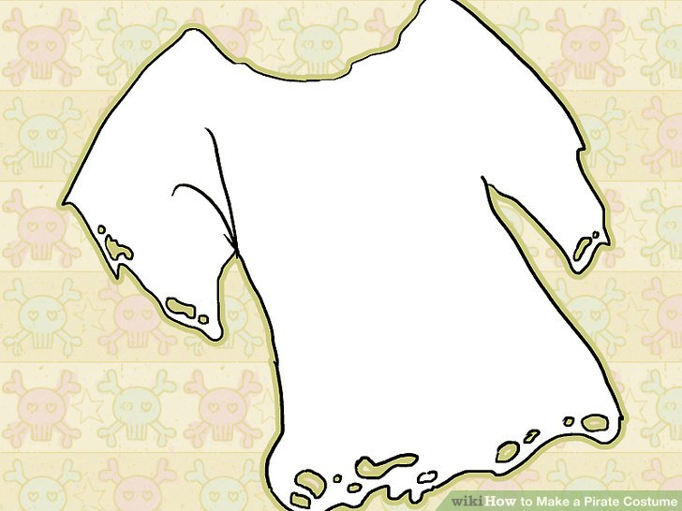
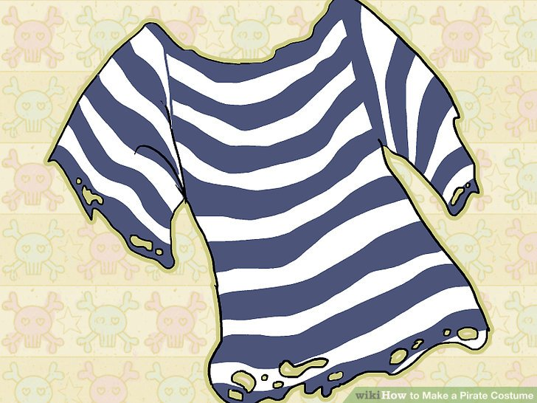
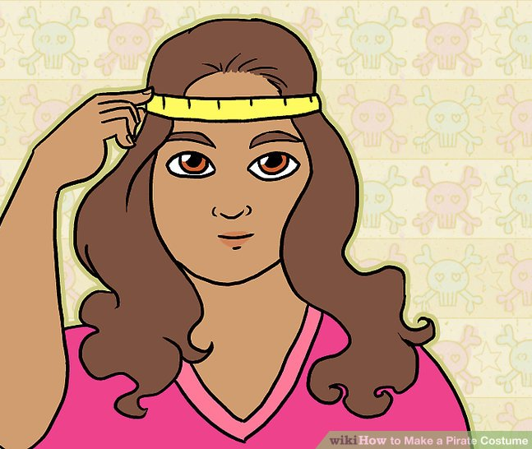
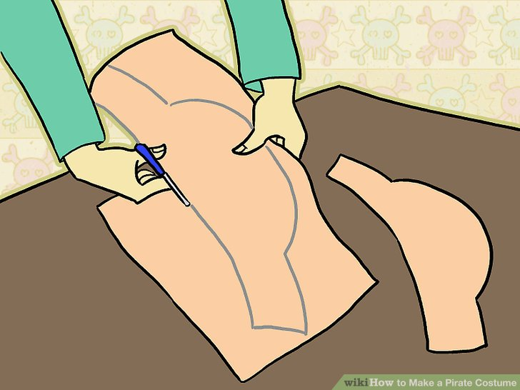
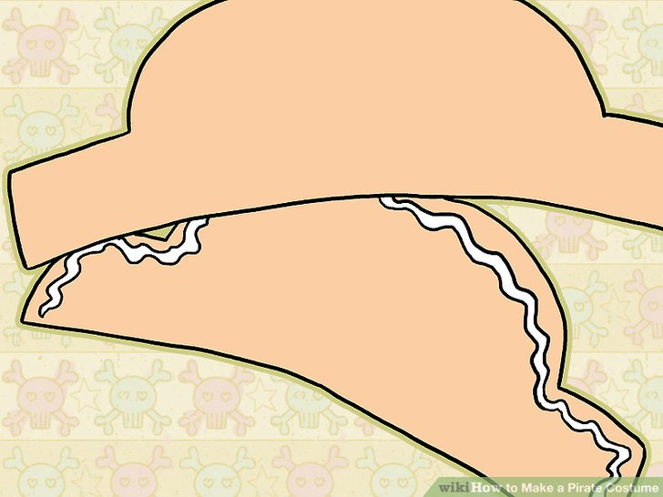
Becoming a Pirate: Dress-up Like a Pirate
Get an old t-shirt and make it look older; paint or mark on some stripes.
Pirate Hat
Make a pirate hat: measure, cut, stick then paint OR
use some material to tie into a pirate bandana.

Slide 4
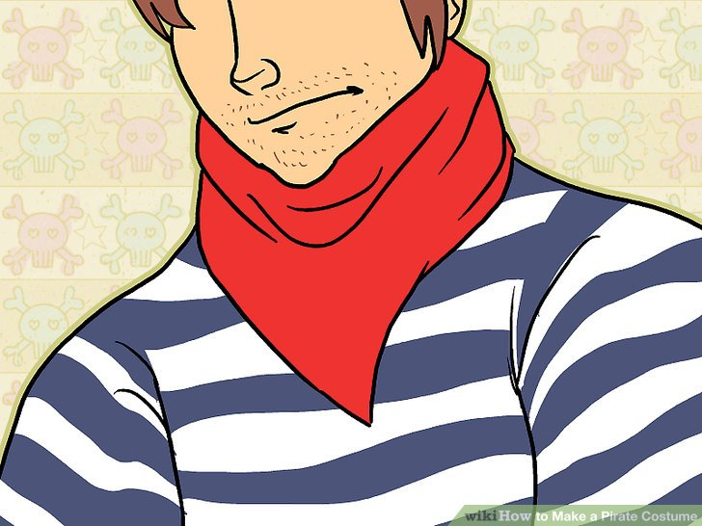
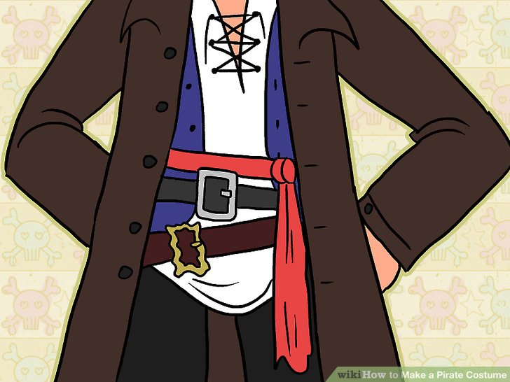
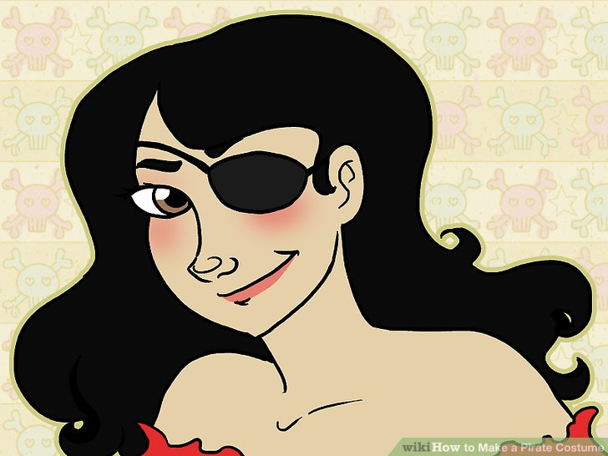
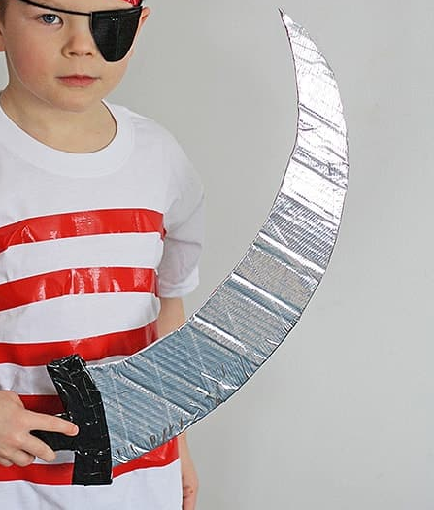
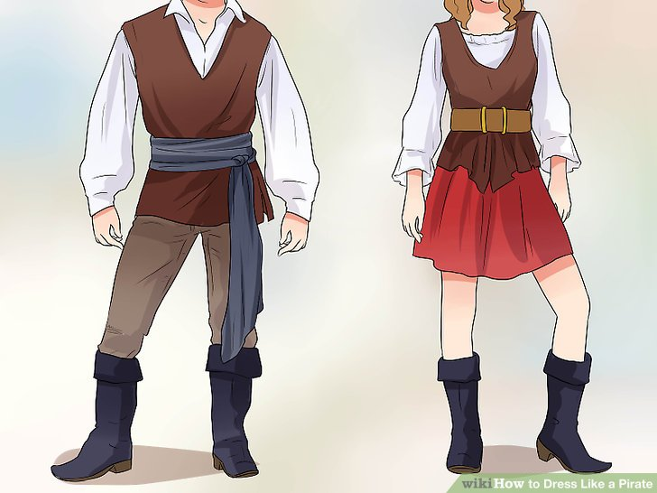
Becoming a Pirate: Dress-up Like a Pirate
Maybe add a bandana, belts or material to make a sash or eye patch .
Use cardboard to make a sword or kitchen/toilet roll for a telescope.

Slide 5
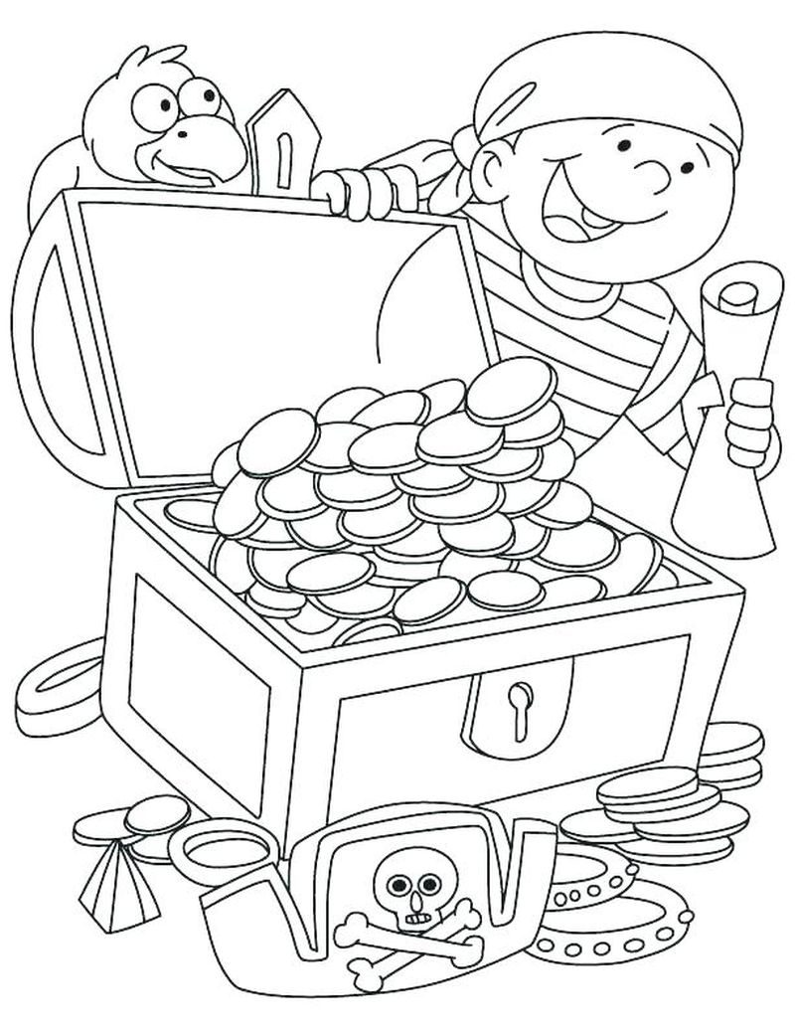
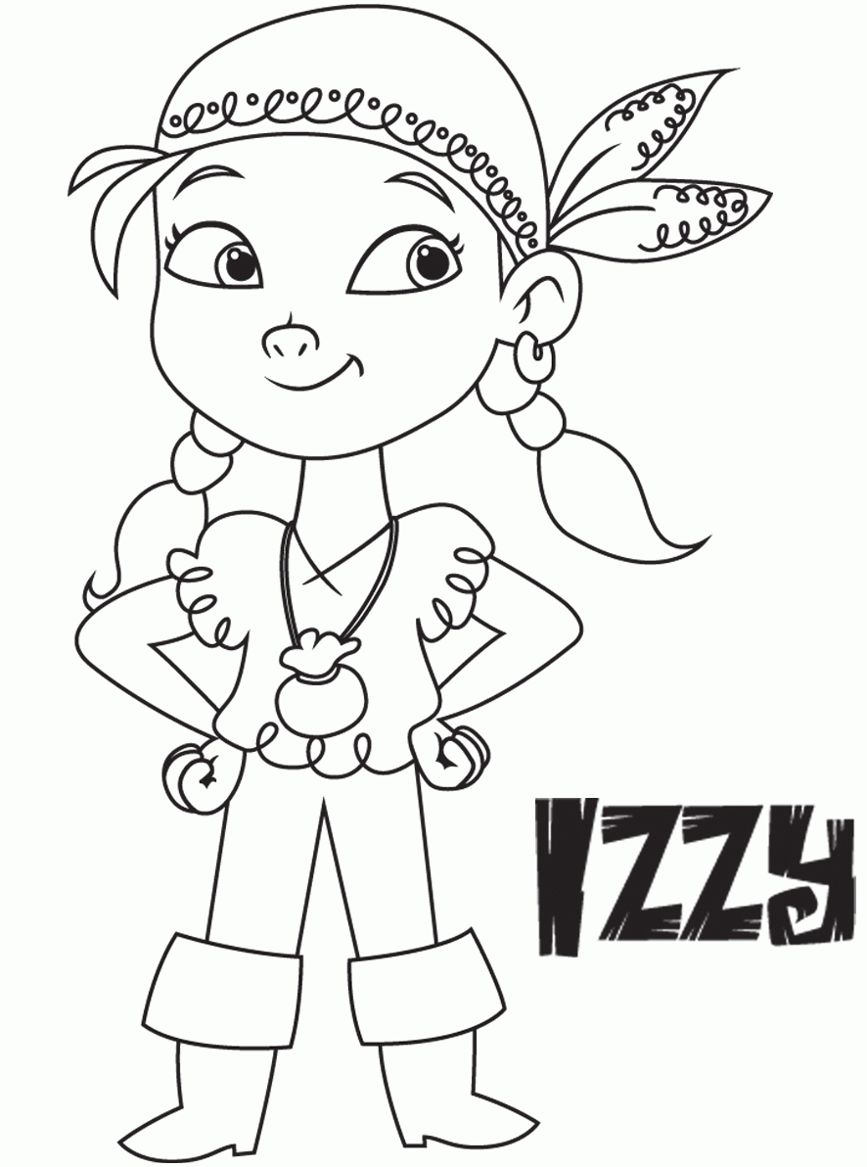
Becoming a Pirate: Draw, colour or take a photo of you as a pirate. Add it to your yellow workbook.
What is your new pirate name?

Slide 6
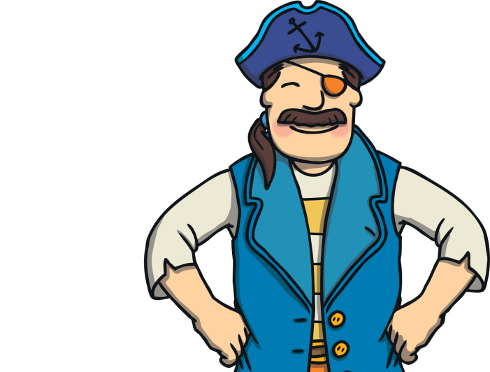
Becoming a Pirate: Talk like a pirate!
- Say these words [in your pirate voice of course!]
- What do they mean?
ahoy matey!
shiver me timbers!
= hello friend
= I’m surprised!
Aye, aye captain!
up to the crow’s nest
= yes, yes I’ll do it!
= quick, go and look!
batten down the hatches!
yo ho ho!
= bad weather is coming
= a cheery way to get someone’s attention
galley
= the kitchen
swab the decks!
cabin
bunk
= your bedroom
climb the rigging
= mop the floor
= your bed
= go upstairs

Slide 7
Becoming a Pirate: Talk like a pirate!
- Choose 3 pirate words to say this week.
- Write them out carefully.
___________________
___________________
___________________
___________________
___________________
___________________
______________________________________________
______________________________________________

Slide 8
Becoming a Pirate: Pirate Ship Jobs
- What jobs are the pirates doing?
- Does someone do that job at home? Who?

Slide 9
Becoming a Pirate: Pirate Ship Jobs
- What jobs are the pirates doing?
- Does someone do that job at home? Who?

Slide 10
The Good Pirate Challenge
- Do as many jobs as you can this week.
- X every time you do – you might find treasure!
Job |  | 1 | 2 | 3 | 4 | 5 | 6 | 7
 | swab the decks = clean the floor
 | polish the port holes = clean the windows
 | clean the cannon = clean the car
 | scrub the washing = help with the washing

Slide 11
Job |  | 1 | 2 | 3 | 4 | 5 | 6 | 7
 | count the treasure = count money or other special things
 | cabin to tidy down = tidy your bedroom
 | supper to serve = help get food ready for everyone
 | quiet in the bunk = go to bed on time + go to sleep
How did you do?: Pirate Ship Jobs
- add up how many ‘X’ you got this week.
- how does helping make you feel?

