Slide 1
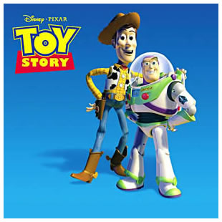
LO: Identify and describe the main characters
Use adjectives to describe a new character

Slide 2
Identify and Describe
Watch the film and think about the characters:
Personality...Are they friendly? Are they mean? Are they bossy? Are they brave?
Looks...what are they wearing? Are they tall/short? Are they young/old?
Speech...what do they say? Is their voice high or low? Do they speak quickly or slowly?

Slide 3
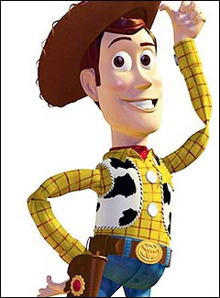
Woody

Slide 4
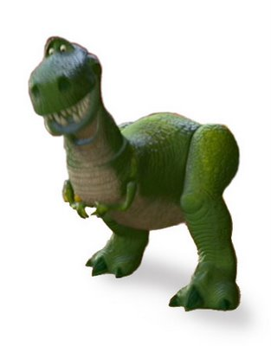
Rex

Slide 5
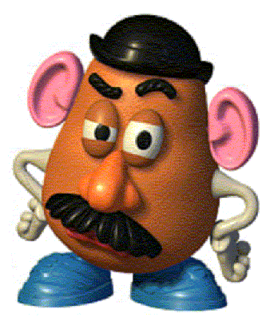
Mr Potato Head

Slide 6
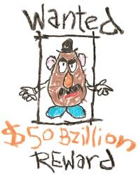
LO: Design a wanted poster for your own toy

Slide 7
Your turn....
Imagine that your favourite toy comes alive when you leave the room....
Have a chat to the person next to you pretending to be your toy....
What would they say? How do they sound?

Slide 8
Extension:
Use adjectives to describe your toy’s personality
Describe their clothes, how do they look?
Write down things your toy might say

