Slide 1
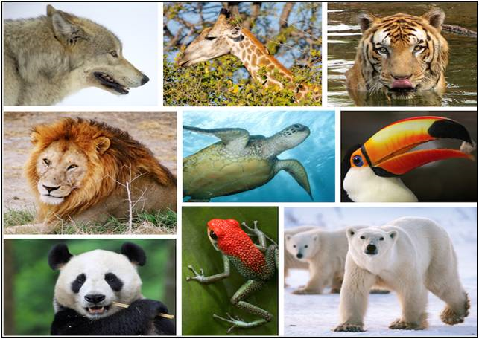
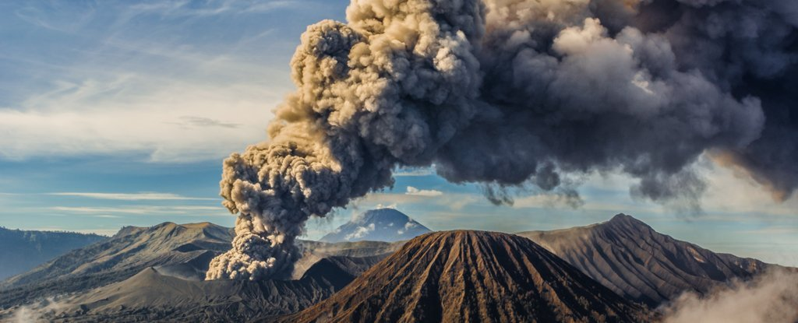
Theme: Leisure – Research
First: Think about content + presentation
look at some examples
Focus: How is information presented to make it
easier to understand. Who is the ‘audience’
Next: Personal Research
Mind Map a Favourite Topic
Focus: What do you know? Identify areas for
further research. Make clear notes, collect
images OR draw your own illustrations
[DO NOT CUT AND PASTE]
Finally: Writing Your Research Project
Focus: audience, format, style, content.
illustrations/images, index, key word glossary
Key Words:
audience = who you want to read this
format = how writing is set out on the page
style = word/language choices linked to the purpose of the text and intended audience
content = what information is included

Slide 2
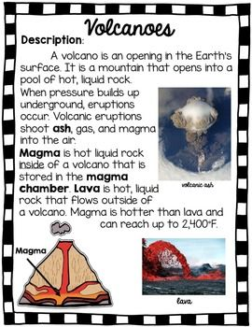
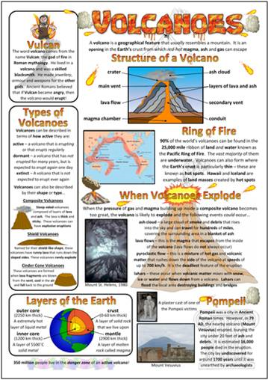
Presentation techniques to help the reader: What worked well?
border text boxes
heading sub-headings
illustrations diagrams photos
different texts fonts, size, colour

Slide 3
Presentation techniques to help the reader: Make notes on techniques you might use.

Slide 4
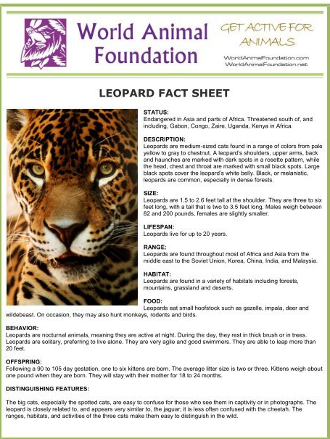
Look at the next two slides -
What do you think of the writer’s decisions? WWW + EBI?
How is the information presented to help the reader? [format]
Does it include the information you wanted? [content]
Could it be more entertaining? [style – matched to the ‘audience’]
Should there be more photos or illustrations? [content - help understanding of key information + look interesting to the reader]
Should there be more colour? [presentation – linked to audience]
What would you change?

Slide 5
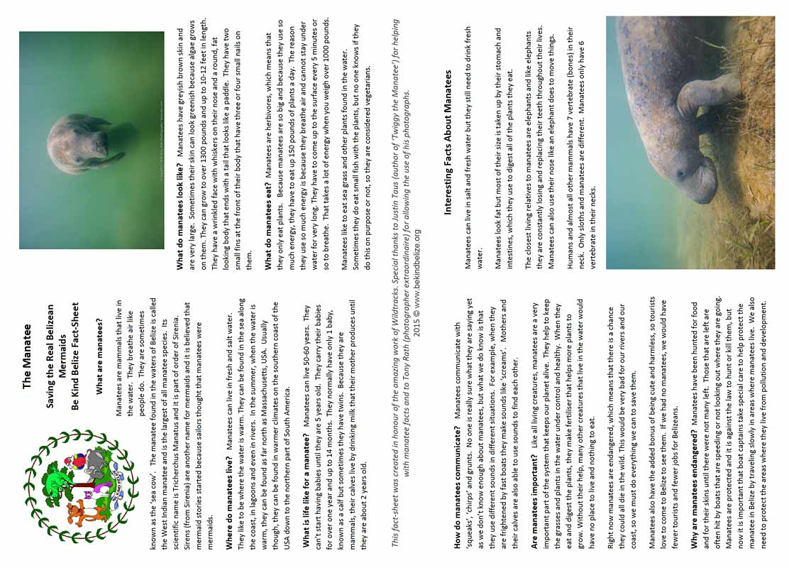

Slide 6
Mind Map
Ideas for topics to research
Ideas: Solar system, space travel or sci-Fi films
Favourite animals, mammals, fish, birds, reptiles
Sports or sports stars, key people or events in history
Inventors, scientists, artists or art movements etc.

Slide 7
Mind Map the topic you chose to research

Slide 8
Making Notes: Research [You can use your yellow workbook.]
You need to think about: Reflect on your mind map, then your decision about who the audience will
be. What do you think they would like to find out more about?
______________________________________________________________________________________________________________________________________________________________________________________________________________________________________________________________________________________________________________________________________________________________________________________________________________________________________________________________________________________________________________________________________________________________________________________________________________________________________________________________________________________________________________________________________________________________________________________________________________________________________________________________________________________________________________________________________________________________________________________________________________________________________________________________________________________________________________________

Slide 9
research notes continued [You can use your yellow workbook.]
Remember notes are short phrases – key facts and information, diagrams, illustrations, photos
______________________________________________________________________________________________________________________________________________________________________________________________________________________________________________________________________________________________________________________________________________________________________________________________________________________________________________________________________________________________________________________________________________________________________________________________________________________________________________________________________________________________________________________________________________________________________________________________________________________________________________________________________________________________________________________________________________________________________________________________________________________________________________________________________________________________________________________

Slide 10
research notes continued [You can use your yellow workbook.]
Add diagrams, illustrations, photos to help get key information across.

