Slide 1
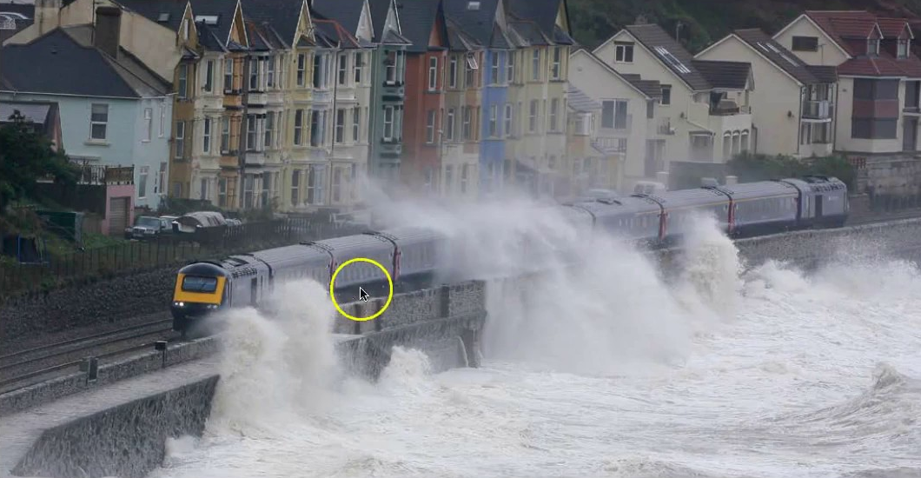
Longer Writing Task: Developing Descriptive Writing Skills
Finally: Longer Writing Task [linked to GCSE]:
This work is to help build your skills and confidence responding to higher level Writing tasks. Focus: Style + descriptive language
Task: Write a description suggested by this picture.
Use to photograph to help you plan
Write
Check your work
Plan THEN Write
Top Tip:
Interesting description - If you’re describing place
or a scene, make sure you think about all five senses.
Describe what things smell, task, feel or sound like. This
will being your writing to life!
Vary your word choices – if you’ve used ‘beautiful’,
find another word that means the same.
Add extra information why – ‘because’ ...
Use imagery – paint pictures with words [see
descriptive writing terms inc. simile, personification]
GCSE Question 5:
Q.5 Description Narrative Writing Use a source to create a piece of original writing.
Key Skills:
This can be a story-writing or descriptive writing task. You get the choice of two options – we are going to practise the descriptive writing task.
[40 marks]
16 marks - technical accuracy ie spelling, punctuation + grammar.
24 marks – content + imagination
Timing: 45 mins. + 25% = 60 mins.
Use 5 mins.to plan – 5 mins. to check.

Slide 2
Top Tip: Set the atmosphere of the scene at the start. mind map what you could write about THEN number in order e.g. the houses, the train, the passengers, the sea. Use writer’s techniques – show off what you can do! – this is a great photo for personification.
Don’t get too focused on just describing what you can see in the photo, use this as a starting point.

Slide 3
Descriptive Writing Task:
____________________________________________________________________________________________________________________________________________________________________________________________________________________________________________________________________________________________________________________________________________________________________________________________________________________________________________________________________________________________________________________________________________________________________________________________________________________________________________________________________________________________________________________________________________________________________________________________________________________________________________________________________________________________________________________________________________________________________________________________________________________________________________________________________________________________________________________________________________________________________________________________________________________________________________________________________________________________________________________________________________________________________________________________________________________________
Top Tip: You are describing what is happening in 5 seconds of time – NOT a narrative...

Slide 4
Descriptive Writing Task continued...
________________________________________________________________________________________________________________________________________________________________________________________________________________________________________________________________________________________________________________________________________________________________________________________________________________________________________________________________________________________________________________________________________________________________________________________________________________________________________________________________________________________________________________________________________________________________________________________________________________________________________________________________________________________________________________________________________________________________________________________________________________________________________________________________________________________________________________________________________________________________________________________________________________________________________________________________________________________________________________________________________________________________________________________________________________________________________________________________________________________________________________________________________________________________________________________________________________________________

Slide 5
Quick Check: Commonly Used ENGLISH TERMS
proper nouns – name of a particular person, place or thing e.g. James Smith, London OR Star Wars, Treasure Island
common nouns – are the names we give things e.g. table, chair, hair, eyes, dog, cat, horse
adjectives – describe the noun e.g. She had long, black hair. The book he read about rivers was boring.
verbs – doing or action words e.g. running, crawling, walking, e.g. Jack always runs to school. Jane made a mess of her homework.
adverbs – describe a verb e.g. Jack quickly ate his breakfast. The boy played the drums loudly.
simile – describes something by comparing it to something else. TOP TIP: Uses the words ‘as’ or ‘like’ - e.g. She cried like a baby. He was as busy as a bee.
You will probably remember your teachers talking to you about these and encouraging you to use them in your work. You might have also come across onomatopoeia – Can you remember what that is? Look below to see if you are right.

Slide 6
Description is used because it helps readers engage with the world of the story, to feel like they are there. It can even create an emotional response. Here are some techniques and examples of how they can be used:
Technique | Examples
Simile - a descriptive technique that compares one thing with another, usually using 'as' or 'like'. alliteration - the same sound or sounds, especially consonants, at the beginning of several words that are close together: | The trees stood as tall as towers. "Round the rugged rocks the ragged rascal ran"
Metaphor - a descriptive technique that names a person, thing or action as something else. | The circus was a magnet for the children.
Hyperbole - a use of obvious exaggeration for rhetorical effect. | The sun scorched through the day.
Personification - a metaphor attributing human feelings to an object. | The sun smiled at the hills, ready to begin a new day.
Pathetic fallacy - a type of personification where emotions are given to a setting, an object or the weather. | The clouds crowded together suspiciously overhead as the sky darkened.
Onomatopoeia - words that sound a little like they mean. | The autumn leaves and twigs cracked and crunched underfoot.
Oxymoron - a phrase combining two or more contradictory terms. | There was a deafening silence
Emotive language - language intended to create an emotional response. | A heart-breaking aroma of death filled the air as he surveyed the devastation and destruction .

