Slide 1
Short Writing Task: Writing a Report on a Sporting Event
Short Creative Writing Task:
This work is to help build your skills and confidence using a text you have read to plan and then write a short report of a sporting event.
Choose either Horrid Henry OR Harry Potter. Re-watch video clips/look at photos and talk about key events.
Planning: Make brief notes of key descriptive words to use in your writing and 2 questions to ask either Harry or Horrid Henry. What would his answer be?
Ready to write: Write a report on what happened using descriptive language.
Extension Communication Games:
Watch the video clip of the best bits of Team GB London 2012 Olympic Games
Join in the HomeSchool Olympic Games
- link to PE tasks this week.
Key Words:
report = a spoken/written account of something that has happened.
descriptive language = words used to help your reader imagine.
interview = ask questions to find out answers
brief notes = ideas recorded in
single words or short phrases
paragraph = a section of writing

Slide 2
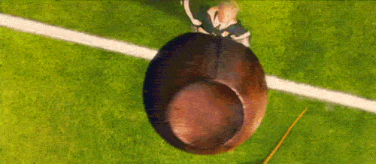
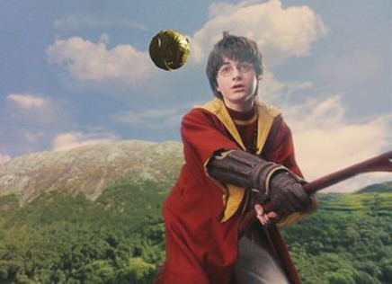
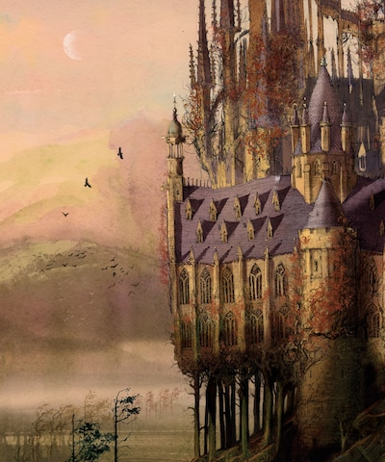
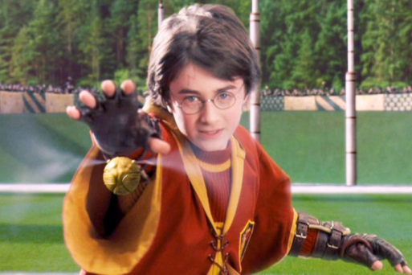
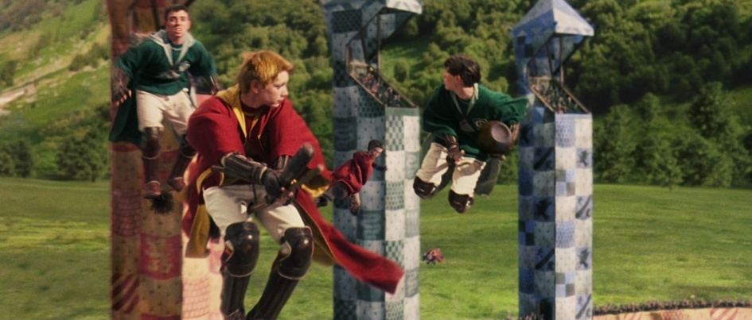

Slide 3
Report Writing Planning Sheet: [You can also use your yellow workbook.]
Talk your ideas through then complete your plan
Focus: Building planning skills. [Just brief notes – not sentences]
Finally:
Next:
Then:
H.H. Sports Day
OR
H.P. Quidditch Match
Post Match Interview : Think of 2 questions to ask the players.
First:

Slide 4
Report on : [You can use your yellow workbook.
______________________________________________________________________________________________________________________________________________________________________________________________________________________________________________________________________________________________________________________________________________________________________________________________________________________________________________________________________________________________________________________________________________________________________________________________________________________________________________________________________________________________________________________________________________________________________________________________________________________________________________________________________________________________________________________________________________________________________________________________________________________________________________________________________________________________________________________
Top Tip: Start with a brief introduction of who, when and where THEN describe the action making sure you include detail for your audience to imagine.

Slide 5
Report writing continued...
______________________________________________________________________________________________________________________________________________________________________________________________________________________________________________________________________________________________________________________________________________________________________________________________________________________________________________________________________________________________________________________________________________________________________________________________________________________________________________________________________________________________________________________________________________________________________________________________________________________________________________________________________________________________________________________________________________________________________________________________________________________________________________________________________________________________________________________
Quick Check: Does your description work? Can your reader imagine the action?

Slide 6
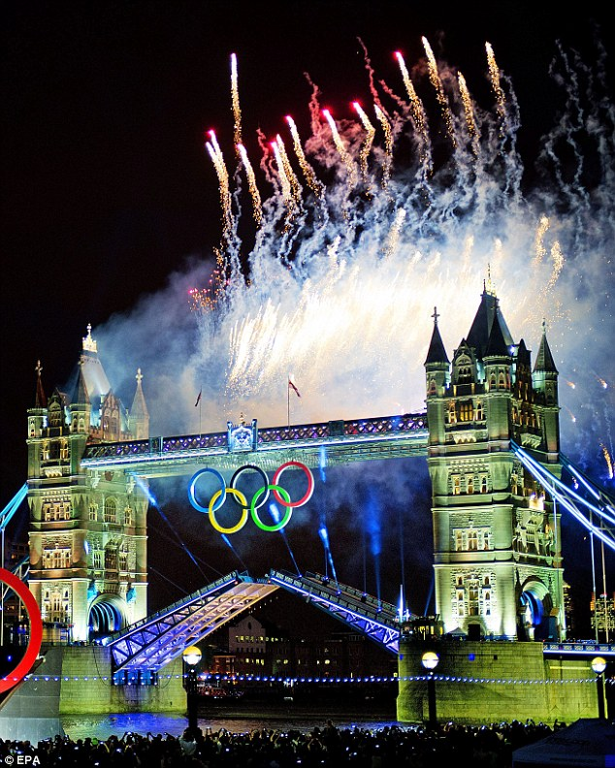
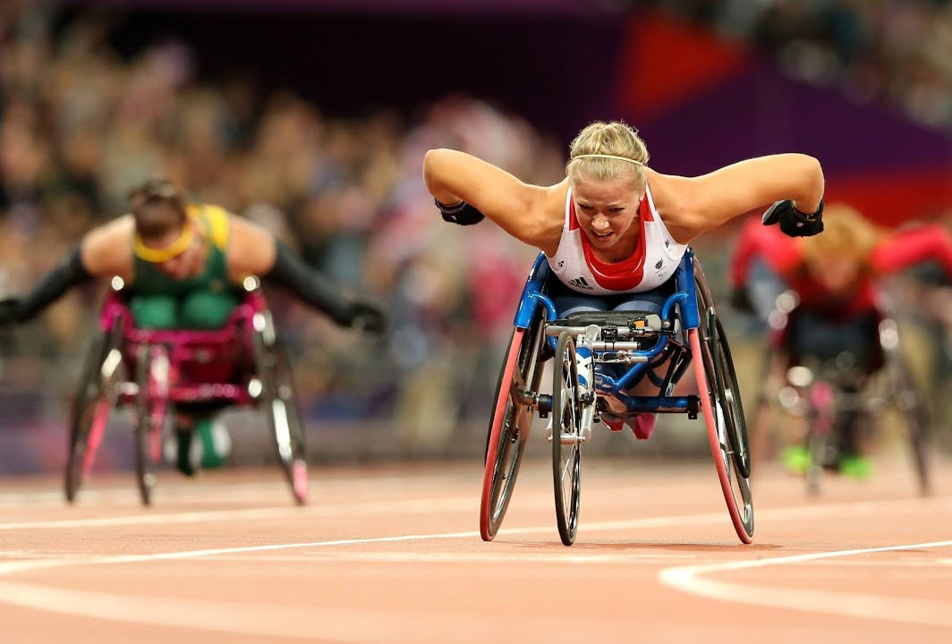
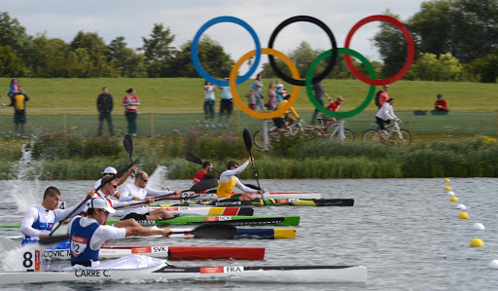
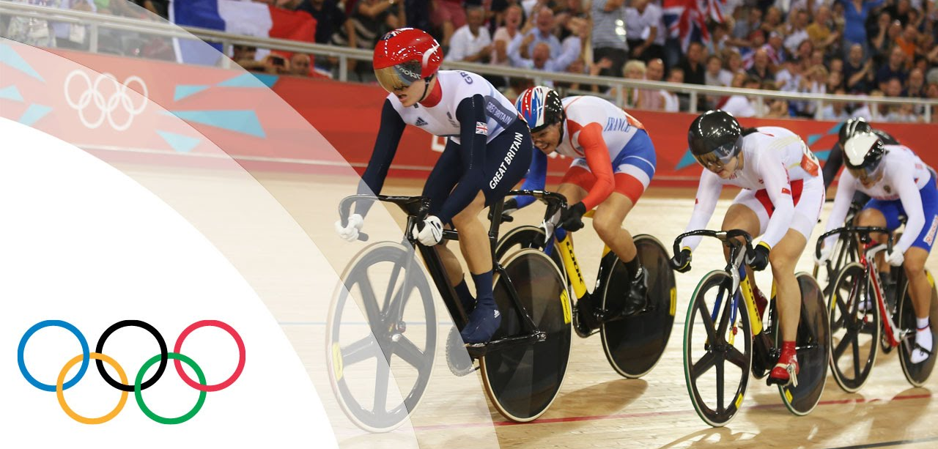
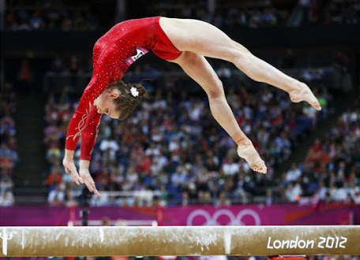
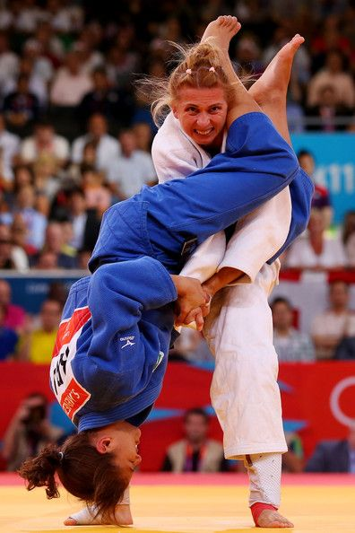
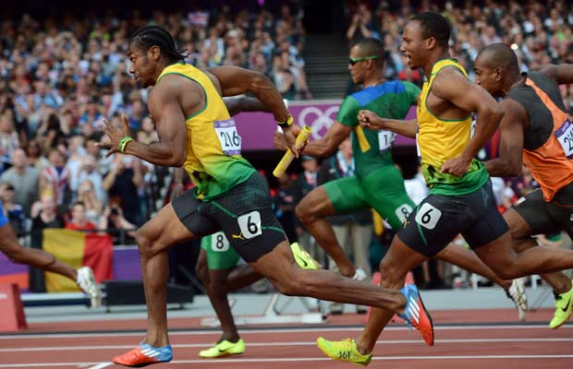
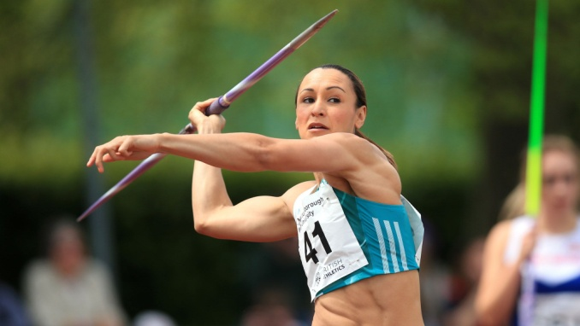
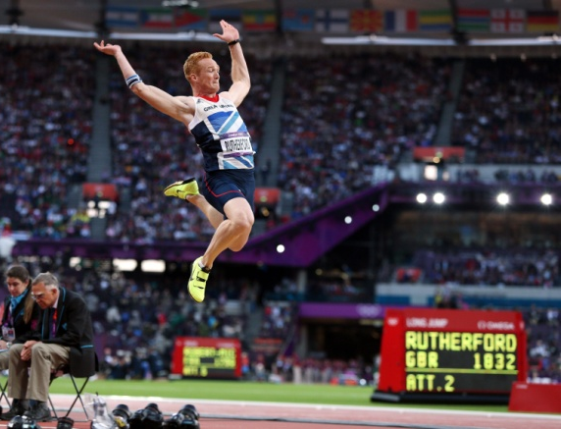
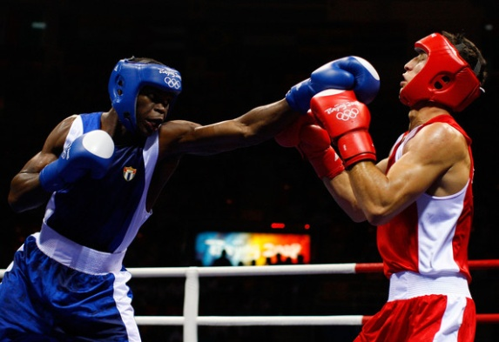
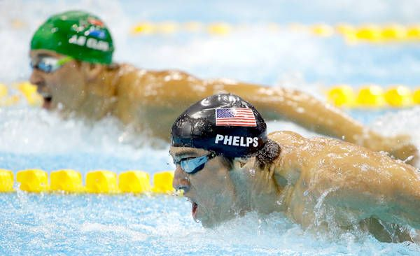
Watch Team GB Gold Moments London 2012
https://www.youtube.com/watch?v=gKJDjg4ebNQ
What sports do you enjoy doing at school or at home?

Slide 7
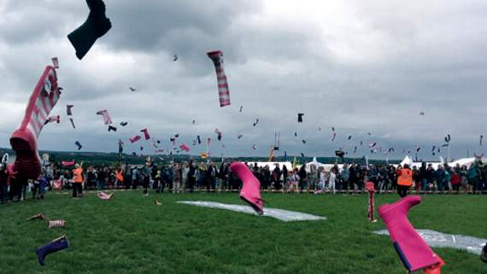
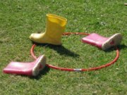
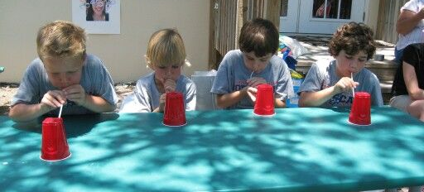
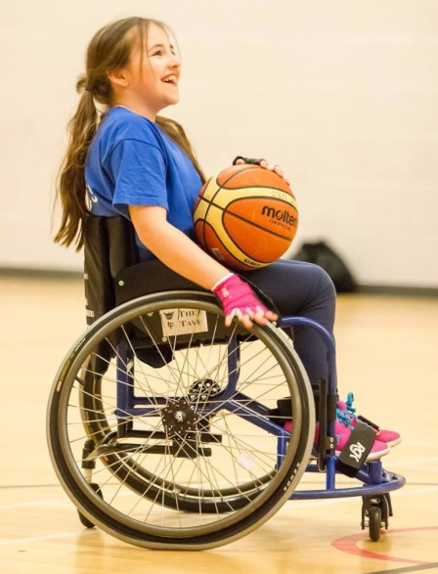
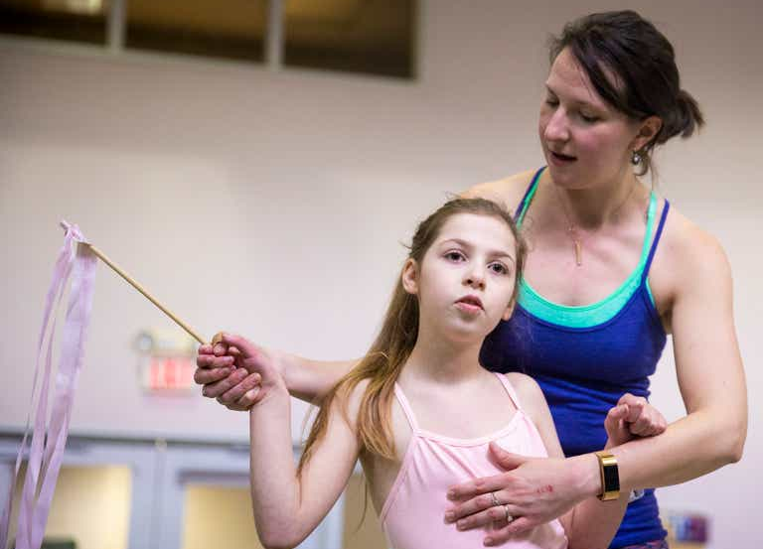
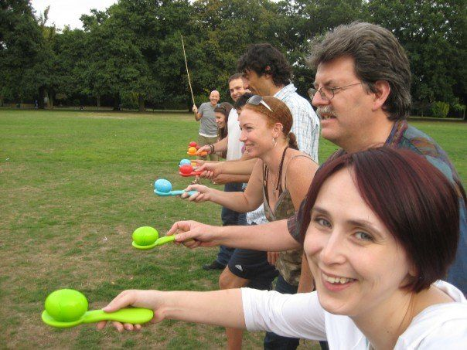
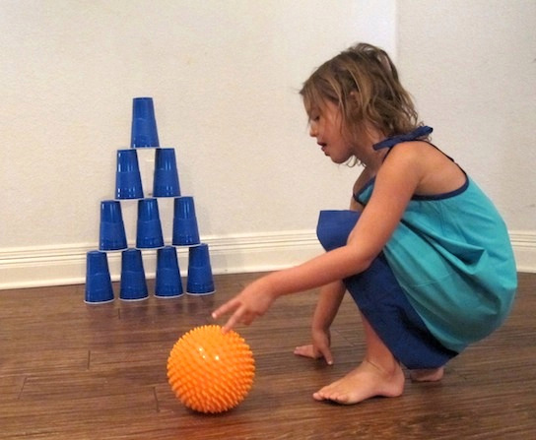
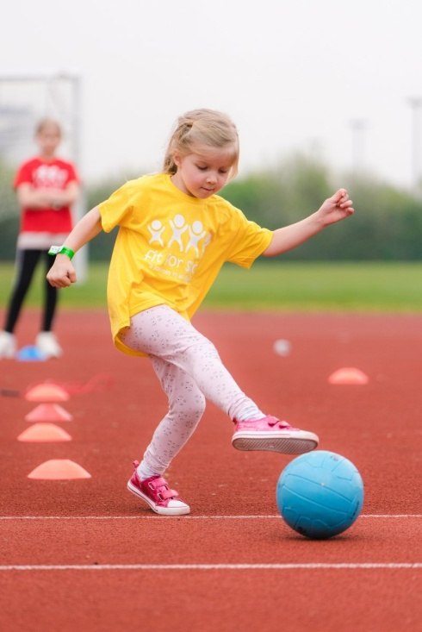
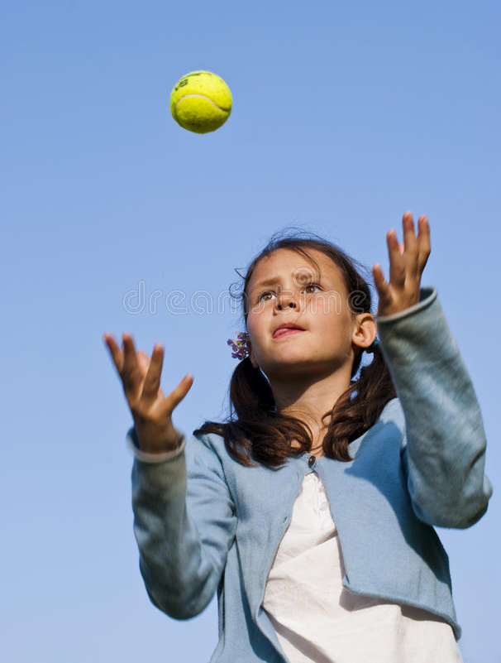
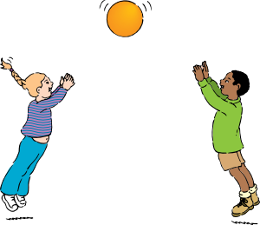
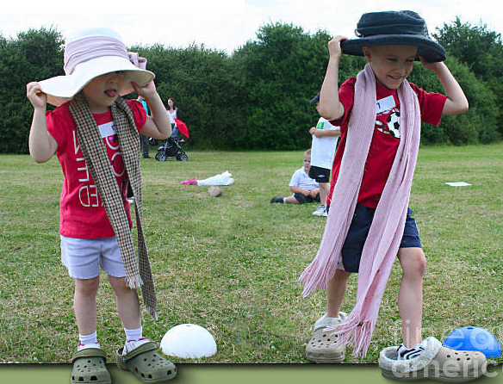
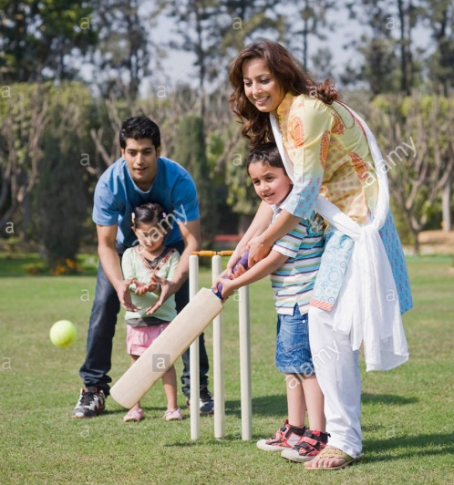
What sports would be fun to do in the HomeSchool Olympics? [Look at the PE HomeSchool Olympics section for ideas - ]
[- make sure everyone can join in!]

