Slide 1
Elmer & the Lost Teddy
https://www.youtube.com/watch?v=bNjIDg6zYPY

Slide 2
First: Go and get your favourite toy to come and watch this story with you.
Next: Listen along to the story about Elmer.
Then: Write your name of Task Sheet A.
Watch the Elmer story again. Pause to add a word in each of the circles to
describe Elmer [What he looks like AND his personality e.g. kind, helpful.]
: Tell the person you are watching with why e.g. kind because...
Finally: Draw or colour in a picture of Elmer to put on your wall.
Play a Communication Game: Hide-and-Seek
Close your eyes [no peeping]. Ask an adult to hide your toy. Now try to find it. Remember, be like Elmer and don’t give up! [You can have clues to help...]
For Parents: One night, Elmer hears the sound of crying. It is Baby Elephant. He can't sleep because he has lost his teddy. Elmer offers to lend Baby Elephant his teddy for the night. Elmer discovers that all the baby animals have teddies, but Baby Elephant's remains missing until Elmer's cousin, Wilbur, gets involved in the search.

Slide 3
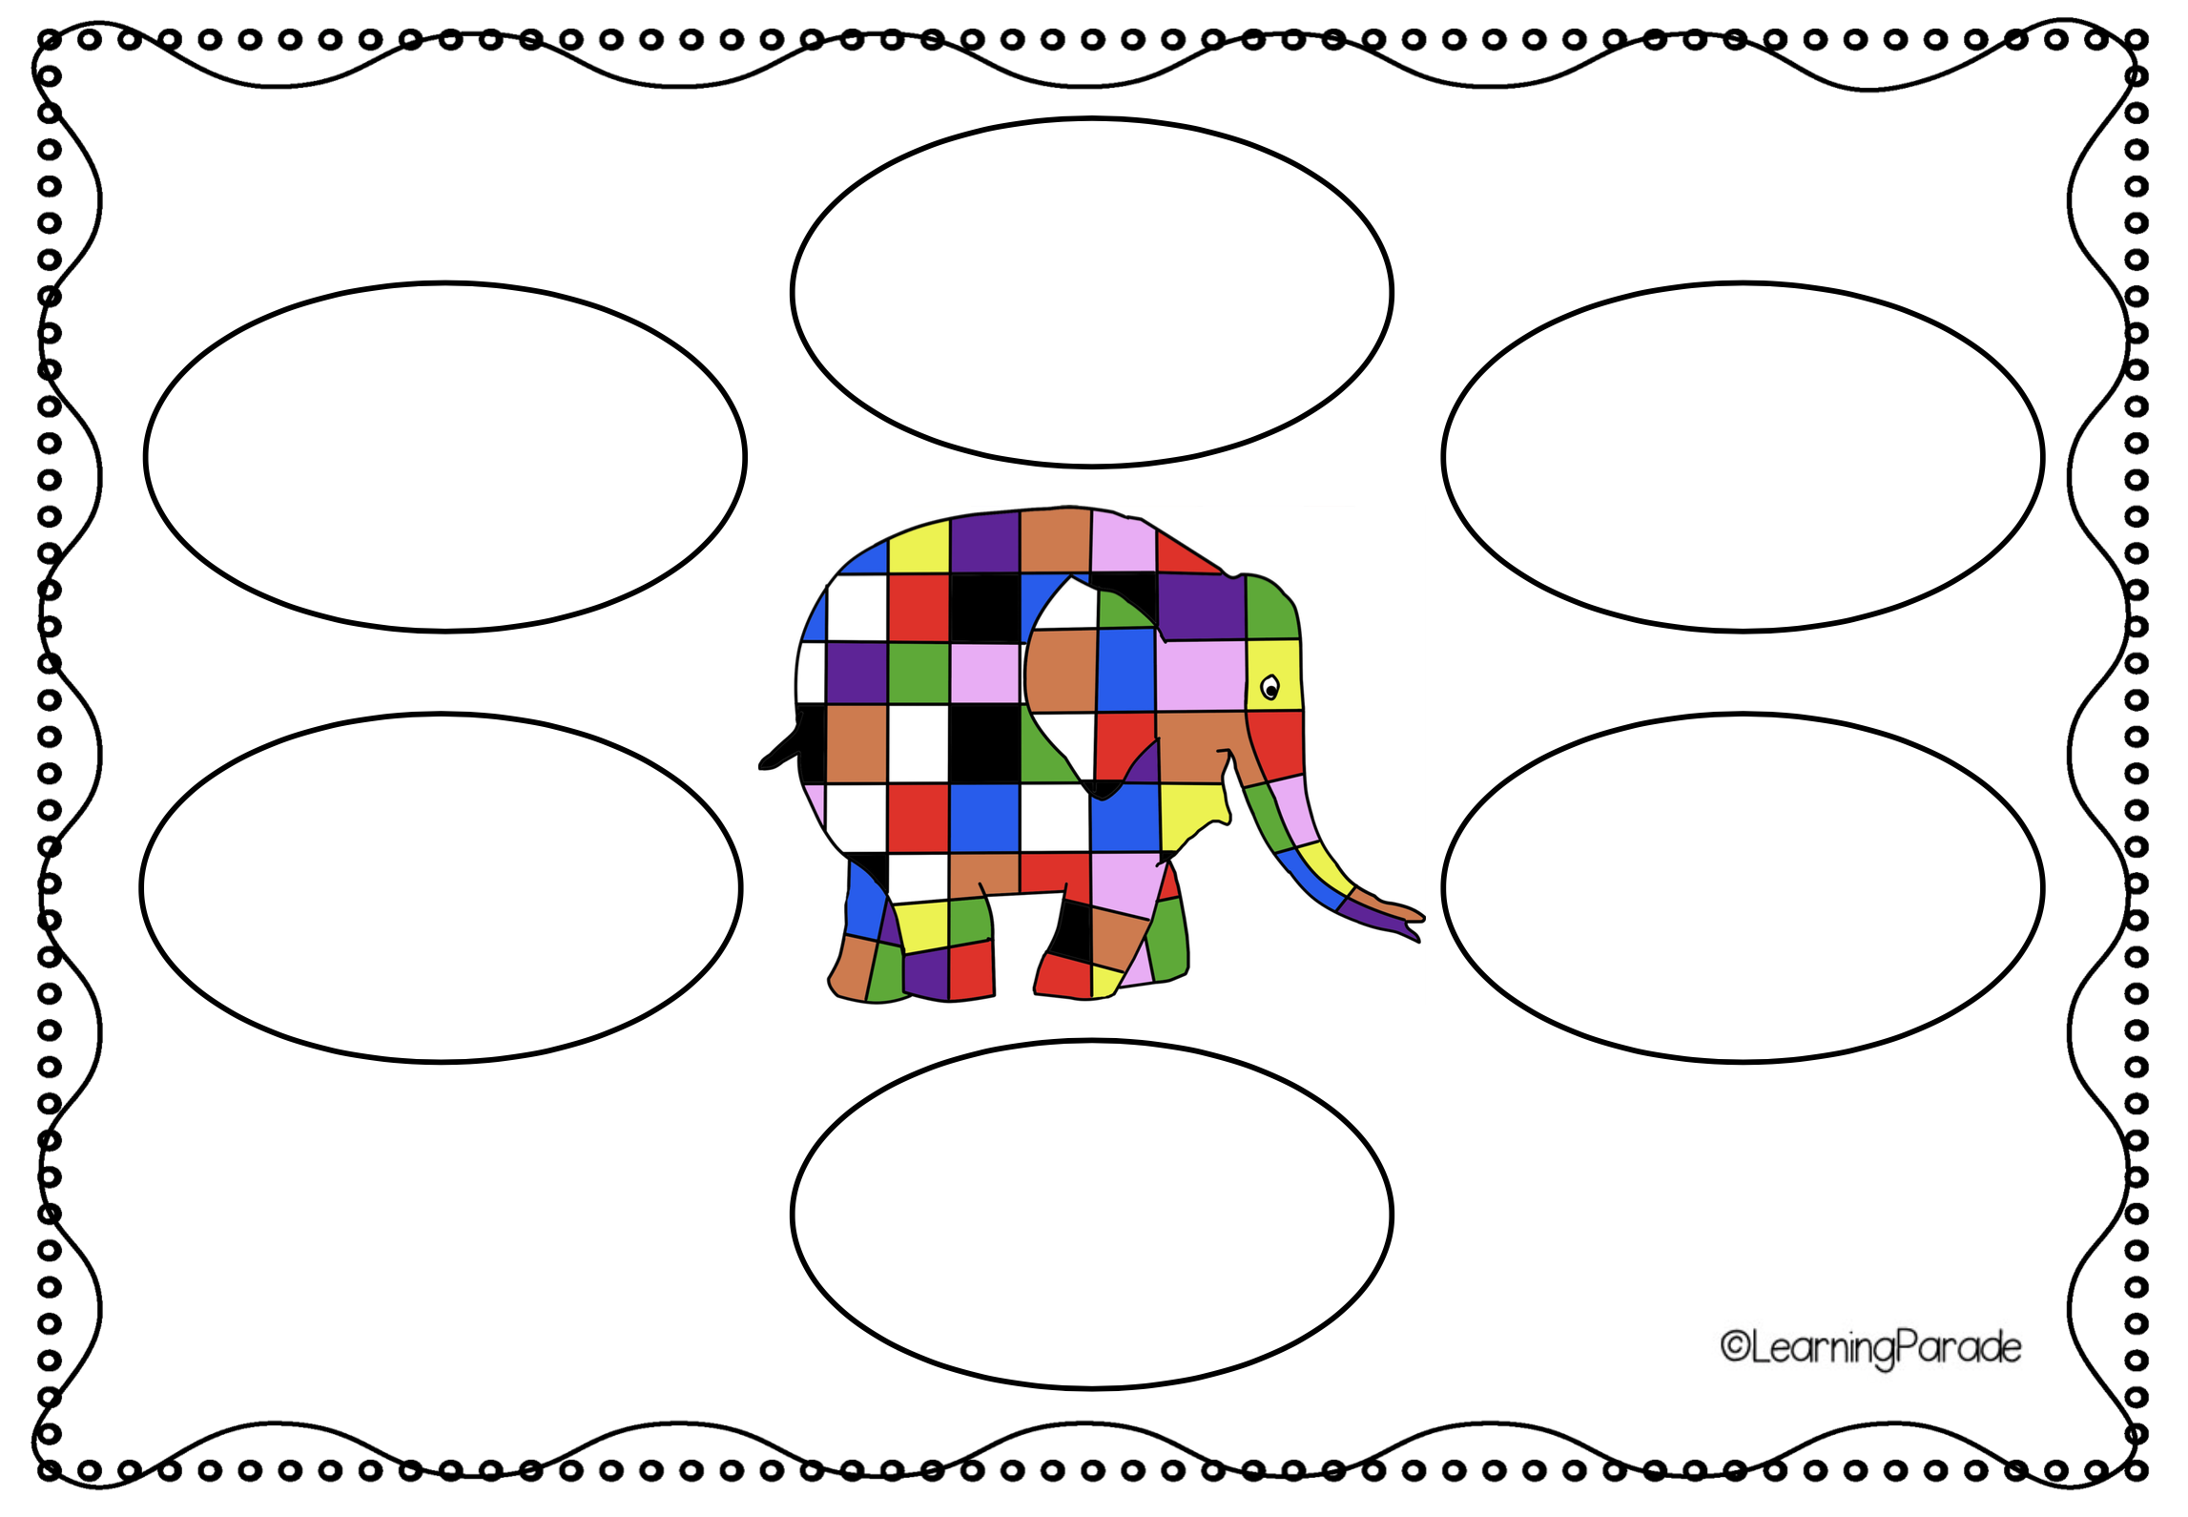
Write your name: ____________________________________
Task Sheet A

Slide 4
Task Sheet B

Slide 5
Star work if you have time:
First: Go and get the toy you played hide-and-seek with.
Next: Lost Poster
Write your name of Task Sheet C.
Draw your toy carefully – remember to add colour if you can!
Write your toy’s name
Add words to describe your toy
[What it looks like AND personality if you want e.g. kind, helpful.]
Write numbers from your phone number
Think – what will you give someone if they find your special toy?
* Say thank you OR a draw a thank you card
* Do a kind thing for them
* Make them a cake
* or anything else you think will work well
Finally: Draw or colour in a picture of Elmer to put on your wall.
Finally: Play the Communication Game again: Hide-and-Seek
This time you are going to do the hiding! Put up your poster. Ask the person you are playing with to close their eyes [no peeping]. Now hide your toy. Now they have to try to find it. Say kind words to make them feel good while they are looking.

Slide 6
Drawing or photo your toy:
LOST
Add words to describe your toy here: ____________________________________________________________________________________________________________________________________________________
Your Name: ___________________________
Phone Number: _______________________
REWARD if your toy is found:
_____________________________________
Name [of your toy]: _____________________

Slide 7
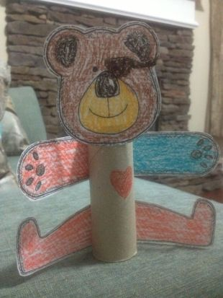
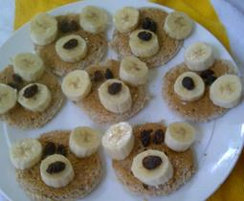
If you’re still feeling creative, maybe try making your own teddy.
This might be fun to play hide-and –seek with too!
If the weather stays nice then maybe think about having a teddy bear’s picnic.

