Slide 1
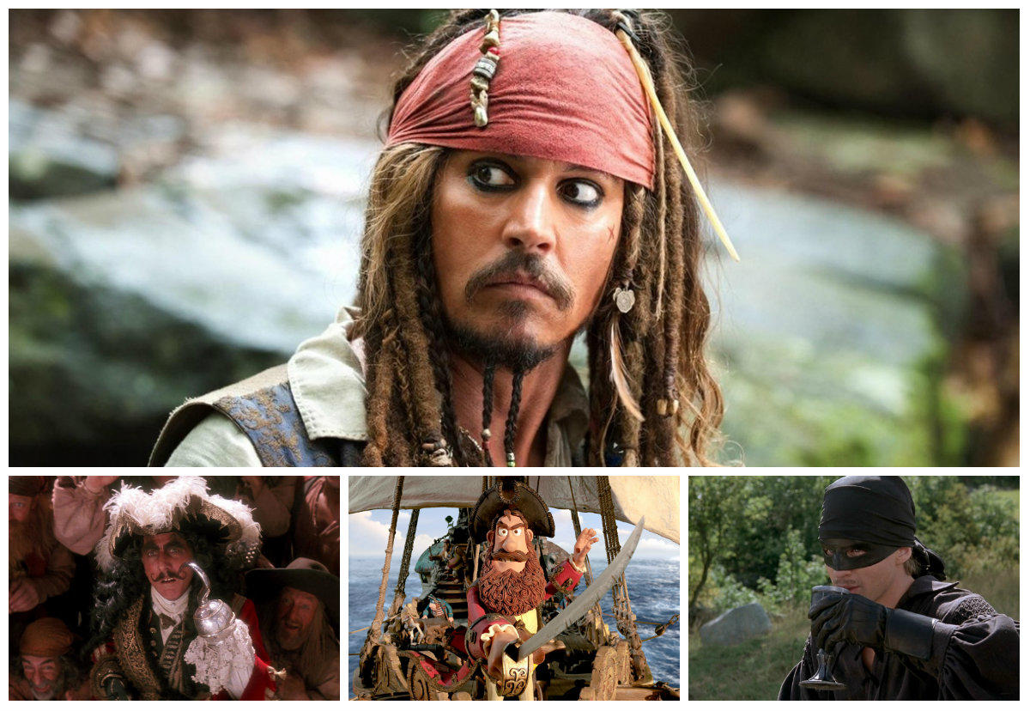
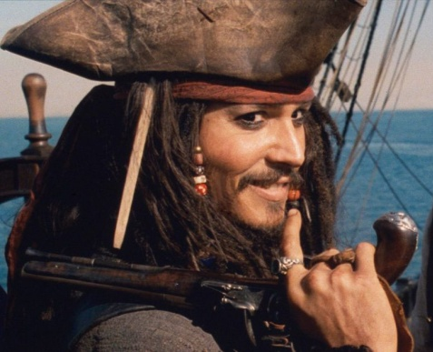
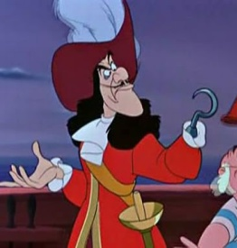
Pirate Research: Creating a new Pirate Character
Yo ho ho me hearties! Ready to research - Let’s get started!
First: What do pirate flags mean?
[slides 2- 10]
Then: Famous real-life pirates
[slides 11-15] [Read at least 2 slides]
Finally: Life at Sea
- pirate ships, rules, life on board, food
[slides 16-21] [Read at least 2 slides]
Optional additional research:
Really get involved in your work this week –
- Talk like a pirate [slides 22- 23]
- Dress like a pirate [slides 24 – 25]
Take part in Good Pirate Challenge
[slides 26 – 27]
Are these real pirates?
What are we learning this week?
Learning Focus: This week you are going to use your reading research skills to help create a new, believable but fictional pirate character.
This week the aim is to have fun and learn through a range of tasks.
Step 1: Research to gain information + develop
ideas
Step 2: Re-visit a favourite pirate film, book or
programme
Step 3: Create your own new pirate character

Slide 2
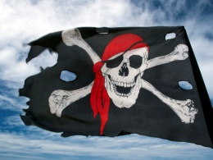

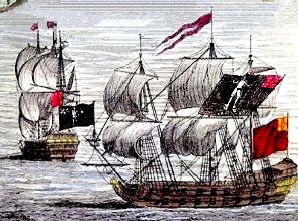
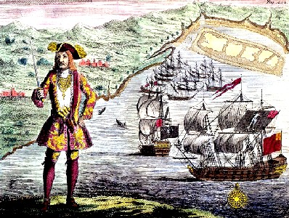
Pirate Flags
The history of ‘pirate’ flags is quite easy to trace. Around 1700 red and black flags were linked with privateering.
Privateers mostly worked for their country, robbing ships from other countries! At the end of the war with Spain in 1714 privateers were not needed anymore… so many became pirates.

Slide 3
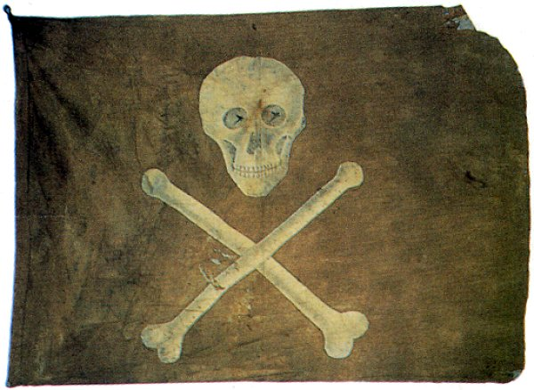
Pirate flags were very important. They were supposed to frighten the ship they were attacking into surrender. [surrender = giving up]
This saved the pirates effort, risk of injury or death and possible damage to property including their ship and the things they were stealing. Therefore, the scarier the flag the better!

Slide 4

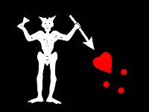
Privateers were said to be “sailing under the Red Jack.”
The pirate flag became know as the
‘Jolly Roger’.
Christopher Moody’s flag
Edward Teach [Blackbeard]
There are some other explanations for the name.
1. French Jolie Rouge (Jolly Red)
became ‘Jolly Roger’.

Slide 5




2. Rouge…Rogue…. Roger = a slang word meaning
vagabond
[a person who travels from place
to place - living on a ship]
3. ‘Old Roger’ = another name for the devil.
Edward Low
A black flag is a warning. “Surrender and we will
spare your life.”
A red flag means no mercy .
Henry Every had TWO flags – for different occasions
and to fit how he was feeling!

Slide 6
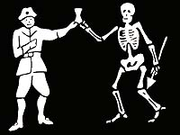
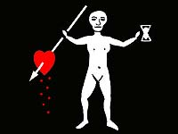

These are the flags of some very famous and VERY scary pirates!
Bartholomew Roberts
a.k.a Black Bart
I wonder what ‘mood’ John Quiech was in when he designed this?!
Why did John Rackham want a laughing skull and crossed swords on his flag?

Slide 7
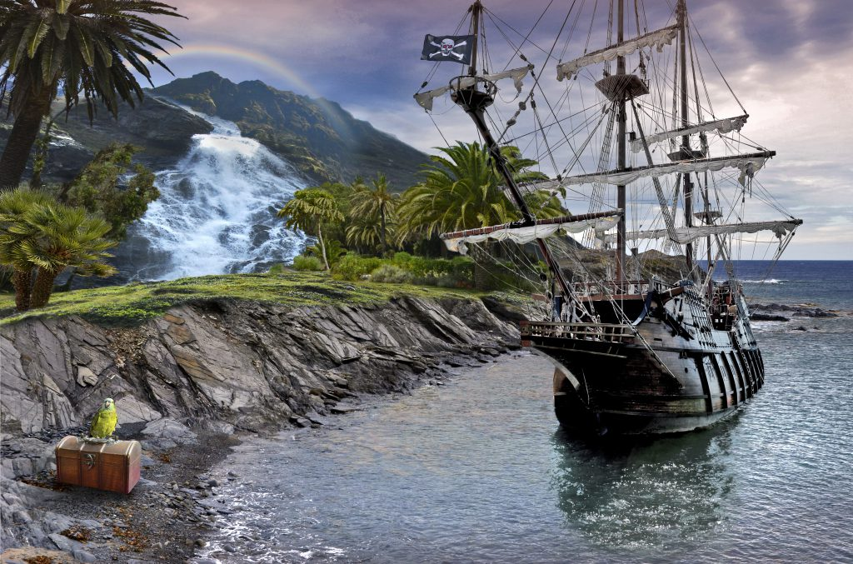



The flags were usually pretty rough and ready looking because they were made by the sail maker…
... or anyone else on board who could sew.
It could also have been the
sail-makers widow –
who would have been
paid in rum!
Richard Worley
Stede Bonnet
Thomas Tew

Slide 8



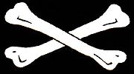


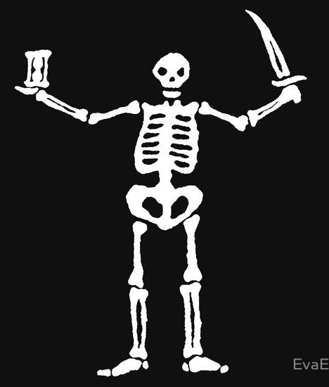
Flags were an important weapon to pirates; the meaning would have been very clear to their victims.
Bones = death
Skulls were always a popular design.
A dancing skeleton
meant a dance of death...
... in other words the pirates didn’t care if they lived
or died. A terrifying enemy to face!

Slide 9
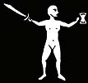




A raised glass meant ‘a toast to death’.
(a drink to honour death = “I’m not afraid to die.”)
Weapons meant slaughter
“We’re going to kill you all.”
An hourglass or wings means time…
...your time is running out
Aaaaahhhhhh!!!!

Slide 10
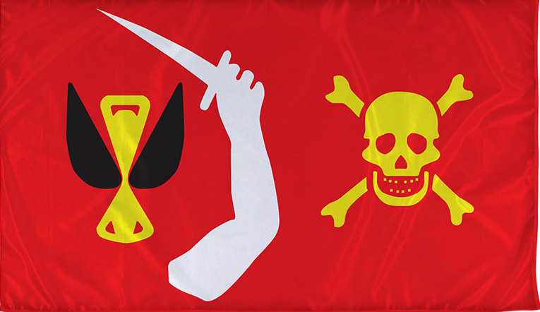
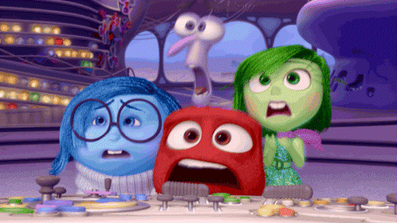
So, what does Christopher Moody’s pirate flag mean?
death
we’re going to kill you
your time is running out
no mercy
Oh dear…

Slide 11
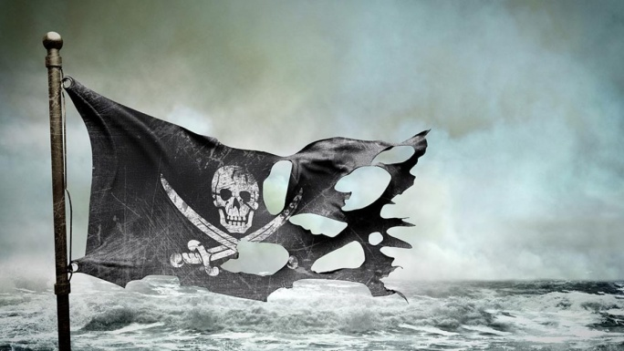
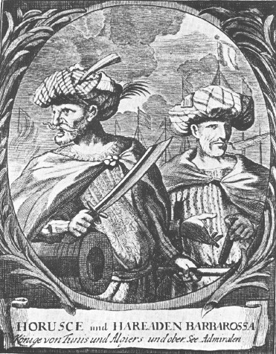
Famous Pirates in History
The Barbarossa Brothers
Barbarossa means ‘red beard’ in Italian.
These brothers became rich by capturing
European ships in the Mediterranean Sea.
They sailed around North Africa’s Barbary Coast
boarding and stealing from many vessels
including a Sardinian warship in the Mediterranean Sea!
One of the brothers, Aruj, sadly lost an arm in battle however his reputation as a skilled captain continued. In 1516, the Ottoman sultan put him in charge of the entire Barbary Coast. Two years later his brother Hizir took over following Aruj’s death. Hizir became the Admiral of the Ottoman navy and spent the rest of his life fighting his enemies, including a fleet of ships sent by the pope to destroy him. He made sure that Ottoman controlled the Mediterranean Sea.

Slide 12
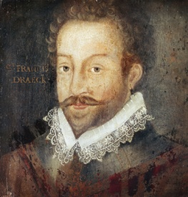
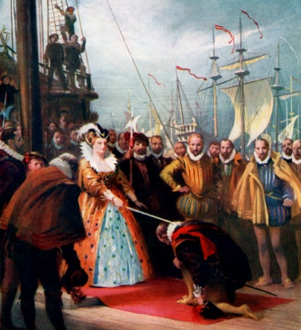
Famous Pirates in History
Sir Francis Drake
We don’t tend to think ‘pirate’ when hear his name,
most people think ‘explorer’. However, Queen Elizabeth I called him ‘my pirate’. He was one of the privateers licensed by the English government to attack Spanish shipping. His most famous voyage was from 1577 to 1580 when he became the first English captain to sail around the world.
On that trip he lost four of the five ships from his fleet, executed one of his crew for allegedly plotting a mutiny, raided various Spanish ports and captured a Spanish vessel loaded with treasure. He also brought back tobacco and potatoes from America!
A delighted Queen Elizabeth knighted him upon his return, he became ‘Sir’ Francis Drake. Eight years later, he helped defeat the Spanish Armada when they sailed into the English Channel.

Slide 13
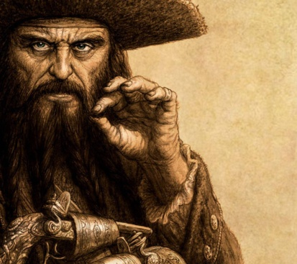
Famous Pirates in History
Edward Teach aka Blackbeard
Blackbeard is the person most people think of when
when they say the word ‘pirate’. He was cunning and ruthless,
intimidating his enemies by coiling smoking fuses into his long beard and by slinging multiple pistols and daggers across his chest. In November 1717 he captured a French slave ship. He refitted it with 40 guns and used this lethal firepower to block the port of Charleston, South Carolina, until the town’s residents met his demands for a large chest of medicine.
Blackbeard died in a battle with the British Navy. The legend is that it took 20 stab wounds and five gunshot wounds to kill him! Blackbeard was part of the Golden Age of Piracy and this era and Blackbeard himself is the inspiration for books, plays and films including Treasure Island and Pirates of the Caribbean.

Slide 14
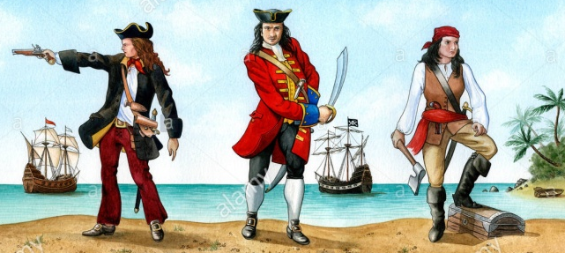
Famous Pirates in History
John Rackam aka Calico Jack
John Rackam received a pardon for previous acts of piracy in 1719
however less than a year later he headed back out to sea after stealing a 12-gun sloop [a smaller ship with only one mast] from harbour in the Bahamas. Among his dozen followers were two of the only women pirates ever to sail the Caribbean waters. One was called Anne Bonny and she left her husband join Rackham’s crew. The other was Mary Read. Her story is that she had been a pirate for quite some time, disguising herself in men’s clothing.
In October 1720 a pirate hunting boat sneaked up on Rackham’s ship. Bonny and Read fought back but he was captured and executed the following month. Bonny and Read escaped the hangman’s noose because they were pregnant. Mary Read died in prison soon after but no one knows what became of Anne Bonny.

Slide 15
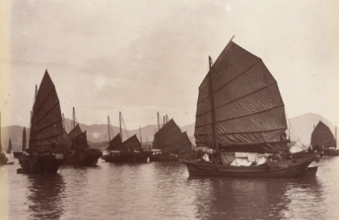
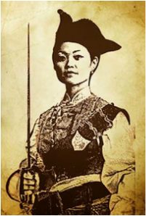
Famous Pirates in History
Madame Cheng
In 1805 Madame Cheng’s husband, Cheng Yih, formed what quickly became the largest pirate confederation in history. When he died two years later, Madame Cheng took over the business. She was a strong, intelligent and ruthless leader and the business did so well she was soon in charge of more than 1,800 ships and 70,000 men.
With the help of Cheung Po Tsai—the adopted son of her husband— she demanded protection money from coastal communities, attacked ships in the South China Sea and once even kidnapped seven British sailors.
In 1810, Madame Cheng gave up piracy because the Chinese authorities began cracking down pirate activities. She lived out her golden years in comfort... still not quite following the law!

Slide 16
Pirate Research: Life on board Ship
Living Conditions:
Life at sea was tough and living conditions were very basic. There was no heating, no air conditioning, no proper toilets or a place to wash. The smell of urine and spillages from cooking would seep down to the bottom of the ship making the whole ship really stink. There was no way to keep yourself or your clothes clean. Very hot sun, strong winds or storms all made life much harder for the pirates – imagine having to close the hatches and stay below deck!
Crews would work in shifts. Work would be on deck or up in the rigging so during a storm there was no way to get dry. To make matters worse most ships leaked and so water would wash below deck.
Worst of all for the sailors were the rats, mice, cockroaches, spiders, snakes and other insects that would be brought on board with supplies when the ship docked.

Slide 17
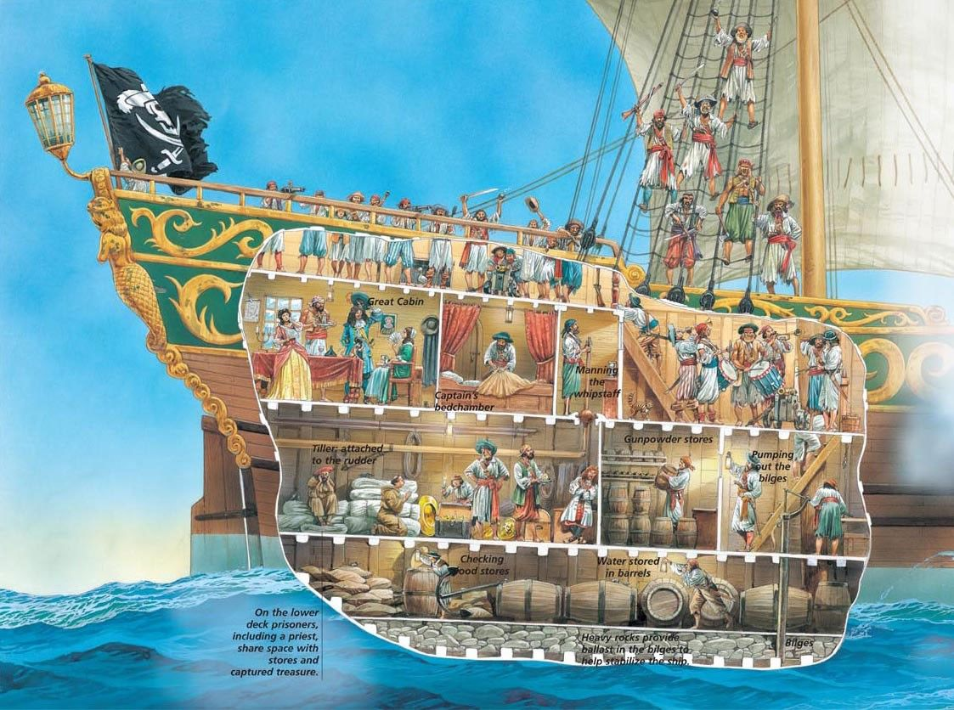
Pirate Research: Life on board Ship

Slide 18
Pirate Research: Life on board Ship
Food:
Before setting out to sea pirates would stock up their ships with things like beef, vegetables and maybe fruit. But these things would go bad pretty quickly. This meant they had to eat things that would go off first and then ration everything else to get them through the journey. It also meant that they had to eat food when it had gone off and just try and make it taste a bit better. They would use lots of herbs and spices to help with this.
One trick pirates tried was to take live animals on board ship like chickens, a goat and sometimes even a cow! They would then have eggs and milk and eventually fresh meat and finally bone soup!
They also had a type of tough bread made out of flour and water called hard tack. At sea it would get infested with weevils [beetles] which the pirates would have to try and tap out before eating.

Slide 19
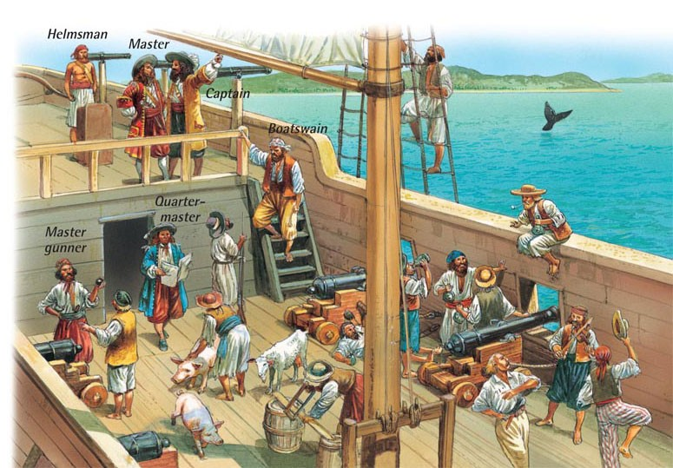
The captain was chosen by the crew. The quartermaster punished
pirates and shared out the treasure. The helmsman steered the ship. The cook was an older pirate who had been injured and could no longer fight.

Slide 20
Pirate Research: Life on board Ship
The Pirate Code:
When they turned ‘pirate’, sailors would create their own set of rules. This meant that there wasn’t one ‘pirate code’ but many. The rules were there to help stop fights onboard ship!
Some common rules were
Every man has a vote on decisions that needed to be made.
No stealing from each other.
No playing cards or dice for money.
Candles and lights to be out at 8:00pm.
Keep your pistol or cutlass clean and ready for battle.
No deserting the ship during battle.
No hitting each other when on board ship. All quarrels to be sorted out before coming back on the ship. [duel by sword or pistol]
Share of the prize (booty/treasure) must be divided as agreed.
If they didn’t stick to the rules the punishments were very harsh – including being marooned on an island all alone.

Slide 21
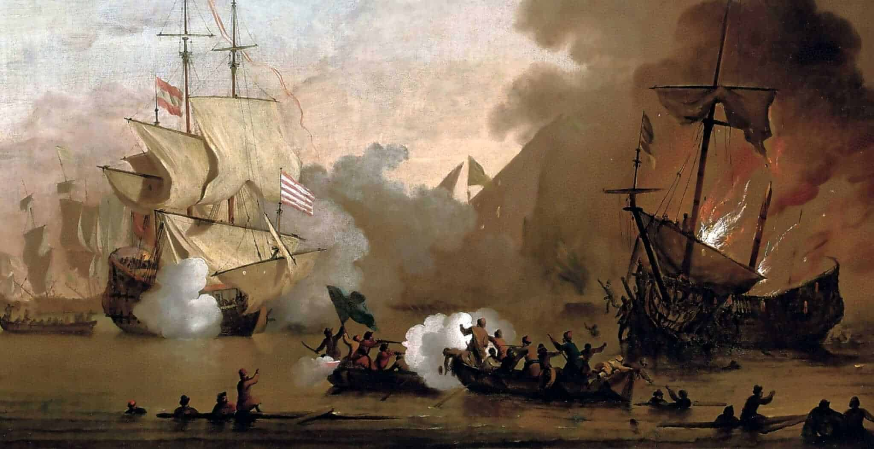
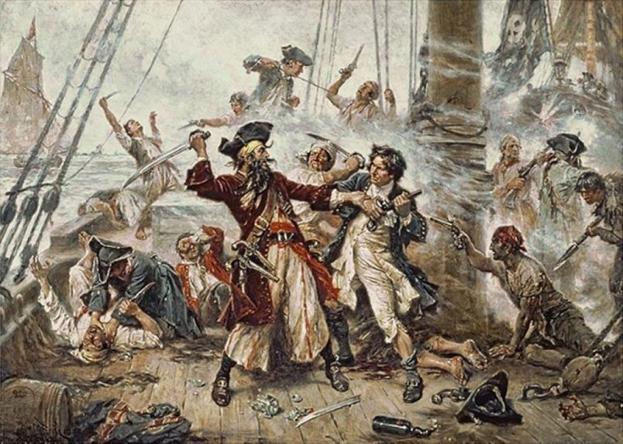
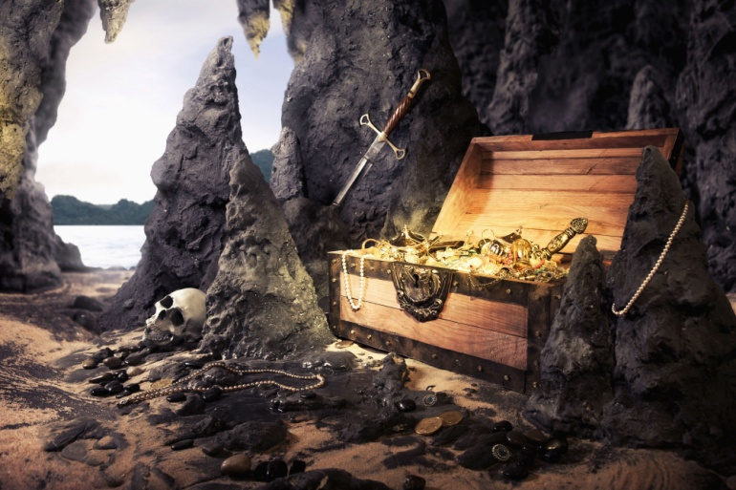
Pirate Research: Life on board Ship
- and finally...
... Life at sea was tough. Battles were dangerous and if you broke the rules, punishments cruel. Food was terrible, the ship and pirates stank! Pirates rarely buried their treasure and treasure maps are only in stories!

Slide 22
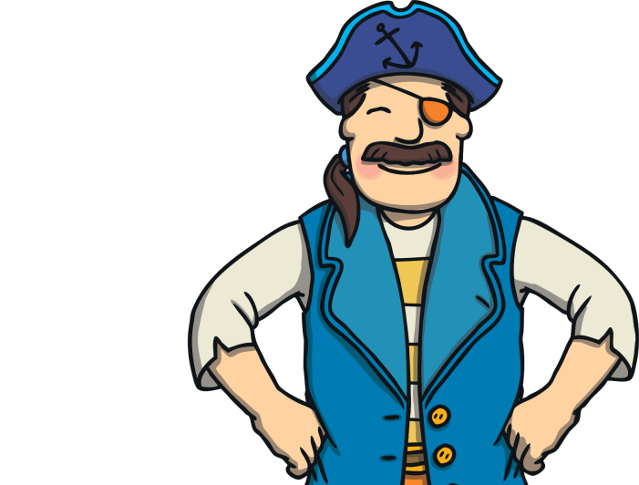
Becoming a Pirate: Talk like a pirate!
- Say these words [in your pirate voice of course!]
- What do they mean?
ahoy matey!
Avast ye!
shiver me timbers!
= pay attention now!
= hello friend
= I’m surprised!
Aye, aye captain!
up to the crow’s nest
= yes, yes I’ll do it!
= quick, go and look!
batten down the hatches!
yo ho ho!
= a cheery way to get someone’s attention
= bad weather is coming
port = left
starboard = right
galley
= the kitchen
swab the decks!
cabin
bunk
= your bedroom
climb the rigging
= clean the floor
= your bed
= run upstairs

Slide 23
Becoming a Pirate: Talk like a pirate!
- Choose 5 pirate words to say this week.
- Write them out carefully.
___________________
___________________
___________________
___________________
___________________
___________________
___________________
___________________
______________________
______________________

Slide 24
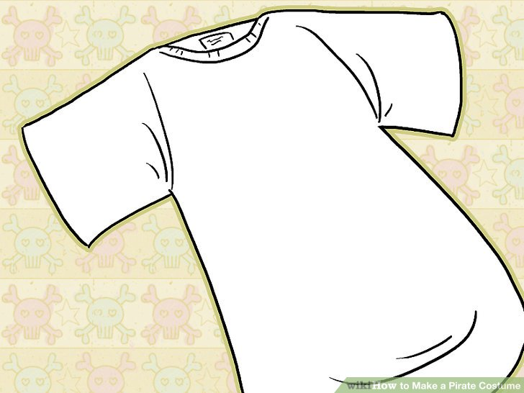
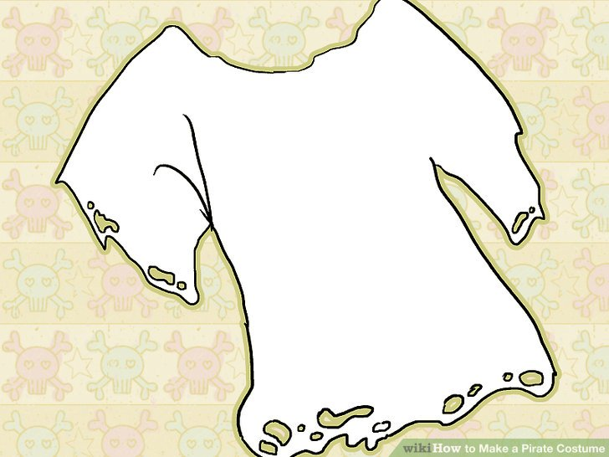
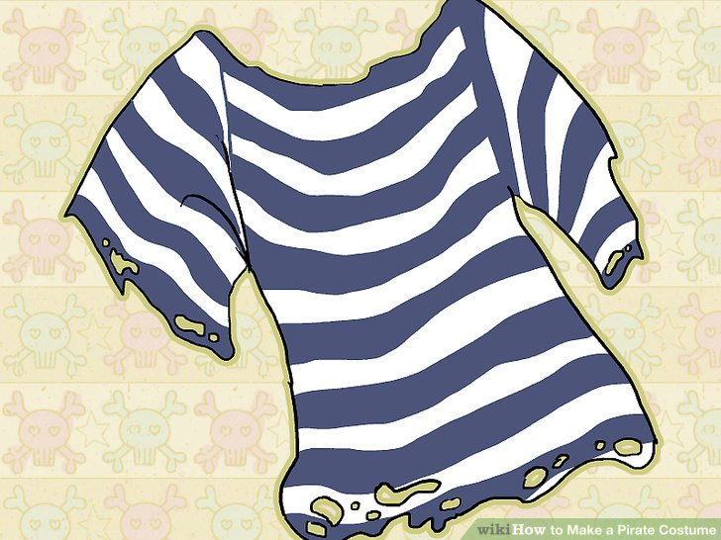
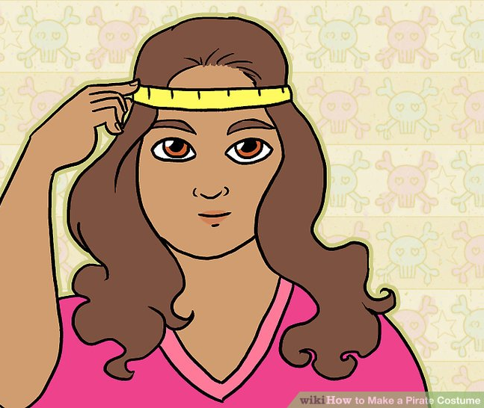
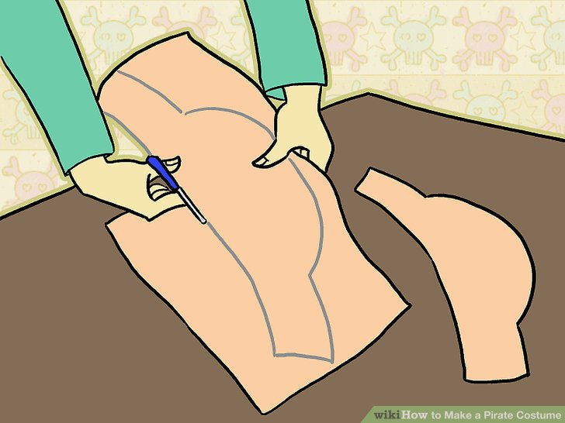
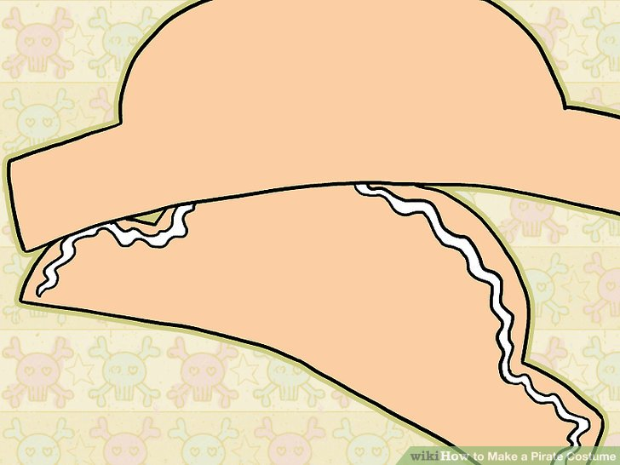
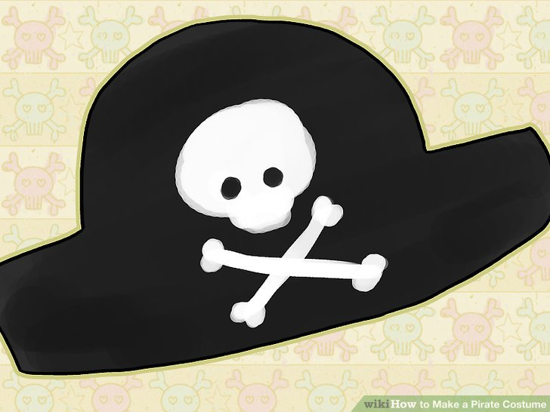
Becoming a Pirate: Dress-up Like a Pirate
Get an old t-shirt and make it look older; paint or mark on some stripes.
Pirate Hat
Make a pirate hat: measure, cut, stick then paint OR
use some material to tie into a pirate bandana.

Slide 25
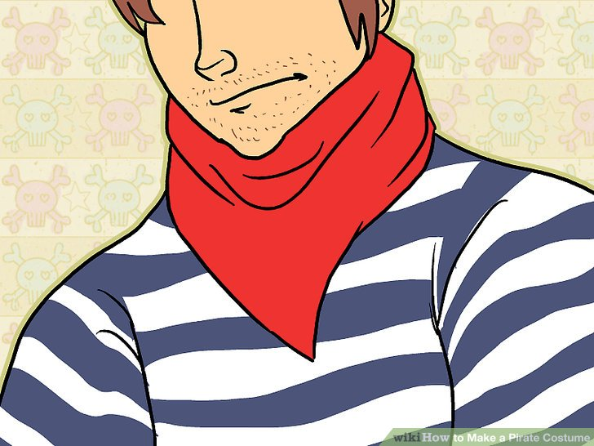
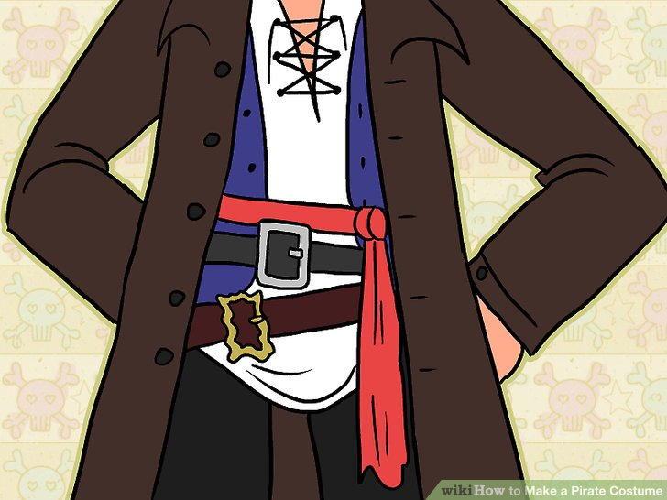
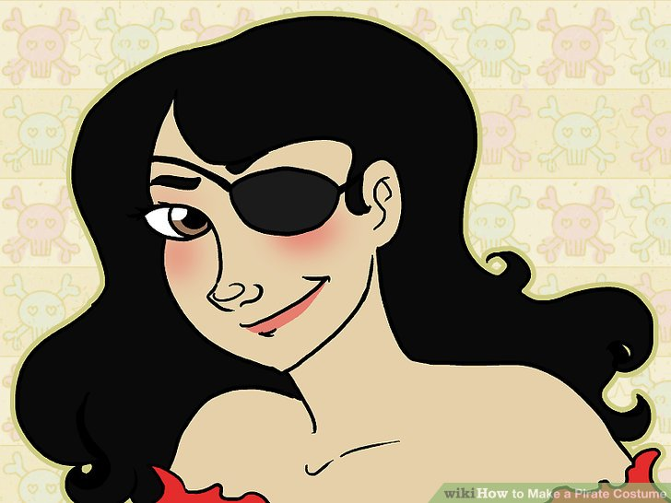
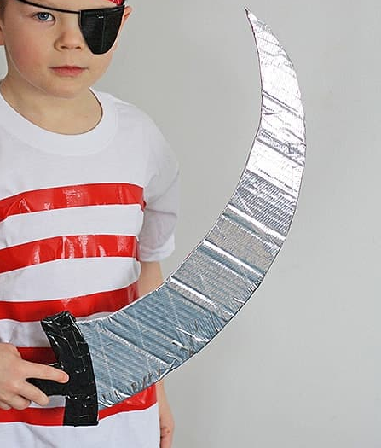

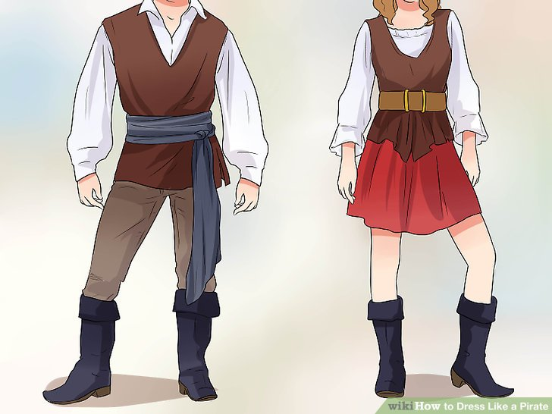
Becoming a Pirate: Dress-up Like a Pirate
Maybe add a bandana, belts or material to make a sash or eye patch .
Use cardboard to make a sword or kitchen/toilet roll for a telescope.

Slide 26
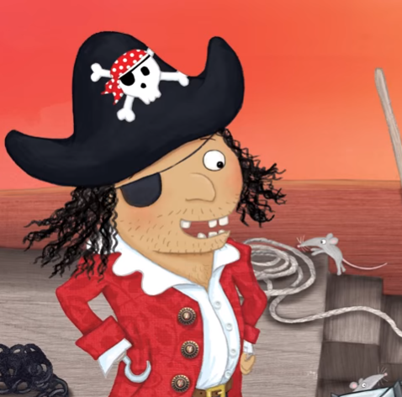
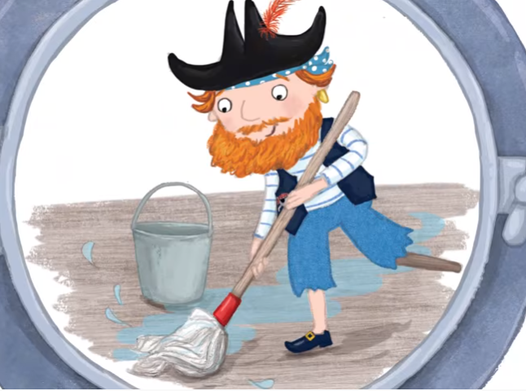
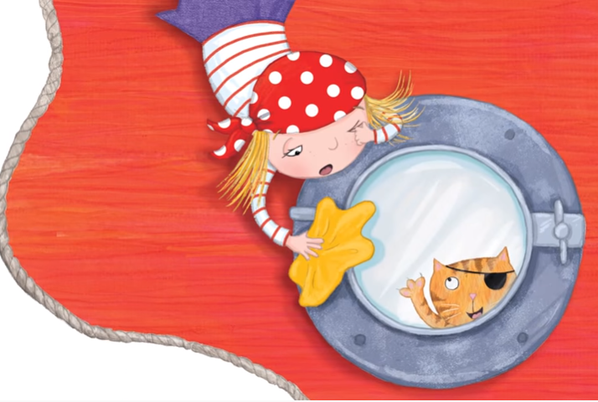
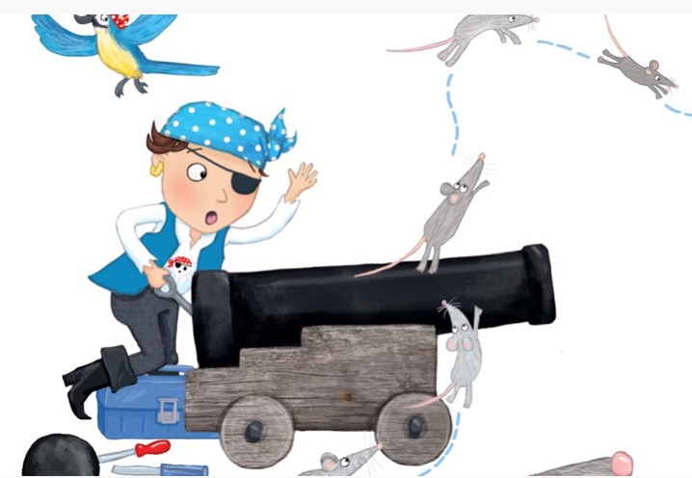
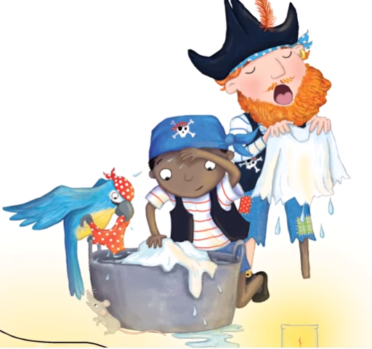
The Good Pirate Challenge
- Do as many jobs as you can this week.
- X every time you do – you might find treasure!
Job |  | 1 | 2 | 3 | 4 | 5 | 6 | 7
 | swab the decks = clean the floor
 | polish the port holes = clean the windows
 | clean the cannon = clean the car
 | scrub the washing = help with the washing

Slide 27
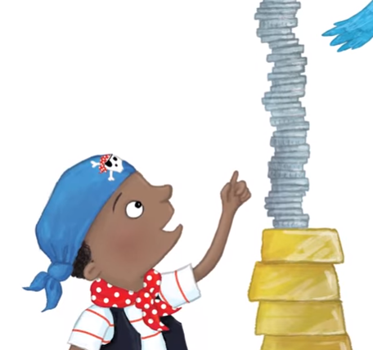
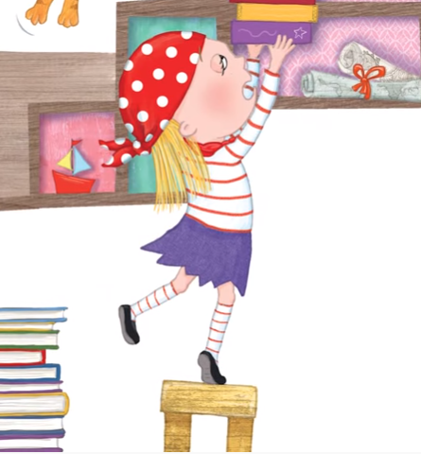
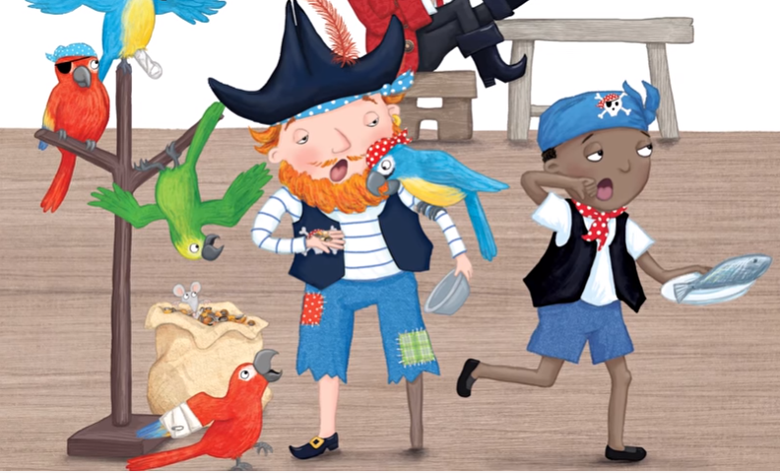



Job |  | 1 | 2 | 3 | 4 | 5 | 6 | 7
 | count the treasure = count money or other special things
 | cabin to tidy down = tidy your bedroom
 | supper to serve = help get food ready for everyone
 | quiet in the bunk = go to bed on time + go to sleep
How did you do?: Pirate Ship Jobs
- add up how many ‘X’ you got this week.
- how does helping make you feel?

