Slide 3
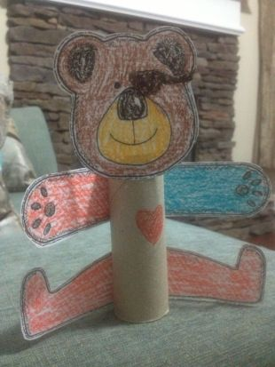
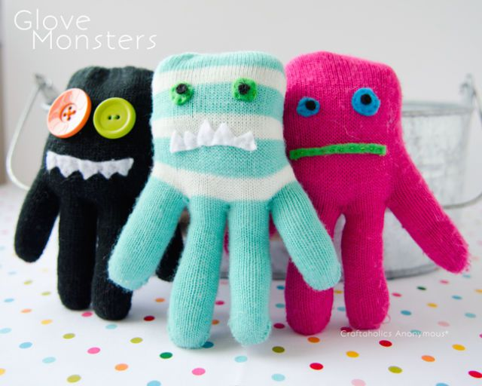
Time to Get Creative – Make a Toy to turn into the hero for the story you’re going to write!
If you use tooth picks be careful, they are quiet sharp!
Socks and cut up old clothes for stuffing might work?

Slide 4
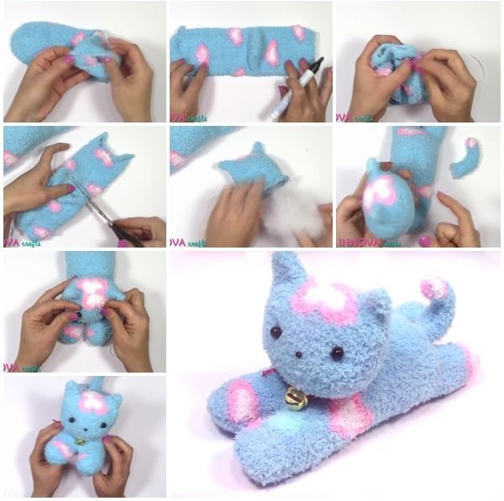
This one looks a bit tricky to me but I know some of you are very good at this sort of thing and LOVE cats!

Slide 5
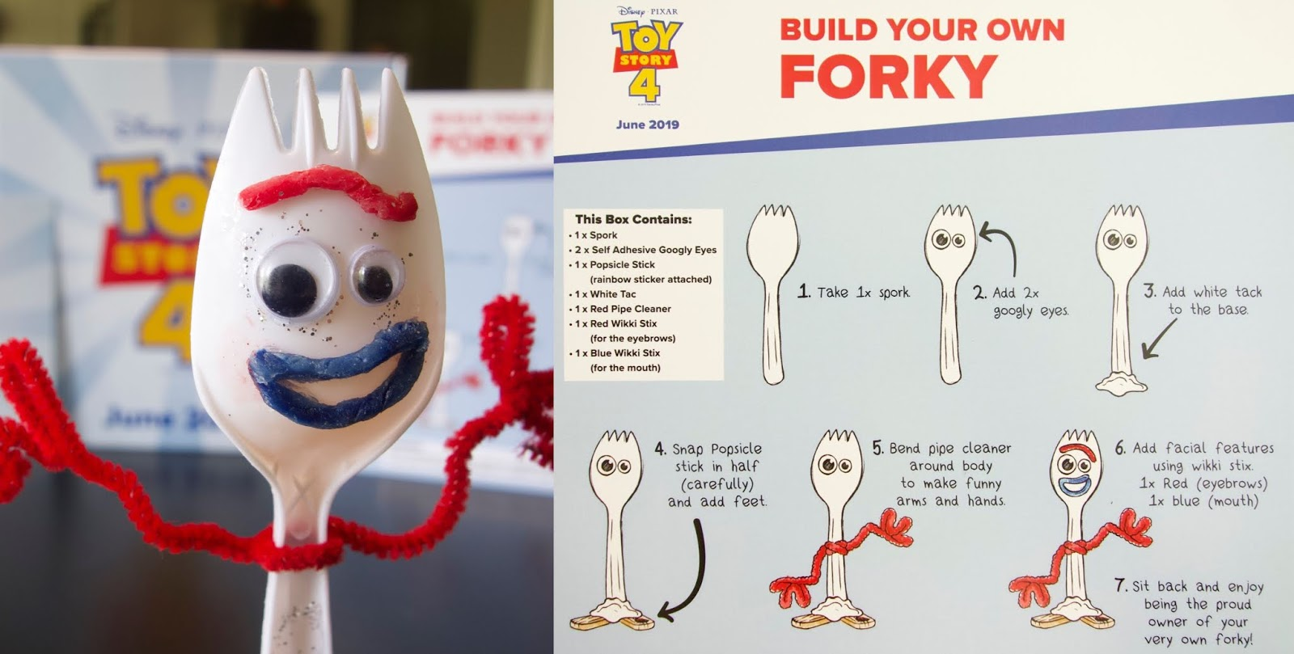
You don’t have to make your Forky exactly the same as in the film – add your own unique, creative ideas! What do you have in the house that you can use?
Top Tip to avoid trouble: Make sure you ask before you use something that isn’t yours!

Slide 6
Key Terms to try and learn: There are lots of others but these are the main ones to focus on.
noun = naming words eg table, chair, pencil, cat, dog
verb = doing word eg the boy crept along the corridor
adjective = describing word eg the corridor was dark and spooky.
adverb = tells you more about the verb eg the boy crept quietly.
punctuation = . , ? ! ‘ we need this to help the reader understand.
. = full stop used at the end of a sentence
, = comma used for listing in a sentence eg She bought jam, butter and bread.
? = question mark used when you are asking a question eg How much?
! = exclamation mark when you are saying something more loudly eg. excited, shocked ,surprised.
isn’t = apostrophe used when we shorten a word eg isn’t - is not , I am - I’m
tense = when something happened, past, present or will happen in the future.
eg. past – ran, present – run(s), future – will run
Higher Challenge: These are trickier. Top Tip: Learn them by linking them to the BBC Bitesize Karate Cat work – repeat the levels several times to help add the information securely.
REMEMBER: Don’t try to learn them all this week, this is something to work on over time!
Jane’s bag = possessive apostrophe used to show something belongs to a person/thing.
tense = [see above] past progressive or future progressive = shows an action in progress eg. past progressive – was running or future progressive = will be running
and finally...
Types of sentence
statement = a sentence that tells you something.
exclamation = a sentence usually said with strong emotion.
question = a sentence that asks something [look out for the ?]
command = tells you to do something.

