Slide 1
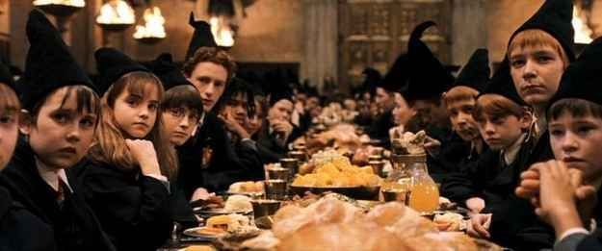
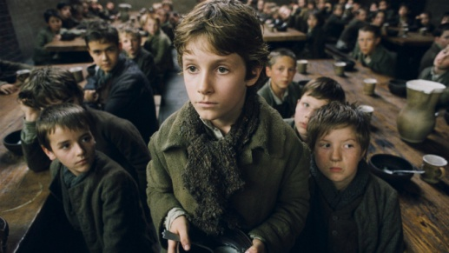
Longer Writing Task: Developing Skills Forming an Argument
Finally: Longer Writing Task [linked to GCSE]:
This work is to help build your skills and confidence responding to higher level Reading tasks - plan and then build an argument.
Question: A group of 6th Form students
have said that the characters Harry Potter
and Oliver Twist are similar. Do you agree or
disagree? Using information in the text to
prove the points you make.
Re-read your notes
Plan
Write
Extension Communication Games:
Food on a Tray Memory Game
Guess the Food in the Bag
Food Alphabet – I went shopping...
Try something new – link to feelings...
Key Information:
Evaluate: To what extent do you agree?
You’re given a point of view about a section of a text [in this case 2 texts!]
Top Tip:
Refer to the text, use quotes.
Inference/ impressions = read between the lines.
- points why you agree.
- points why you disagree,
1 point overall conclusion – do you
mostly agree or disagree?

Slide 2
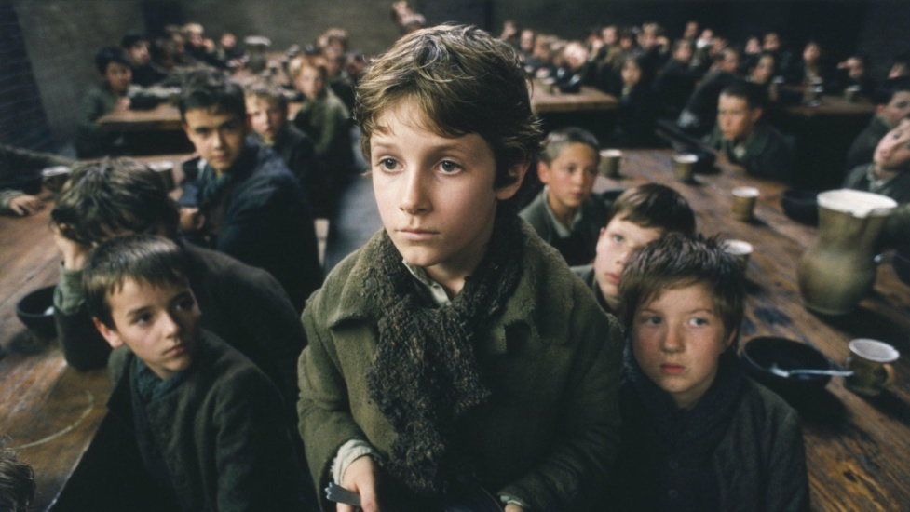
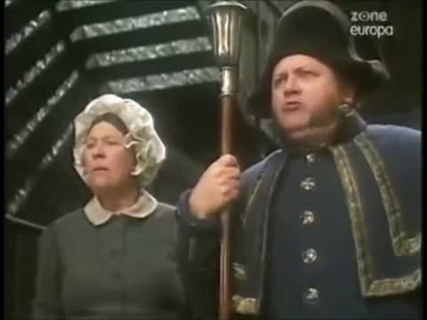
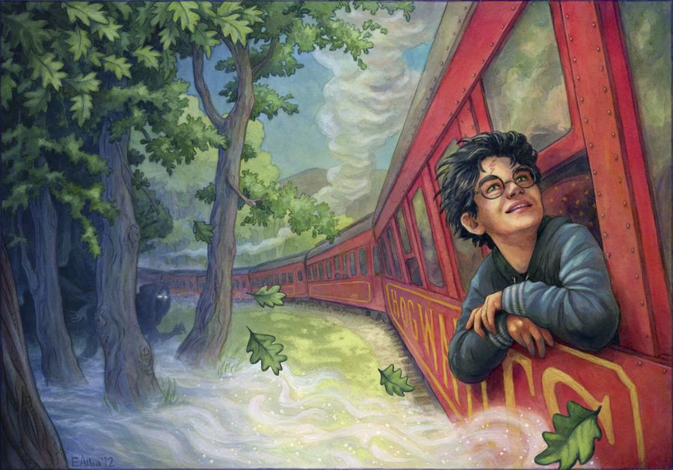
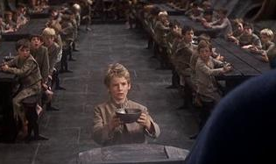
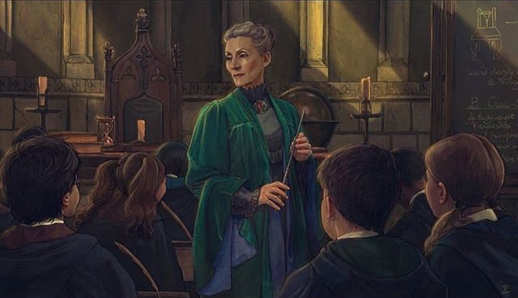
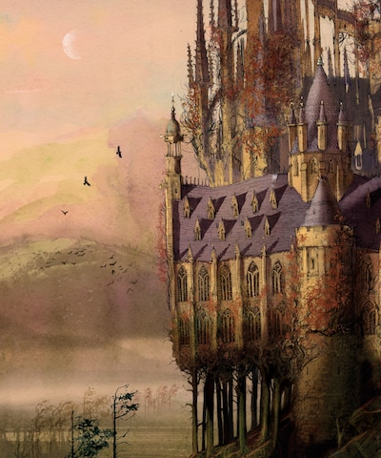
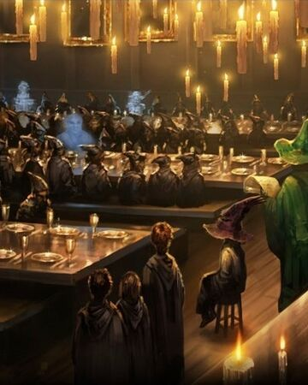
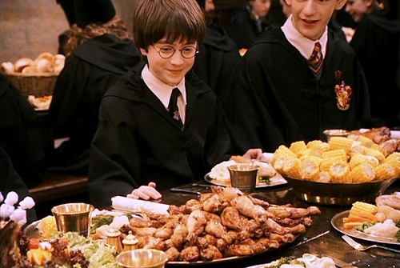
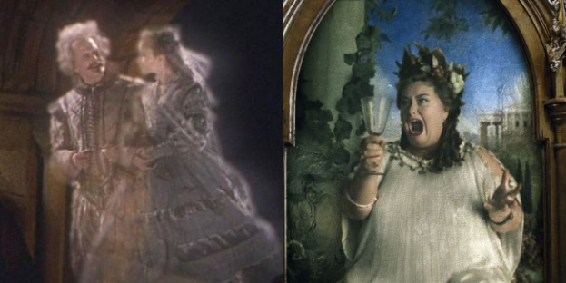

Slide 3
Longer Writing TaskPlanning Sheet: [You can also use your yellow workbook.]
Talk your ideas through then complete your plan
Focus: Building planning skills. [Just brief notes – not sentences]
Agree:
[family, food, friends, location]
Disagree:
[family, food, friends, location]
The characters Harry Potter and Oliver Twist are similar?
Big final point to prove my argument :

Slide 4
Longer Writing Task: [You can also use your yellow workbook.]
______________________________________________________________________________________________________________________________________________________________________________________________________________________________________________________________________________________________________________________________________________________________________________________________________________________________________________________________________________________________________________________________________________________________________________________________________________________________________________________________________________________________________________________________________________________________________________________________________________________________________________________________________________________________________________________________________________________________________________________________________________________________________________________________________________________________________________________
Top Tip: Point, Evidence to prove – Explain what the evidence shows/tells the reader.

Slide 5
Longer Writing Task continued...
______________________________________________________________________________________________________________________________________________________________________________________________________________________________________________________________________________________________________________________________________________________________________________________________________________________________________________________________________________________________________________________________________________________________________________________________________________________________________________________________________________________________________________________________________________________________________________________________________________________________________________________________________________________________________________________________________________________________________________________________________________________________________________________________________________________________________________________
Top Tip: Point, Evidence to prove – Explain what the evidence shows/tells the reader.

Slide 6
Communication Tasks: Why not try one of these to build your skills?!
Memory Game: Food of a Tray
ONE player chooses 5 items of food from the cupboard and places them on a tray/table. Cover with a cloth. Next take the cloth off and let the players look for 3 minutes. Put the cover back. The players then write down or draw the items they can remember. The player who remembers the most wins and gets to choose 6 new items for the other players to guess. Repeat – each time add one more item. Skill: Building Memory
Guess the Food in the Bag:
ONE player puts an item of food in a bag. The other players have to take it in turns to ask one question at a time to find out what it is. You cannot ask what the food is but you can ask up to THREE questions, one at a time. When you think you know, have a guess. Each player has 1 guess only so use them wisely! Skill: Asking questions. Listening. Concentration.
Challenge Task- Try Something New: Be bold and dare to try something new - choose a food to try that you’ve never tried before. [Think , Green Eggs & Ham– see BLUE Themed pack]
Skill: Talk about your feelings before - during and after!
Food Alphabet: The first player says, ‘I went shopping and I bought ...’ and says the name of food beginning with the letter ‘A’. The next player says, ‘I went shopping and I bought ...’ Then names the food beginning with ‘A’ before adding a food beginning with ‘B’. Keep going and see how far through the alphabet you can get! You can help each other because this game is tricky! Skill: Listening. Concentration and Alphabet knowledge!

