Slide 1
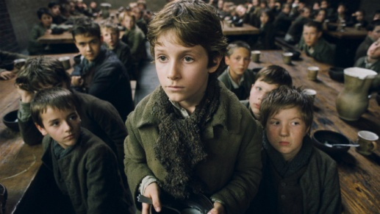
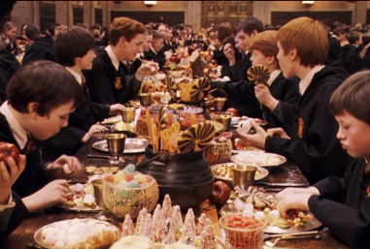
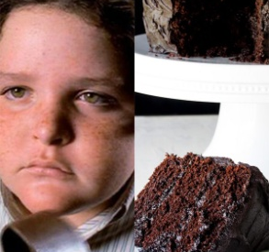
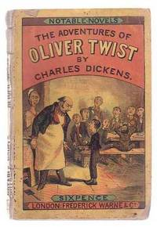
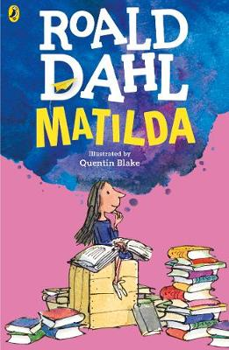
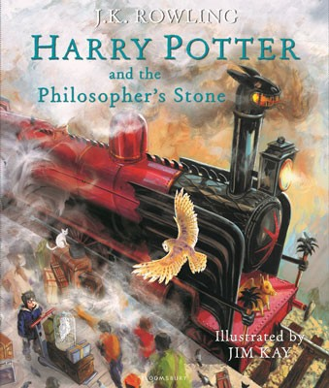
Reading and Understanding: Read, Discuss + Compare 2 Characters
Grab a snack so that you don’t get hungry – Ready?!?
First: Oliver Twist – More Please!
close read then watch [slides 2 - 4]
make brief notes [annotate the text]
what do you learn about the character
[including quotes from the text as evidence]
Then: Harry Potter - The Feast!
close read then watch [slides 6 - 9]
make brief notes [annotate the text]
what do you learn about the character
[including quotes from the text as evidence]
AND/OR
Matilda – Bruce gets chocolate cake
[as above] [slides 11 -15]
What are we learning this week?
Learning Focus: To study contrasting texts on the same theme focusing on what we learn about the main character [protagonist].
First Reading Comprehension
Text 1: Oliver by Charles Dickens [1837].
- Close read making brief notes
- Expressing a personal opinion [writing]
Next
Text 2: Modern text Harry Potter or Matilda
- Close reading making brief notes
- Expressing a personal opinion [writing]
Finally Extended writing task -
Developing skills forming an argument at GCSE level.
Communication Games:
Focus: Memory and Language Skills

Slide 2
‘Oliver Twist’ the second novel by Charles Dickens. It was initially published in monthly instalments between February 1837 and April 1839.
Read, watch then talk about this scene. What do we learn about the character Oliver?
Summary of the plot so far: Oliver Twist’s mother died when he was a baby. Oliver was taken into the ‘care’ of the parish and he was sent to an orphanage until the age of 8 years old. He was lucky to survive as historically we know that 9 out of 10 children did not. At the age of 8 years old it was determined that he was old enough to work and he was sent to a poor house to work picking oakum, shredding old ropes into fine strands – cutting the pickers fingers in the process!. The boys were fed barely enough gruel [watery porridge] to keep them alive.
The room in which the boys were fed was a large stone hall with a copper at one end: out of which the master, dressed in an apron for the purpose, and assisted by one or two women, ladled the gruel at mealtimes.
The bowls never wanted washing. The boys polished them with their spoons till they shone again; and when they had performed this operation (which never took very long, the spoons being nearly as large as the bowls), they would sit staring at the copper, with such eager eyes, as if they could have devoured the very bricks of which it was composed; employing themselves, meanwhile, in sucking their fingers most assiduously, with the view of catching up any stray splashes of gruel that might have been cast thereon. Boys have generally excellent appetites. Oliver Twist and his companions suffered the tortures of slow starvation for three months: at last they got so voracious and wild with hunger, that one boy, who was tall for his age, and hadn't been used to that sort of thing (for his father had kept a small cook-shop), hinted darkly to his companions, that unless he had another basin of gruel, he was afraid he might some night happen to eat the boy who slept next him, who happened to be a weakly youth of tender age. He had a

Slide 3

wild, hungry eye; and they implicitly believed him. A council was held; lots were cast who should walk up to the master after supper that evening, and ask for more; and it fell to Oliver Twist.
The evening arrived; the boys took their places. The master, in his cook's uniform, stationed himself at the copper; his pauper assistants ranged themselves behind him; the gruel was served out; and a long grace was said over the short commons. The gruel disappeared; the boys whispered each other, and winked at Oliver; while his next neighbours nudged him.
Child as he was, he was desperate with hunger, and reckless with misery. He rose from the table; and advancing to the master, basin and spoon in hand, said: somewhat alarmed at his own temerity:
'Please, sir, I want some more.'
The master was a fat, healthy man; but he turned very pale. He gazed in stupefied astonishment on the small rebel for some seconds, and then clung for support to the copper. The assistants were paralysed with wonder; the boys with fear.
'What!' said the master at length, in a faint voice.
'Please, sir,' replied Oliver, 'I want some more.'
The master aimed a blow at Oliver's head with the ladle; pinioned him in his arm; and shrieked aloud for the beadle.
copper – the stove used to heat the gruel beadle – a church officer in charge of looking after the poor
short commons – insufficient food ration ladle - large serving spoon

Slide 4
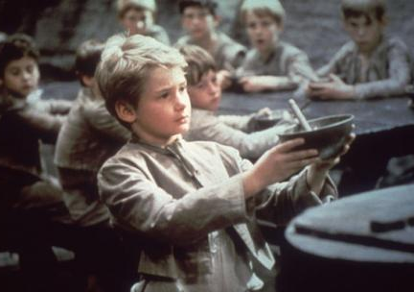
The board were sitting in solemn conclave, when Mr. Bumble rushed into the room in great excitement, and addressing the gentleman in the high chair, said,
'Mr. Limbkins, I beg your pardon, sir! Oliver Twist has asked for more!‘
There was a general start. Horror was depicted on every countenance.
'For more!' said Mr. Limbkins. 'Compose yourself, Bumble, and answer me distinctly. Do I understand that he asked for more, after he had eaten the supper allotted by the dietary?'
'He did, sir,' replied Bumble.
'That boy will be hung,' said the gentleman in the white waistcoat. 'I know that boy will be hung.'
Nobody controverted the prophetic gentleman's opinion. An animated discussion took place. Oliver was ordered into instant confinement; and a bill was next morning pasted on the outside of the gate, offering a reward of five pounds to anybody who would take Oliver Twist off the hands of the parish. In other words, five pounds and Oliver Twist were offered to any man or woman who wanted an apprentice to any trade, business, or calling.
‘Oliver Twist’ is a story about how society treats its poorest citizens. This is a subject that has not gone away over the 173 years since Charles Dickens asked this question through his stories. Oliver Twist has been told and re-told in plays, musicals and film. Watch the clips below and think about how well you think they tell this scene – does the character Oliver look the way you imagined?
Musical Oliver (1968) https://www.youtube.com/watch?v=hEQDllvuy1I then https://www.youtube.com/watch?v=7tOkpntQtBM
Oliver Twist (2005 film version) https://www.youtube.com/watch?v=NHRwmfSfl7A

Slide 5
What do you learn about the main character Oliver Twist? Remember to ‘quote’ evidence from the text to prove the points you make.
____________________________________________________________________________________________________________________________________________________________________________________________________________________________________________________________________________________________________________________________________________________________________________________________________________________________________________________________________________________________________________________________________________________________________________________________________________________________________________________________________________________________________________________________________________________________________________________________________________________________________________________________________________________________________________________________________________________________________________________________________________________________________________________________________________________________________________________________________________________________________________________________________________________________________

Slide 6
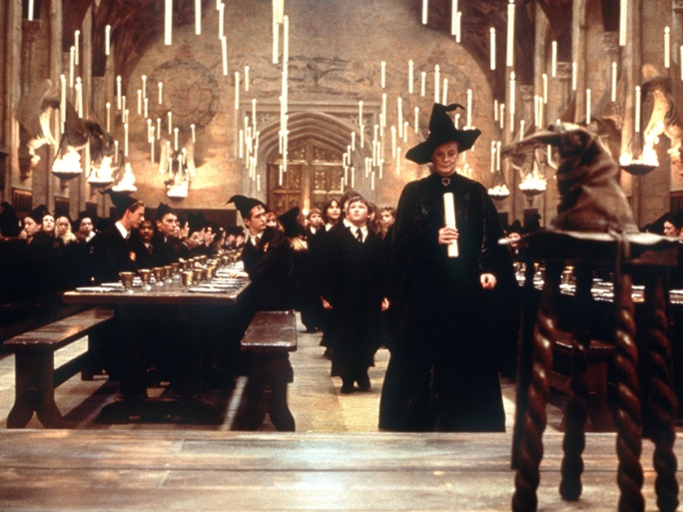
‘Harry Potter’ is J.K. Rowling first novel. She went on to create a whole wizarding world!
Read, watch then talk about this scene. What do we learn about the character Harry?
"Now, form a line," Professor McGonagall told the first years, "and follow me."
Feeling oddly as though his legs had turned to lead, Harry got into line with Ron behind him, and they walked out of the chamber, back across the hall and through a pair of double doors into the Great Hall.
Harry had never even imagined such a strange and splendid place. It was lit by thousands and thousands of candles that were floating in midair over four long tables, where the rest of the students were sitting. These tables were laid with glittering golden plates and goblets. At the top of the hall was another long table where the teachers were sitting. Professor McGonagall led the first years up here, so that they came to a halt in a line facing the other students, with the teachers behind them. The hundreds of faces staring at them looked like pale lanterns in the flickering candlelight. Dotted here and there among the students, the ghosts shone misty silver. Mainly to avoid all the staring eyes, Harry looked upward and saw a velvety black ceiling dotted with stars. He heard Hermione whisper, "Its bewitched to look like the sky outside. I read about it in Hogwarts, A History."
It was hard to believe there was a ceiling there at all, and that the Great Hall didn't simply open on to the heavens.
Harry quickly looked down again as Professor McGonagall silently placed a four-legged stool in front of the first years. On top of the stool she put a pointed wizard's hat. This hat was patched and frayed and extremely dirty. Aunt Petunia wouldn't have let it in the house.
For a few seconds, there was complete silence then the Sorting Hat began to sing.

Slide 7
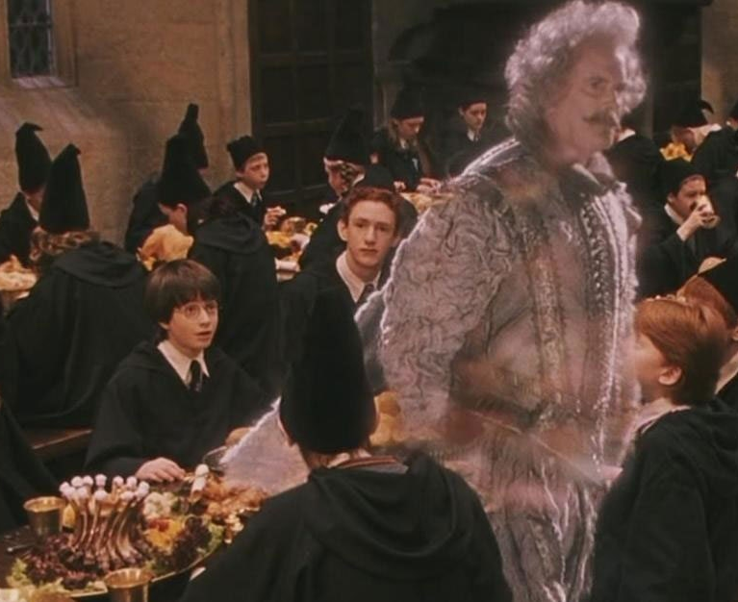
The Sorting Hat then sorted the first years into the Hogwarts Houses. Remember them? Gryffindor, Hufflepuff, Ravenclaw and Slytherin. Harry is relieved to be sorted in to Gryffindor not Slytherin!
Professor McGonagall rolled up her scroll and took the Sorting Hat away. Harry looked down at his empty gold plate. He had only just realized how hungry he was. The pumpkin pasties seemed ages ago. Harry's mouth fell open. The dishes in front of him were now piled with food. He had never seen so many things he liked to eat on one table: roast beef, roast chicken, pork chops and lamb chops, sausages, bacon and steak, boiled potatoes, roast potatoes, fries, Yorkshire pudding, peas, carrots, gravy, ketchup, and, for some strange reason, peppermint humbugs.
The Dursleys had never exactly starved Harry, but he'd never been allowed to eat as much as he liked. Dudley had always taken anything that Harry really wanted, even if It made him sick. Harry piled his plate with a bit of everything except the peppermints and began to eat. It was all delicious.
"That does look good," said the ghost in the ruff sadly, watching Harry cut up his steak.
"Can't you -- ?"
"I haven't eaten for nearly five hundred years," said the ghost. "I don't need to, of course, but one does miss it. I don't think I've introduced myself? Sir Nicholas de Mimsy-Porpington at your service. Resident ghost of Gryffindor."
"I know who you are!" said Ron suddenly. "My brothers told me about you -- you're Nearly Headless Nick!"
[When they asked how he could be ‘nearly headless’ the Gryffindor ghost enjoyed showing them!]
Looking pleased at the stunned looks on their faces, Nearly Headless Nick flipped his head back onto his neck, coughed, and said, "So -- new Gryffind house championship this year? Gryffindors have never gone so long without winning. Slytherins have got the cup six years in a row! The Bloody Baron's becoming almost unbearable -- he's the Slytherin ghost.“

Slide 8
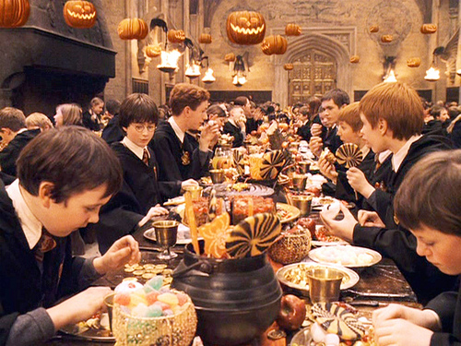
Harry looked over at the Slytherin table and saw a horrible ghost sitting there, with blank staring eyes, a gaunt face, and robes stained with silver blood. He was right next to Malfoy who, Harry was pleased to see, didn't look too pleased with the seating arrangements.
When everyone had eaten as much as they could, the remains of the food faded from the plates, leaving them sparkling clean as before. A moment later the desserts appeared. Blocks of ice cream in every flavour you could think of, apple pies, treacle tarts, chocolate éclairs and jam doughnuts, trifle, strawberries, Jell-O, rice pudding...
As Harry helped himself to a treacle tart, the talk turned to their families.
"I'm half-and-half," said Seamus. "Me dad's a Muggle. Mom didn't tell him she was a witch 'til after they were married. Bit of a nasty shock for him."
The others laughed.
"What about you, Neville?" said Ron.
"Well, my gran brought me up and she's a witch," said Neville, "but the family thought I was all-Muggle for ages. My Great Uncle Algie kept trying to catch me off my guard and force some magic out of me -- he pushed me off the end of Blackpool pier once, I nearly drowned -- but nothing happened until I was eight. You should have seen their faces when I got in here -- they thought I might not be magic enough to come, you see. Great Uncle Algie was so pleased he bought me my toad."
On Harry's other side, Percy Weasley and Hermione were talking about lessons ("I do hope they start right away, there's so much to learn -- ").
Harry, who was starting to feel warm and sleepy, looked up at the High Table again. Hagrid was drinking deeply from his goblet. Professor McGonagall was talking to Professor Dumbledore. Professor Quirrell, in his absurd turban, was talking to a teacher with greasy black hair, a hooked nose, and sallow skin. [- I think you can all guess who that teacher is!]

Slide 9
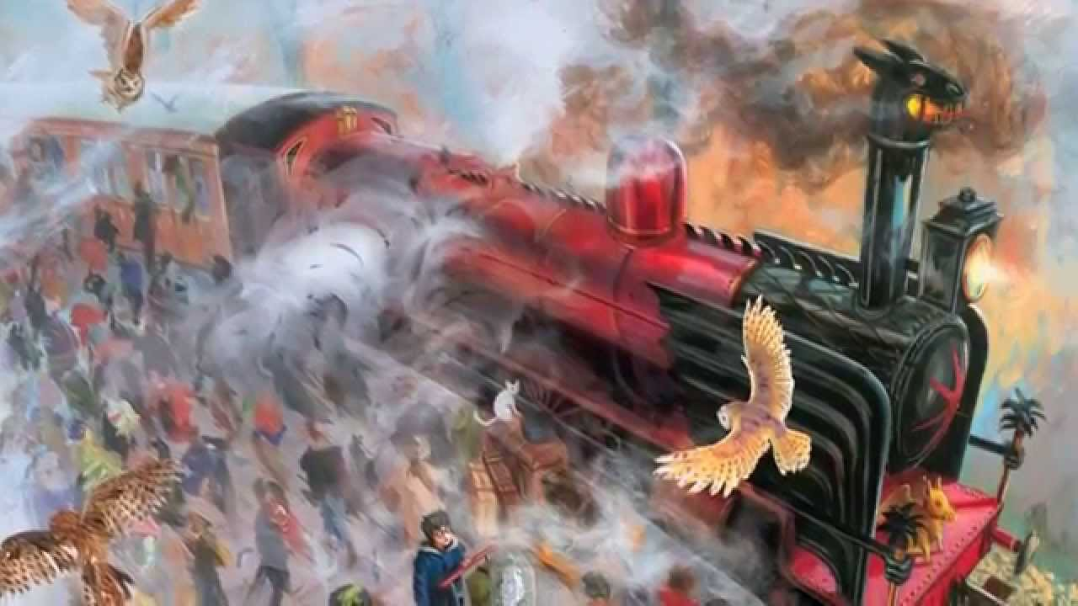
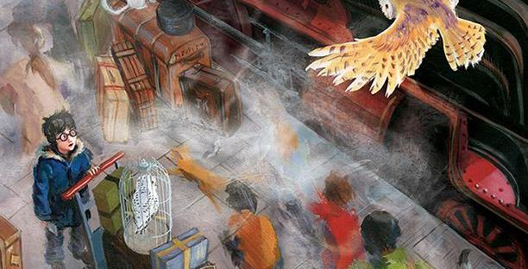
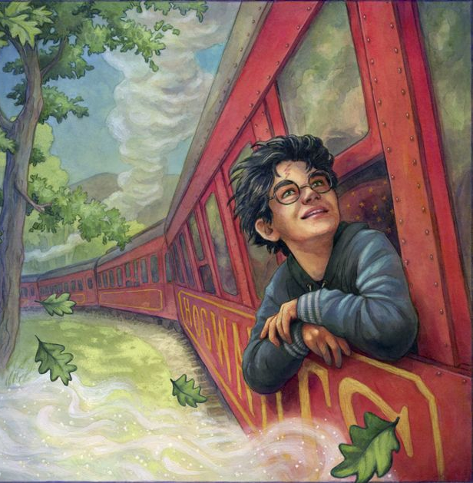
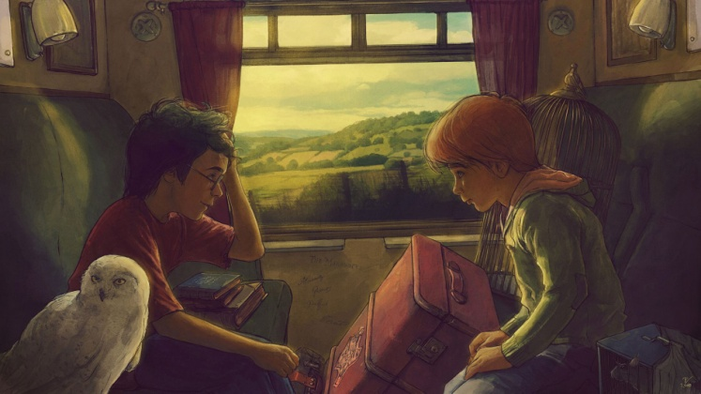
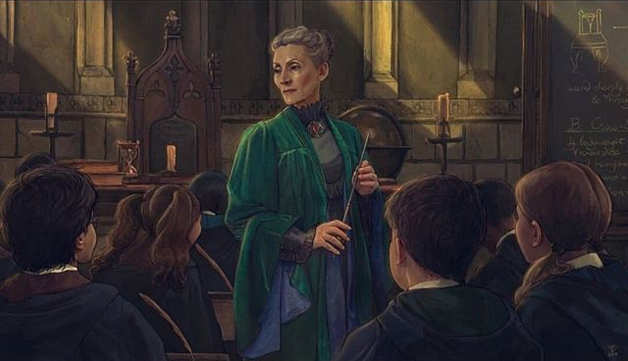
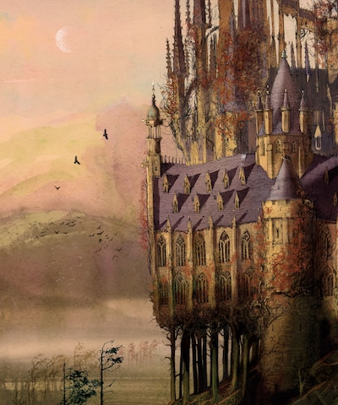
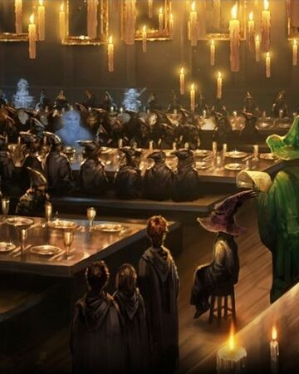
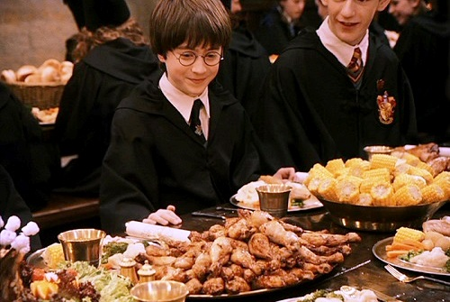
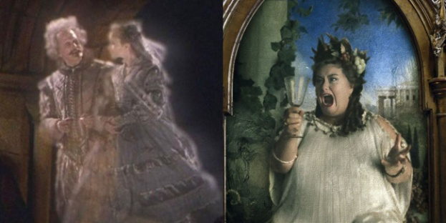
Video clip of the sorting hat scene:
https://www.youtube.com/watch?v=A0cla_h_f8M
Video clip of the feast scene:
https://www.youtube.com/watch?v=HjUq1HSbfRU

Slide 10
What do you learn about the main character Harry Potter?
Remember to ‘quote’ evidence from the text to prove the points you make.
____________________________________________________________________________________________________________________________________________________________________________________________________________________________________________________________________________________________________________________________________________________________________________________________________________________________________________________________________________________________________________________________________________________________________________________________________________________________________________________________________________________________________________________________________________________________________________________________________________________________________________________________________________________________________________________________________________________________________________________________________________________________________________________________________________________________________________________________________________________________________________________________________________________________________

Slide 11
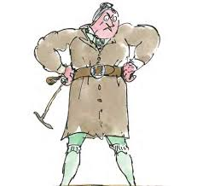
‘Matilda’ is the 12th novel from the amazing imagination of Roald Dahl..
Read, then talk about this scene. What do we learn about the character Matilda?
‘Do you think she’s mad?’ Lavender asked.
‘Who? The Trunchbull? No, I don’t think she’s mad,’ Matilda said. ‘But she’s very dangerous. Being in this school is like being in a cage with a cobra. You have to be very fast on your feet.’
They got another example of how dangerous the Headmistress could be on the very next day. During lunch an announcement was made that the whole school should go into the Assembly Hall. The Trunchbull marched on to the platform. She was carrying riding- crop in her right hand. She stood up there on centre stage in her green breeches with legs apart and riding- crop in hand, glaring at the sea of upturned faces before her.
‘What’s going to happen?’ Lavender whispered.
‘I don’t know,’ Matilda whispered back.
The whole school waited for what was coming next. ‘Bruce Bogtrotter!’ the Trunchbull barked suddenly. ‘Where is Bruce Bogtrotter?’ A hand shot up.
‘Come up here!’ the Trunchbull shouted. ‘And look smart about it!’
An eleven-year-old boy stood up and climbed up on to the platform. He looked extremely wary and kept edging farther and farther away from her, rather as a rat might edge away from a terrier dog . His plump face had turned grey with fear. His stockings hung about his ankles.
‘This clot,’ boomed the Headmistress, pointing the riding-crop at him like a rapier [sword], ‘this poisonous pustule that you see before you is none other than a disgusting criminal!’

Slide 12
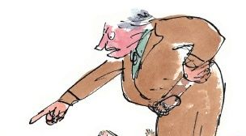
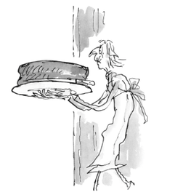
‘Who, me?’ Bruce Bogtrotter said, looking genuinely puzzled.
‘A thief!’ the Trunchbull screamed. ‘A crook! A pirate! A brigand! A rustler!’
‘I don’t know what you’re talking about,’ the boy said, more puzzled than ever.
‘I’ll tell you what I’m talking about, you little blister!’ the Trunchbull shouted. ‘Yesterday morning, during break, you sneaked like a serpent into the kitchen and stole a slice of my private chocolate cake from my tea-tray! That tray had just been prepared for me personally by the cook! It was my morning snack from my own private stock! You don’t think for one minute I’m going to eat the filth I give to you? That cake was made from real butter and real cream! And you, stole it and ate it!
'I never did,’ the boy exclaimed, turning from grey to white.
'Don’t lie to me, Bogtrotter!’ barked the Trunchbull. 'The cook saw you! What’s more, she saw you eating it!’
The Trunchbull paused to wipe a fleck of froth from her lips. When she spoke again her voice was suddenly softer, quieter, more friendly, and she leaned towards the boy, smiling. ‘You like my special chocolate cake, don’t you, Bogtrotter? It’s rich and delicious, isn’t it, Bogtrotter?’
‘It’s very good,’ the boy mumbled. The words were out before he could stop himself.
You’re right,’ the Trunchbull said. ‘It is very good. Therefore I think you should congratulate the cook.’
The boy remained silent.
‘Cook!’ the Trunchbull shouted, turning her head towards the door. ‘Come here, cook! Bogtrotter wishes to tell you how good your chocolate cake is!’ .

Slide 13
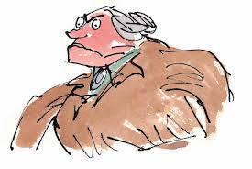
The cook came towards the stage, staggering under the weight of an enormous round chocolate cake on a china platter. The cake was fully eighteen inches in diameter and it was covered with dark-brown chocolate icing.
There was a small table centre stage with a chair behind it. The cook placed the cake carefully on the table. ‘Sit down, Bogtrotter,’ the Trunchbull said. ‘Sit there.’ The boy moved cautiously to the table and sat down. He stared at the gigantic cake.
‘There you are, Bogtrotter,’ the Trunchbull said, her voice became soft, even gentle. ‘It’s all for you, every bit of it. As you enjoyed that slice you had yesterday so very much.’
‘Well, thank you,’ the boy said, totally confused.
‘Come on then,’ the Trunchbull said. ‘Why don’t you cut yourself a nice thick slice and try it?’
‘What? Now?’ the boy said, cautious. He knew there was a catch in this somewhere.
‘Go on, get on with it,’ the Trunchbull said. ‘Cut a slice and taste it. We haven’t got all day.’
All the children in the hall were watching, waiting for something to happen. The Trunchbull was not a person who would give someone a whole chocolate cake out of kindness. Many were guessing that it was filled with something that would make the boy violently sick or dead in ten seconds flat!
‘I don’t want to eat it,’ the boy said nervously.
‘Taste it, you little brat,’ the Trunchbull said. ‘It’s good, isn’t it?’
‘Very good,’ the boy said, chewing and swallowing.
‘Have another,’ the Trunchbull said.
‘That’s enough, thank you,’ the boy murmured.
‘I said have another,’ the Trunchbull said. ‘Eat another slice!’
‘I don’t want another slice,’ the boy said.

Slide 14
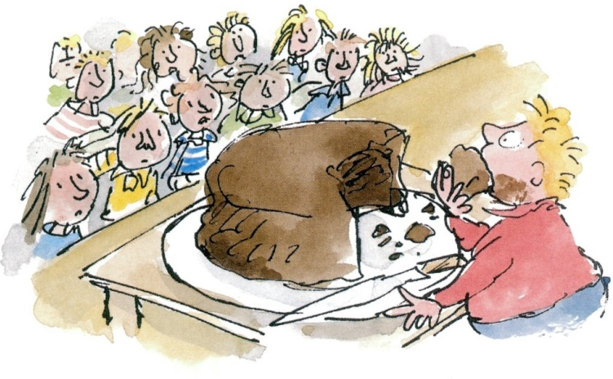
Suddenly the Trunchbull exploded. ‘Eat!’ she shouted, banging her thigh with the riding-crop. ‘If I tell you to eat, you will eat! You wanted cake! You stole cake! And now you’ve got cake! What’s more, you’re going to eat it! Nobody leaves this hall until you have eaten the entire cake! Do I make myself clear, Bogtrotter?’
The boy looked at the Trunchbull. Then he looked down at the enormous cake.
‘Eat! Eat! Eat!’ the Trunchbull was yelling.
Very slowly the boy cut himself another slice and began to eat it. Matilda was fascinated. ‘Do you think he can do it?’ she whispered to Lavender.
‘No,’ Lavender whispered back. ‘It’s impossible. He’d be sick before he was halfway through.’
‘Eat!’ the Trunchball shouted. ‘Greedy little thieves who like to eat cake must have cake! Eat faster boy! Eat faster! Next time you stop before it’s all finished you’ll go straight into The Chokey!’
The boy cut a third slice and started to eat it. The two hundred and fifty watching children had prepared themselves for an terrible scene in which Bruce, too full with chocolate cake, would have to give up and beg for mercy. Not a bit of it. Bruce Bogtrotter was three-quarters of the way through now and still going strong. He knew the children were on his side and this was a battle between him and the mighty Trunchbull.
Suddenly someone shouted, ‘Come on, Brucie! You can make it!’
The Trunchbull wheeled round and yelled, ‘Silence!‘

Slide 15
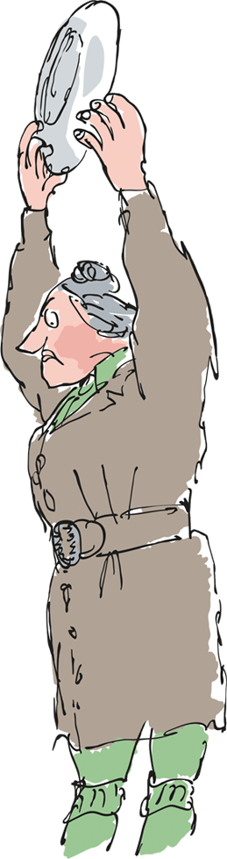
The boy was slowing down now. There was no doubt about that. But he kept pushing the stuff into his mouth like a long¬ distance runner who has sighted the finishing-line and knows he must keep going. As the very last mouthful disappeared, a tremendous cheer rose up from the audience and children were leaping on to their chairs and yelling and clapping and shouting, ‘Well done, Brucie! Good for you, Brucie! You’ve won a gold medal, Brucie!’
The Trunchbull stood motionless on the platform. Her great horsy face had turned the colour of molten lava and her eyes were glittering with fury. She glared at Bruce Bogtrotter, who was sitting on his chair so full he was unable to move or to speak. A fine sweat was beading his forehead but there was a grin of triumph on his face.
Suddenly the Trunchbull lunged forward and grabbed the large empty china plate on which the cake had rested. She raised it high in the air and brought it down with a crash right on the top of Bruce Bogtrotter’s head. Pieces flew all over the platform. The boy was by now so full of cake he was like a bag of wet cement and you couldn’t have hurt him with a sledge-hammer. He simply shook his head a few times and went on grinning.
‘Go to blazes!’ screamed the Trunchbull and she marched off the platform followed closely by the cook.
https://www.youtube.com/watch?v=EOQeU_6vbeg

Slide 16
What do you learn about the main character Matilda Wormwood? Remember to ‘quote’ evidence from the text to prove the points you make.
____________________________________________________________________________________________________________________________________________________________________________________________________________________________________________________________________________________________________________________________________________________________________________________________________________________________________________________________________________________________________________________________________________________________________________________________________________________________________________________________________________________________________________________________________________________________________________________________________________________________________________________________________________________________________________________________________________________________________________________________________________________________________________________________________________________________________________________________________________________________________________________________________________________________________

