Slide 1
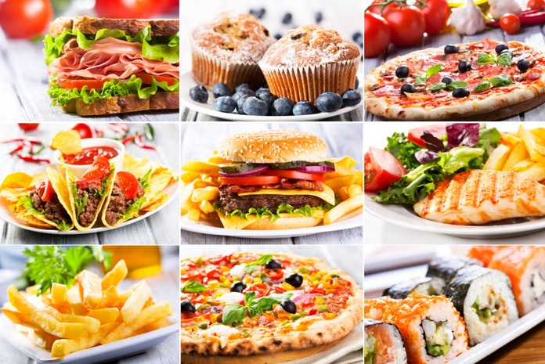
Short Writing Task: Descriptive Writing on the theme of Food
Short Creative Writing Task:
This work is to help build your skills and confidence using your research to plan and then write a descriptive paragraph.
Watch video clips/look at family photos and talk about favourite food or a meal you have enjoyed.
Planning: Make brief notes of key descriptive words/phrases you are going to include in your writing.
Ready to write: Write a description of a meal you have enjoyed OR take part in
Describe that Food Challenge.
Extension Communication Games:
Food on a Tray Memory Game
Guess the Food in the Bag.
Food Alphabet – I went shopping and I bought.
Try something new – link to feelings...
Key Words:
description = a spoken or written account of a person, object or event
similar = being like something else without being identical
difference = ways in which something is not like something else
brief notes = ideas recorded in
single words or short phrases
paragraph = a section of writing

Slide 2
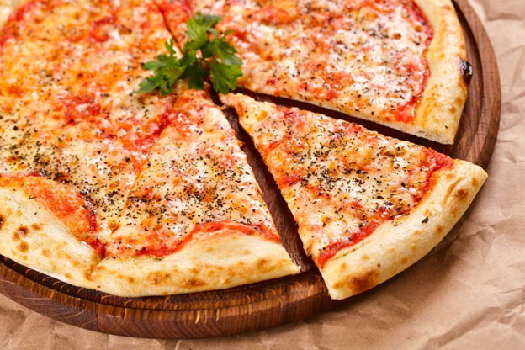
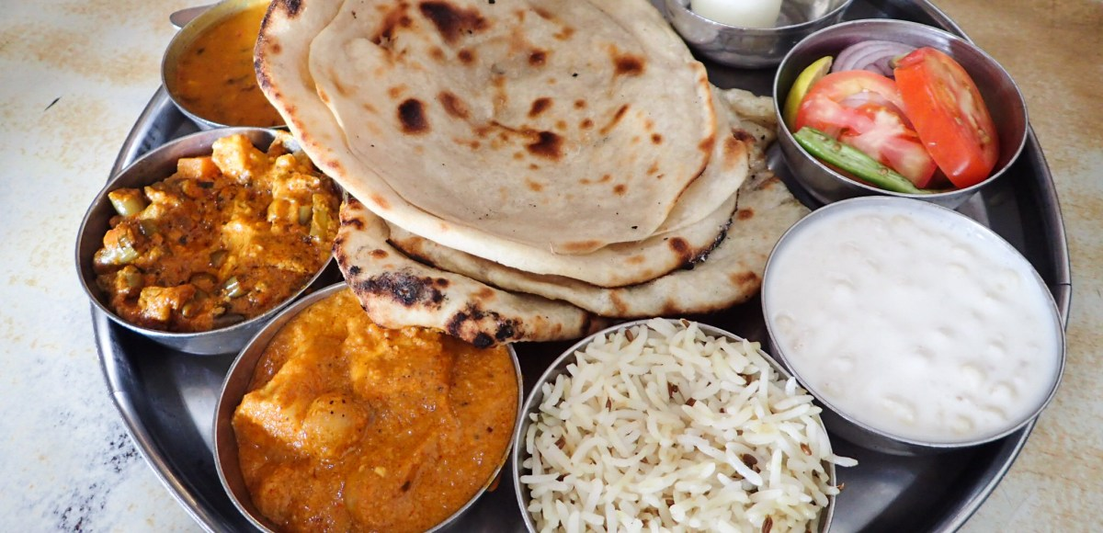
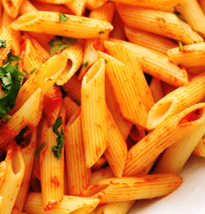
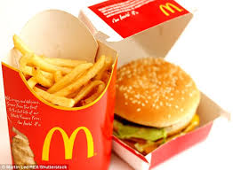
Food ideas to make your mouth water!

Slide 3
Descriptive Writing Planning Sheet: [You can also use your yellow workbook.]
Talk your ideas through then complete your plan
Focus: Building planning skills. [Just brief notes – not sentences]
Taste like:
Look like: [shape/colour]
Sound words: when you eat it.
Name of food/meal
Smells like :
Feels like:

Slide 4
Describe a Meal you have Enjoyed: [You can also use your yellow workbook.]
______________________________________________________________________________________________________________________________________________________________________________________________________________________________________________________________________________________________________________________________________________________________________________________________________________________________________________________________________________________________________________________________________________________________________________________________________________________________________________________________________________________________________________________________________________________________________________________________________________________________________________________________________________________________________________________________________________________________________________________________________________________________________________________________________________________________________________________
Top Tip: Start with a brief introduction of who, when and where THEN describe in detail using your planning sheet - make your reader’s mouth water!

Slide 5
Describe that Food Challenge Sheet 1 : [You can also use your yellow workbook.]
______________________________________________________________________________________________________________________________________________________________________________________________________________________________________________________________________________________________________________________________________________________________________________________________________________________________________________________________________________________________________________________________________________________________________________________________________________________________________________________________________________________________________________________________________________________________________________________________________________________________________________________________________________________________________________________________________________________________________________________________________________________________________________________________________________________________________________________
Task: Write a detailed description of a piece of food [use the planning sheet] THEN read it to someone - Does your description work? Can they name that food?!

Slide 6
Describe that Food Challenge 2 : [You can also use your yellow workbook.]
______________________________________________________________________________________________________________________________________________________________________________________________________________________________________________________________________________________________________________________________________________________________________________________________________________________________________________________________________________________________________________________________________________________________________________________________________________________________________________________________________________________________________________________________________________________________________________________________________________________________________________________________________________________________________________________________________________________________________________________________________________________________________________________________________________________________________________________
Task: Write a detailed description of a VERY DIFFERENT piece of food [use the planning sheet] THEN read it to someone - Does your description work? Can they name that food!

Slide 7
Communication Tasks: Why not try one of these to build your skills?!
Memory Game: Food of a Tray
ONE player chooses 5 items of food from the cupboard and places them on a tray/table. Cover with a cloth. Next take the cloth off and let the players look for 3 minutes. Put the cover back. The players then write down or draw the items they can remember. The player who remembers the most wins and gets to choose 6 new items for the other players to guess. Repeat – each time add one more item. Skill: Building Memory
Guess the Food in the Bag:
ONE player puts an item of food in a bag. The other players have to take it in turns to ask one question at a time to find out what it is. You cannot ask what the food is but you can ask as many questions as you like, one at a time. When you think you know, have a guess. Each player has 2 guesses only so use them wisely! Skill: Asking questions. Listening. Concentration.
Challenge Task- Try Something New: Be bold and dare to try something new - choose a food to try that you’ve never tried before. [Think , Green Eggs & Ham– see BLUE Themed pack]
Skill: Talk about your feelings before - during and after!
Food Alphabet: The first player says, ‘I went shopping and I bought ...’ and says the name of food beginning with the letter ‘A’. The next player says, ‘I went shopping and I bought ...’ Then names the food beginning with ‘A’ before adding a food beginning with ‘B’. Keep going and see how far through the alphabet you can get! You can help each other because this game is tricky! Skill: Listening. Concentration and Alphabet knowledge!

