Slide 1
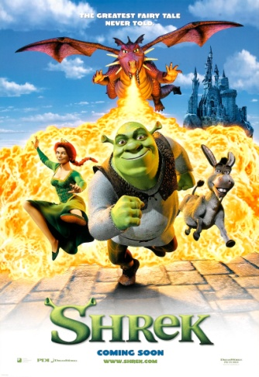
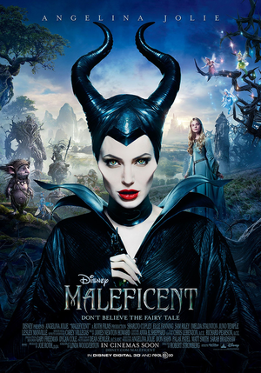
Ready to Write: Writing an original Story – Set in a Castle
Storytelling Task:
This work is to help build your skills and confidence planning and then writing an original story.
Remember: Use your research to make your story feel like it is true!
Watch and talk about either the video clips or films/stories you have at home.
Planning: Choose a castle, decide on 2 or 3 main characters and then the order of events in your story. [see slide 3]
Ready to write: Write a short story set in a castle.
Think: What type of story will it be?
adventure + battles, romance or a scary tale!
Who will be in the story?
a prince or princess, dragon, ogre or witch!
Key Words:
character = a person, animal, creature or animated object in a story.
castle = a strong building which can withstand an attack usually with thick walls and battlements.
setting = a place where a story happens
adjective = a word that describes an animal, person, place, thing.

Slide 2
Characters and what might happen?
Watch these clips OR re-watch your favourite films, T.V. Programmes or stories.
THINK
Who will be in your story? maybe a prince or princess, a dragon, ogre, donkey or a wicked witch or wizard
What will happen in your story? moments of tension and danger for your characters, moments of romance perhaps Whose side are you on – is the ‘baddie’ really bad?
Shrek - Entering the Princess Fiona’s castle
https://www.youtube.com/watch?v=Za2QkHEAE9Q
Shrek - The highest room in tallest tower
https://www.youtube.com/watch?v=iropsnsCEjA
Beauty and the Beast – Who lives here?
https://www.youtube.com/watch?v=i3Kh61bNpgA
Malificent - Whose side are you on?
https://www.youtube.com/watch?v=n0OFH4xpPr4

Slide 3
Story Title: ___________________________________________________
Task A: Talk your ideas through then complete your plan Focus: Building story planning skills. [Just brief notes – not sentences]
1. Introduce where:
2. Introduce when:
4. First Event:
3. Introduce the main character(s) in your story:
5. Next – leading to the most exciting bit :
6. Finally – the climax to the story and ending:

