Slide 1
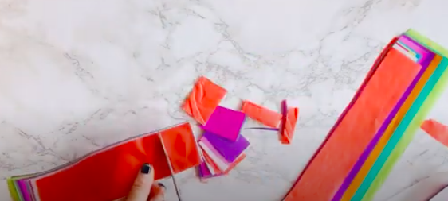
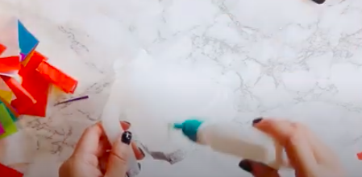
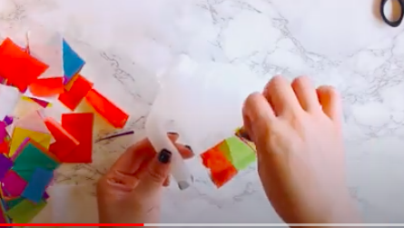
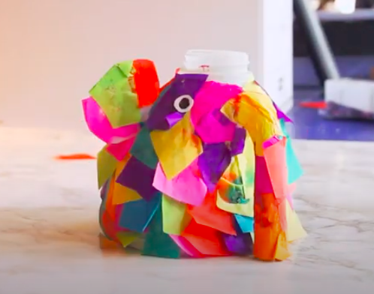
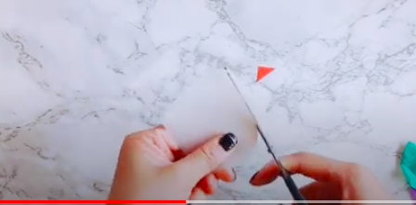
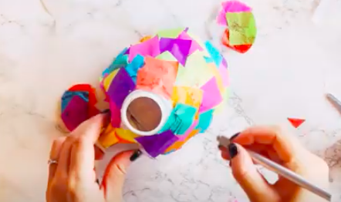
Slides for Blue Theme Week-Arts Making Elmer the Elephant
Cut up tissue paper or coloured paper . Cut the large plastic milk bottle in half , make sure you use the handle end as this will be the trunk. Add glue starting on one side building up. Stick on coloured tissue paper squares.
Cut out ears from the rest of the bottle Get an adult to cut holes for the ears and slide in
Cut eyes out of paper and glue on.

Slide 2
