Slide 1
Meadow High School
Keeping the Community safe
Plan for Community layout from 8th March 2021

Slide 2
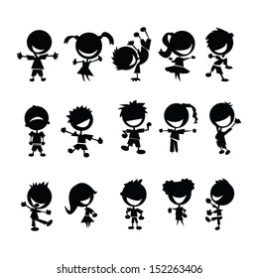
January 2021 - February 2021
During lockdown Meadow High School had a small number of students and staff on site, whilst the rest of us have learnt from home.

Slide 3
January 2021 - February 2021
During this time students were in bubbles, this was to keep them safe.

Slide 4
March 2021
On the 8th of March, all students and staff come back to Meadow High School, this is good.

Slide 5
March 2021
Meadow High School is a Community and we are one bubble. For two weeks pupils and teachers will work in tutor groups, this is to help us get back to normal, this is good

Slide 6
March 2021
Staff want students at Meadow to be happy.
After two weeks students will be able to mix with their friends, this is good.

Slide 7
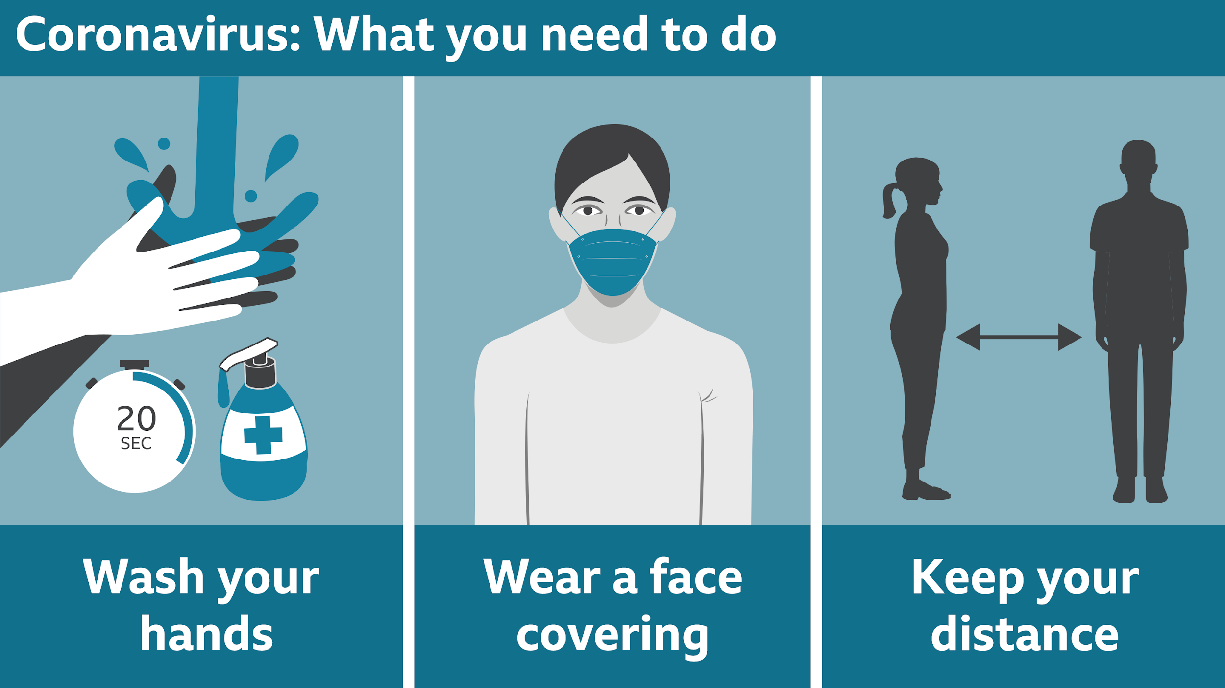
Keeping the Community Safe
We all have a job to keep our friends and staff safe. We need to wash our hands, wear a mask if we can and keep a distance as much as possible.

