Slide 2
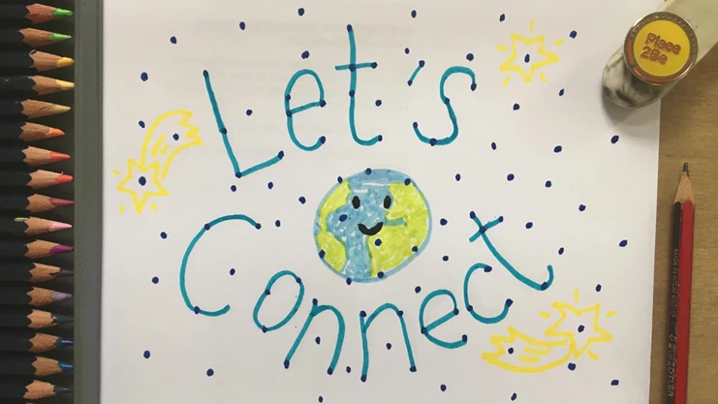
Children’s Mental Health Week 2023 will take place from 6-12 February 2023. This year’s theme is Let’s Connect.
https://youtu.be/wb8SDnS-M_M

Slide 3
Taskmaster Education partners with Place2Be for Children’s Mental Health Week
Taskmaster Education and Place2Be have announced that they are partnering for Children’s Mental Health Week 2023, in a bid to get children across the country puzzle and problem solving.
During Children’s Mental Health Week 2023, Alex Horne will set daily tasks for children to do at school or at home.
There will also be a treasure hunt, with daily clues to solve. If solved correctly over the week, schools, families, or other groups will make it onto the Wall of Fame and have a chance to win the Taskmaster Treasure Hunt Grand Prize.
https://youtu.be/mHeFsSb5qxk
https://taskmastereducation.com/treasurehunt
https://taskmastereducation.com/sites/default/files/clue-worksheet/2023-01/Clue%201%20%28PF%29.pdf
https://taskmastereducation.com/sites/default/files/treasure-hunt-2023-answer-grid-pf.pdf

Slide 4
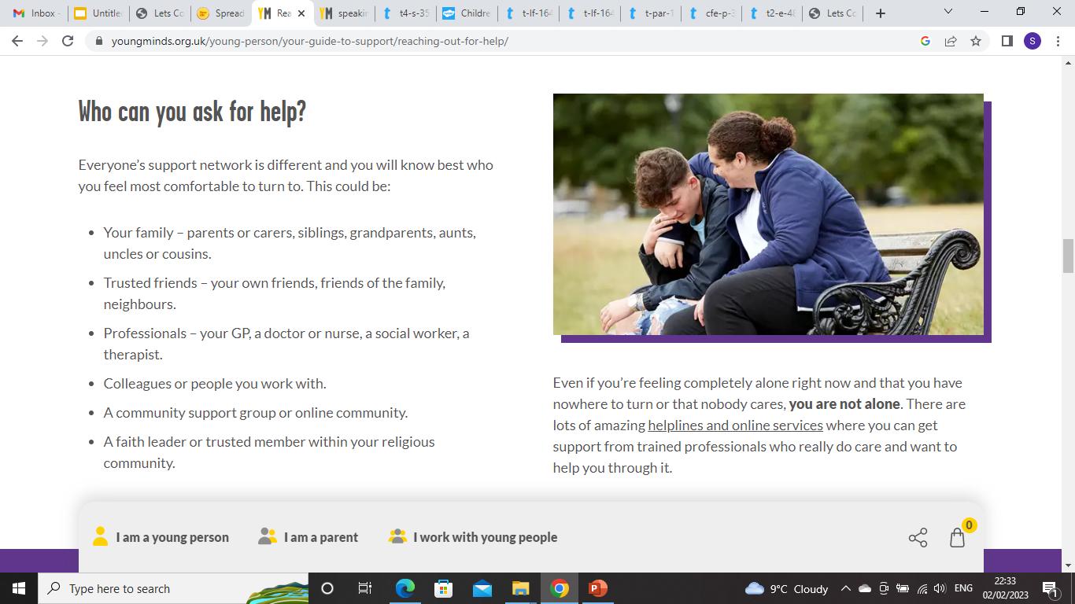

Slide 5
Take a look at these activities to do as a class.
https://www.childrensmentalhealthweek.org.uk/schools/secondary-age-activities/
https://www.childrensmentalhealthweek.org.uk/?utm_source=Place2Be+E-news&utm_campaign=100700b586-EMAIL_CAMPAIGN_2021_10_27_02_50_COPY_01&utm_medium=email&utm_term=0_acf77df294-100700b586-220223692
Services that can help:
https://www.mind.org.uk/information-support/for-children-and-young-people/useful-contacts/

